Slide 1
Acquisitions Meeting
Fox River Valley Public Library District
September 11, 2019

Slide 2
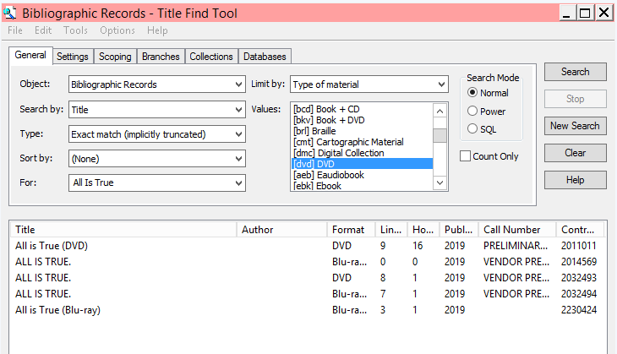
Duplicate Records

Slide 3
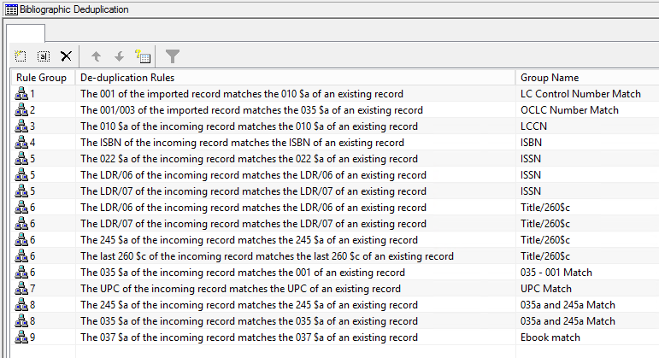
Duplicate Records: Potential Causes
Import Profiles
  Not using correct duplicate detection rules
System defined dupe rules:

Slide 4
Duplicate Records: Potential Causes
Hand-keyed records not able to match with vendor records
Vendor records missing key access points (such as 037)
Staff not merging duplicates when encountered

Slide 5
Discussion: What do libraries currently do when encountering vendor provisionals?

Slide 6
If you encounter a dupe...
MERGE, don't move your items!
Why? Moving your items breaks the links needed for acquisitions to work properly
Merging the records maintains the correct links between records

Slide 7
Fiscal year rollover: recap!

Slide 8
Types of Rollovers in May-July 2019
Replicate Fiscal Year Hierarchy
Creates a new fiscal year with a fund structure identical to that of the current FY
All new funds have a $0 free balance
Encumbrances are *not* rolled over to the new fiscal year
Linked records are *not* rolled over to the new fiscal year
Libraries: Crystal Lake, Northbrook
Run Fiscal Year Rollover – Zero Out Free Balance
Creates a new fiscal year with a fund structure identical to that of the current fiscal year
Rolls encumbrances from the current fiscal year to the new fiscal year
Closes all funds from the current fiscal year so that they will not be available for future orders
Unlinks certain records from the old funds, and relinks them to the corresponding funds in the new fiscal year
Creates all funds in the new fiscal year with a $0 free balance, leaving any unexpended funds in the current fiscal year
Libraries: Cary, Ela, Fox River, Fremont, Huntley, McHenry, Niles, Round Lake, Winnetka

Slide 9
Indian Trails Go Live Schedule
October 16 through October 22

Slide 10
Go Live Schedule: Data Extract
Wednesday, October 16, 9:00 PM
Indian Trails stops work in Horizon at 9:00 PM
SirsiDynix performs a database backup after the library is closed.
The backup is delivered to Innovative

Slide 11
Go Live Schedule: ITPLD Offline
Thursday, October 17
Indian Trails begins offline circulation using Polaris offline client
Indian Trails remains offline through Monday, October 21

Slide 12
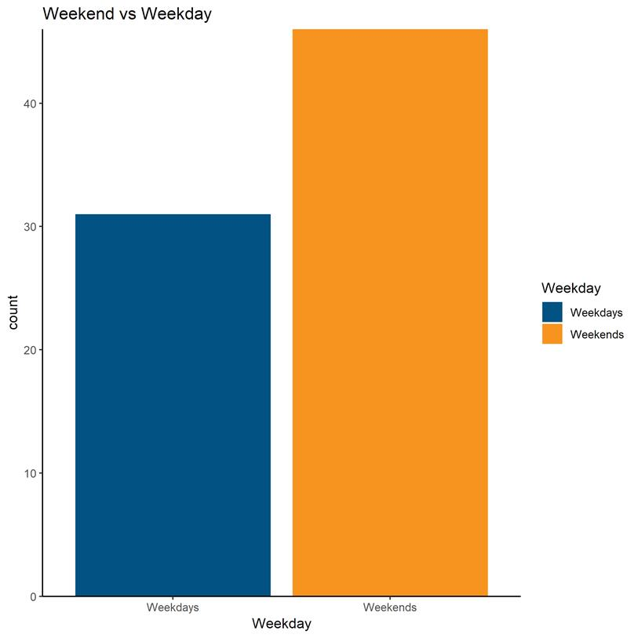
Go Live Schedule: CCS offline
Saturday, October 19-October 20
All CCS libraries begin offline circulation using Polaris offline client
CCS libraries remain offline
*In a January 2019 survey, for downtime spanning multiple days, like adding a library, 63% of respondents preferred concentrating downtime on weekends and 37% preferred weekdays. Here, results varied by department (see graph for breakdown).

Slide 13
Go Live Schedule: CCS potentially online
Monday, October 21
CCS libraries may come back online during the day on Monday
*In a January 2019 survey, when asked if CCS should bring libraries back online as soon as possible or stick with a firm schedule, 89% of respondents wanted to be back in action as soon as possible. This option does add some uncertainty for staff, but overall provides better service for patronsto add text
89%

Slide 14
Go Live Schedule: Live in CCS!
Tuesday, October 22
Indian Trails is live in Polaris! Staff begin using production Leap and client
Wednesday, October 23
Backup Go Live Day
​

Slide 15
Polaris Offline
Available Services
Unavailable Services
Check out materials
Patron registration (optional)
Hourly material check-in (optional)
Available holds pickup
Training PowerPAC search functions
Training Leap search functions
Database/SIP Authentication against training
Technical Services functions (Adding/editing items, bibs, etc.)
API Services
Checking in any materials
Placing holds
Paying fines
Modifying patron records
Processing Holds
Running the picklist
Creating ILL or on-the-fly records

