Slide 1
ILL Technical Group
AUGUST 26, 2021

Slide 2
SHARE Illinois Update

Slide 3
SHARE
Illinois
Update
SHARE Illinois is an agreement that allows for staff-initiated interlibrary loans directly between participating libraries/consortia.
RAILS will be discontinuing support for SHARE as of October 30, 2021

Slide 4
SHARE
Illinois
Update
Why is RAILS discontinuing SHARE Illinois?
Consortium membership continues to grow throughout the state, member libraries satisfy most of their interlibrary loan needs through their own consortia, and Find More Illinois exists as a statewide opportunity for ILL and discovery options.
Sunsetting a lower-impact service like SHARE Illinois allows RAILS to focus more resources on supporting a broader range of RAILS libraries in their resource sharing efforts.

Slide 5
SHARE
Illinois
Update
What does this mean for libraries?
The SHARE Illinois website will go offline (shareillinois.info)
Email listserv will be discontinued
Libraries may not be able to log in to other consortia catalogs and place holds

Slide 6
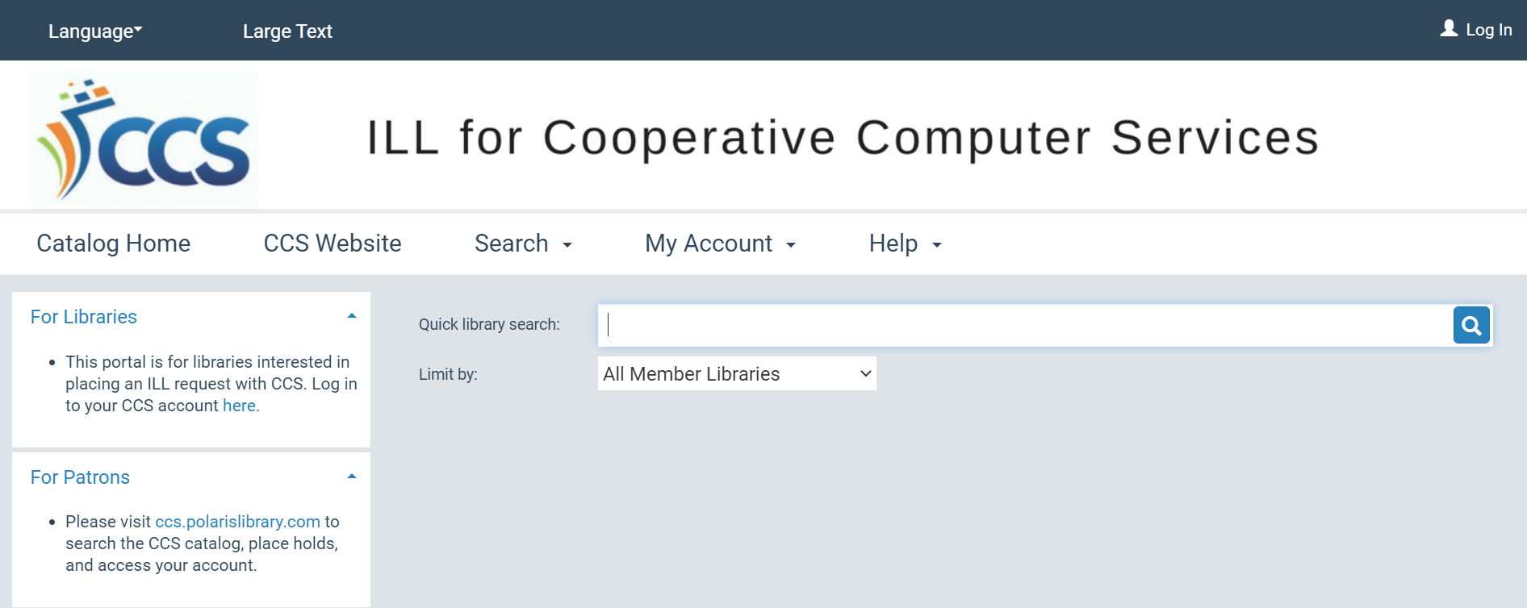
SHARE
Illinois
Update
Options for CCS Libraries
We can choose to continue to lend directly to libraries via ILL for CCS PowerPAC profile
We can discontinue the ILL for CCS profile

Slide 7
SHARE
Illinois
Update
Options for CCS Libraries
Governance will likely decide how we will move forward over the fall
CCS is interested in hearing feedback from ILL staff on the ILL PAC moving forward

Slide 8
SHARE
Illinois
Update
How many SHARE requests do CCS libraries receive?
Between August 2018 – July 2021, 2,160 SHARE holds were placed in the ILL for CCS PAC
  Averages to 98 requests per active month
  ILL for CCS PAC was not active during COVID (March 2020-May 2021)

Slide 9
ILL Library Accounts - Review

Slide 10
ILL Library Accounts Review
ILL Library Accounts
When lending items via WorldShare, staff may choose to check outgoing items out to an in-house account OR to a library account in Polaris.
If creating a new ILL library account OR updating an existing account, please refer to directions at
https://www.learning.ccslib.org/ill-libraries

Slide 11

ILL Library Account Review
Orange County Public Library
146A Madison Road
Orange, VA 22960
Phone: 540-672-3811

Slide 12
ILL Library Account Review
Delivery code that applies best to RAILS's delivery label standards.
If they are on the XWH delivery route, use the RAILS 3-letter code (ex/ HPK, NBK)
If they are a RAILS library but not on the XWH delivery route, use their ILDS code (ex/ XBR, XSW)
If they are not part of RAILS, use their OCLC code.

Slide 13
ILL Library Account Review
If they are not part of RAILS, use their OCLC code.
Orange County Public Library (VA) = PEW

