Slide 1
Missing Part Check In

Slide 2
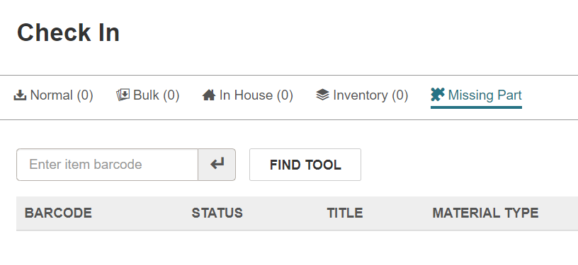
Missing Part Check In:
OPTIONAL check in function
Used with items that are missing a part, like audiobook missing a disc

Slide 3
Missing Part Check In
Item's status changed to "Claim Missing Parts"
A block is added to the item record
A claim is added to the patron's record
Missing part notice is generated for the patron

Slide 4
Missing Part Check In
Default – notice is turned off for all libraries
    Email help@ccslib.org to turn on
Because of how notice is issued, only use Missing Part check in for items that were checked out from your library

Slide 5
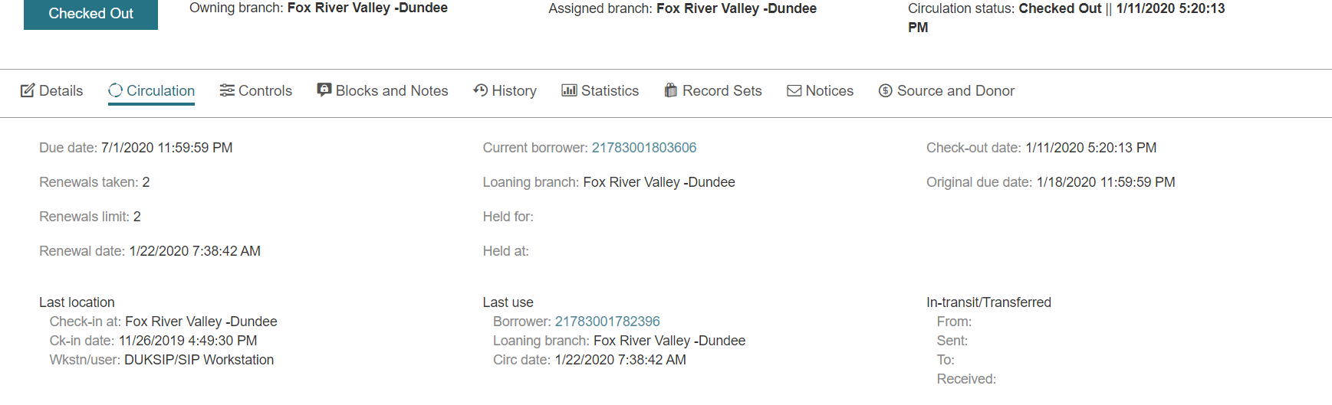
Item is Checked Out : use Loaning Branch

Slide 6
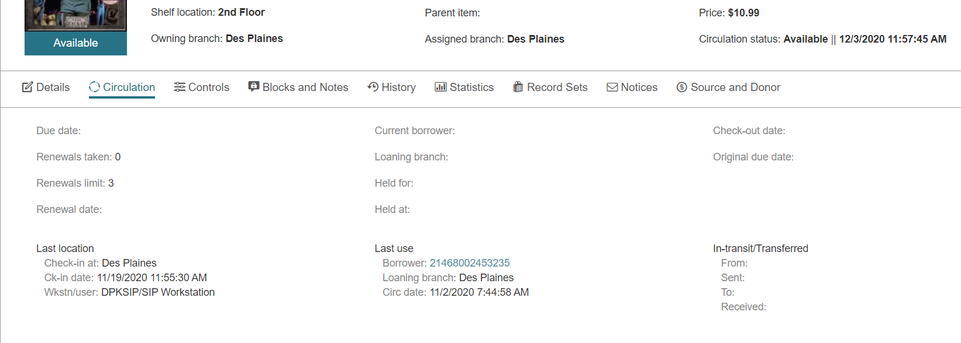
Item is Available : use Last Use Loaning Branch

Slide 7
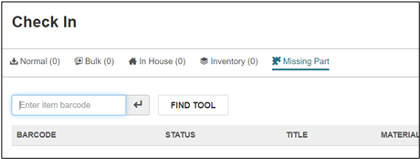
If the item was checked out at your location:
1. Check item in using Missing Part check in mode.

Slide 8
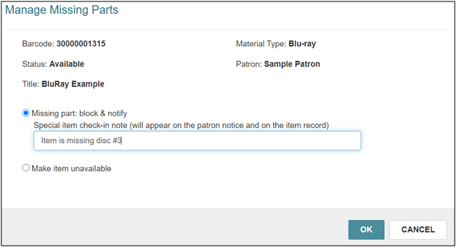
2. Select the “Block and Notify” option. Include note about the missing part(s). This note will be included in the email and print notification and added as a Special Item Check In note in the item record.

Slide 9
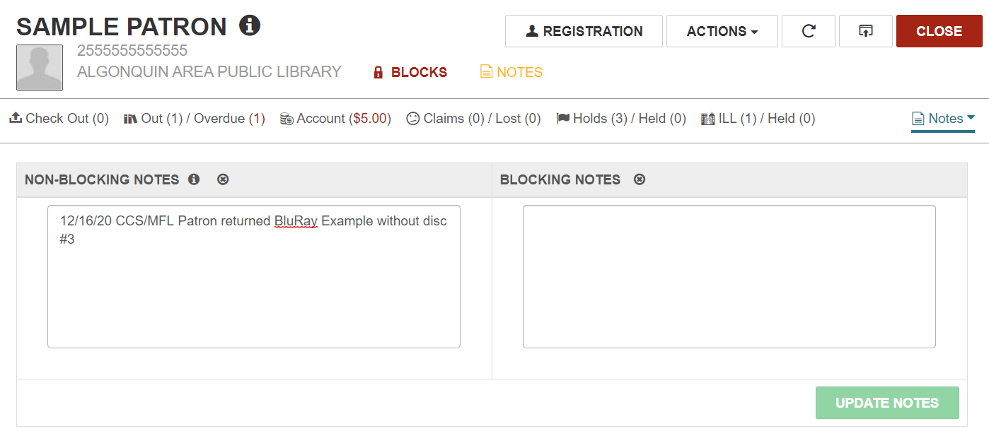
3. Optionally, add block or note to patron's record as per local procedure.

Slide 10
Item will move from patron's list of check outs to their Claims/Lost tab.
Claim missing part item does count towards patron's current claims count.
Claimed item does not appear in patron's online PowerPAC account – only staff can view claims.

Slide 11
If item was checked out at a different library:
1. Contact patron manually.
2. Optionally, add block or note to patron’s account as per local procedure.

Slide 12
RESOLVING CLAIMS MISSING PARTS
Claim Missing Parts item will remain on patron's claims list until
The item is checked in again and resolved, or
The patron is charged for the missing part.

Slide 13
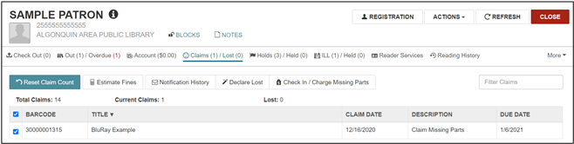
RESOLVING CLAIMS MISSING PARTS: Charging the Patron

Slide 14
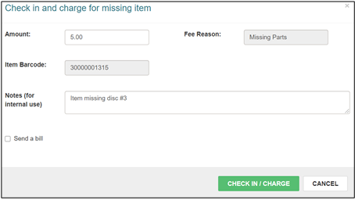
RESOLVING CLAIMS MISSING PARTS: Charging the Patron

Slide 15
RESOLVING CLAIMS MISSING PARTS:
Don't forget to remove the item note(s) and patron blocks/notes!

Slide 16
REPORTS
Web Reports
Bib & Item Management > "Items with a status of claims"
Staff Client Reports
Cataloging > Item > "Claimed Items"
Both reports list items belonging to your library with a status of "claimed."

Slide 17
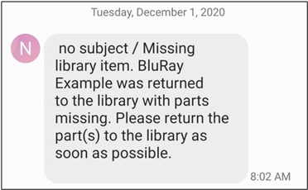
SAMPLE TEXT NOTICE

Slide 18
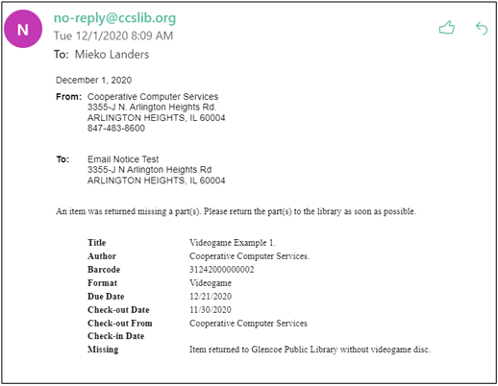
SAMPLE EMAIL NOTICE

