Slide 1
Vega Partner Program Overview
Circulation Technical Group
April 9, 2021
Notes:
CCS announced in December that we had signed on as development partners for Innovative’s Vega Discover product. Today, I wanted to provide an introduction to Vega Discover and what our participation as development partners means for all of you.

Slide 2
What is Vega?
Developing platform to be comprised of multiple solutions, including:
  Discovery - Catalog interface
  Patron engagement tools
  Analytics
  Program & Events
Notes:
Vega is a new platform currently in development from Innovative. When it is completed, it will be made up of multiple solutions, including a discovery/catalog interface, patron engagement tools, analytics software, and programs and events piece

Slide 3
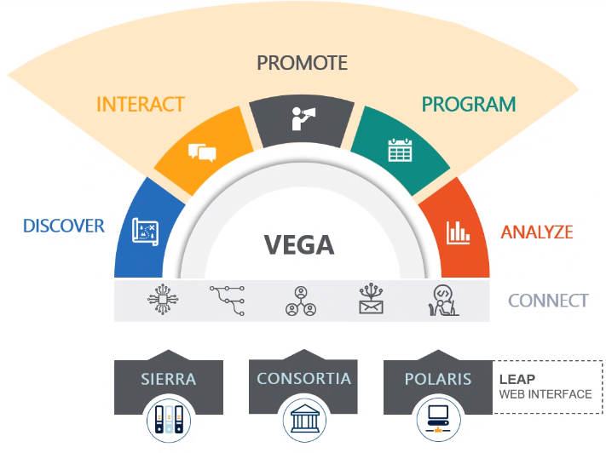
What is Vega?
Notes:
Here’s a visual of the Vega development plan. You see the various components or pieces of the Vega platform across the top—discover, or catalog interace; interact and promote, which include patron engagement tools such as a chat bot service and email marketing tools; program piece, which include event registration, and analyze , which would be the data analytics and reporting piece. Vega connect is the underlying infrastructure that will link these components together. Vega will work or overlay with both Sierra and Polaris.

Slide 4
Vega Discover
Development Partner Program
CCS has signed on to be a development partner for Vega Discover (catalog interface)
As development partners, we’ll:
  Participate in advisory discussions and usability testing
  Beta test Vega
  Share feedback with Innovative
  If needs are met, adopt Vega Discover as replacement for PowerPAC
Notes:
When finished, Vega will be more than just a catalog interface, but the discovery piece is the first component that Innovative is working to complete. CCS has signed on to be a development partner for Vega discover. As development partners, CCS will participate in advisory discussions and testing with Innovative and other development partners. We’ll get a Vega instance and begin beta testing the product with staff and with patrons. As we go along, we’ll share out feedback with Innovative. If at the end of this multi-month project, our needs our met by Vega Discover, we will adopt it as a replacement for PowerPAC.

Slide 5

Notes:
So we have a better sense of what Vega Discover is, I’m going to play a short promo video from iii.

Slide 6
Current State of Vega Discover
General availability for Sierra standalone partners; 3 libraries live:
  Ferguson Library
  MidPointe Library System
iii is working to develop Vega for standalone and consortia Polaris partners
2 Polaris consortia partners:
  CCS + Pinnacle
Notes:
As I mentioned earlier, Vega Discover is a product in progress. It’s not finished, and Innovaitve is actively working to develop it. They roll out updates at least once or twice a month. Vega Discover is currently in general availability for Sierra standalone partners. There are only 3 libraries who are currently live on the new product, and I’ve linked to two of them here and will pop those links into the chat when I’m done so you can take a peek. Innovative is currently building Vega for Polaris customers, both standalone and consortia partners. We are one of 6 consortia partners for Vega, and one of 2 Polaris consortia partners. The other is Pinnacle.

Slide 7
CCS Draft Project Timeline
Project Kickoff and Planning
1
Early Access/Soft launch
2
General Availability Tentative Go Live
3
Notes:
Let’s talk about what our timeline looks like. I’ve divided the project into three rough phases: Project Kickoff and planning, early access and soft launch, and general availability for Polaris and CCS’ tentative go live

Slide 8
Phase 1: Project Planning & Kickoff
January 2021-June 2021
CCS attends regular meetings with iii
Establish blockers/must-haves for go live
CCS develops UX testing plan and strategy for gathering member feedback
CCS recruits beta libraries for soft launch phase
CCS begins creating training materials and documentation for members
iii develops Vega for Polaris/consortia
Notes:
We are currently in the early stages of the project, planning and kickoff. During this time, the CCS team is attending development partner meetings with innovative. During these meetings, innovative demos new and upcoming features for partners, and we provide feedback. CCS is working to establish out blockers or must-haves for going live on the product. What are our the features and pieces we would absolutely need to switch from PowerPAC to Vega? I’m currently working with ourteam to develop our user testing plan for patrons, because we need to make sure that the product is easy for them to use and that our end users can accomplish all of their important tasks in the new interface. We’ll also build our plans for gathering feedback from all of you. Beginning next month, CCS will also plan to recruit beta libraries for our soft launch phase, which we’ll talk more about on the net slide. We’ll start our initial push to create training documentation for our members. And while we’re working on all of these things, the Innovative development team is actively building Vega for Polaris customers.

Slide 9
Phase 2: Early Access/Soft Launch
July 2021-October 2021
CCS receives Vega instance
iii hosts introductory webinar for our members
CCS works with iii to test & troubleshoot bugs, issues, etc.
CCS begins testing with patrons and gathering staff feedback
Beta libraries begin using Vega at OPACs
CCS attends ongoing meetings with consortia library partners and iii
Notes:
In late June or early uly, we’ll move into the second phase of the project, which is our early access or soft launch phase. During this phase, CCS will receive a Vega instance that will sync against our production environment. It will be a live Vega instance that is running parallel to PowerPAC. Once we have our test instance, we’ve asked iii to host an introductory webinar for all of you, so that you can have a live demo and the oppprunity to ask questions of the iii team. We’ll begin our testing full force, and we will work with all of you and with innovative to test and torubleshoot bugs and issues. We’ll also being testing with patrons in late summer with the help of our beta libraries. Our beta libraries will begin using Vega at their OPACs within the library as part of that user testing. CCS will consintue to attend small meetings to provide feedback with our consortia parnerts and iii.

Slide 10
Phase 3: General Availability
November 2021-March 2022
General availability
  Product isn’t finished, but is ready to adopt
CCS continues to work with members to test, evaluate product
iii continues to roll out product updates on a monthly basis
Governing Board votes whether to adopt Vega as primary discovery solution
Notes:
Late fall, we’ll move into the last phase, which is Polaris general availability. Now, general availability means that Vega is ready to be adopted as a primary deiscovery interface by Polaris consortia partners, because all of the core functionality is there. It doesn’t mean that Vega is done. Innovative will continue to roll out product updates on a monthly basis, and we will continue to test and evaluate during this phase. At the end of this phase, Governing Board will vote on whether to adopt Vega as our primary discovery solution, replacing PowerPAC. Governing Board is having initial discussions about Vega rollout at their meeting next week, and they will work with CCS at subsequent meetings to determine our requirements for moving to Vega as a consortium.

Slide 11
Want to Learn More?
Ferguson Library Discover Catalog: https://ferg.na.iiivega.com/
Innovative Webinar: Vega Vision and Beyond: https://vimeopro.com/innovativeiii/webinars/video/489570637

