Slide 1
CCS Updates
Circulation Technical Group October 8, 2021

Slide 2
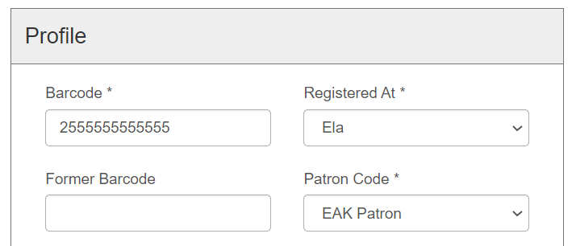
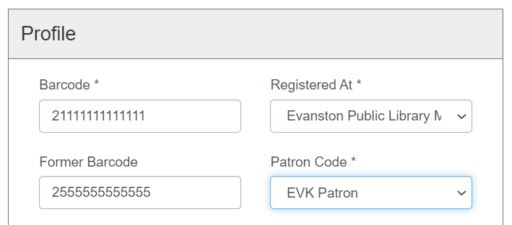
Claiming an Item
Quick Reminder
If registering a user with an existing account, do not create a brand-new patron record.
Instead, update the information on their existing patron record.

Slide 3
Claiming an Item
Vega Discover Update
Timeline shifted for development of key functionality.
Fall 2021
Winter 2021/22
Summer 2022
Spring 2022

Slide 4
Claiming an Item
Vega Discover Update
CCS will still perform user experience testing over winter.
Fall 2021
Winter 2021/22
Summer 2022
Spring 2022

Slide 5
Claiming an Item
Vega Discover Update
Start beta testing in Spring 2022.
Fall 2021
Winter 2021/22
Summer 2022
Spring 2022

Slide 6
Claiming an Item
Vega Discover Update
Governing Board will vote to adopt or not in summer 2022.
Fall 2021
Winter 2021/22
Summer 2022
Spring 2022

Slide 7
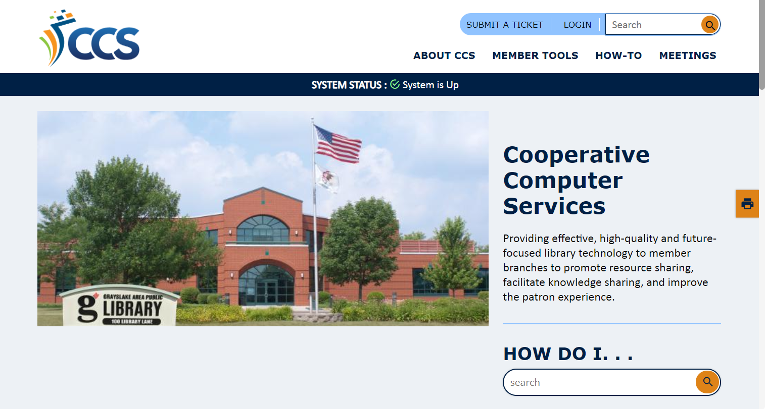
Claiming an Item
Website Update – ccslib.org
New CCS Website launches October 11!
Start using L2 login with CCS website and can also use with Web Reports

Slide 8
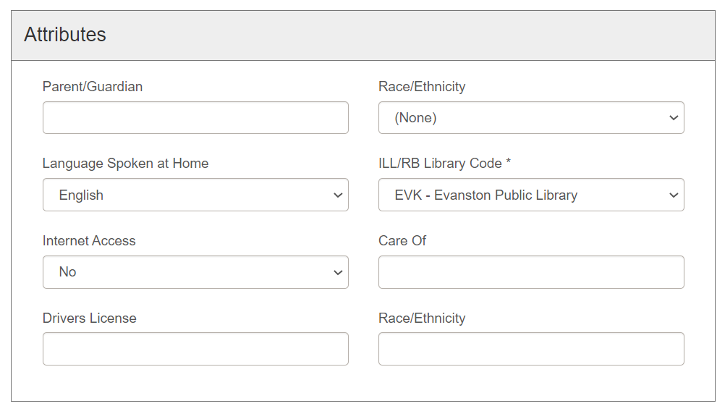
Claiming an Item
Evanston Race/Ethnicity Field
Evanston patrons now have additional race/ethnicity field in registration workform
ONLY Evanston staff may modify those fields

Slide 9
Claiming an Item
Custom Content Field Bug
Bug in custom content free text fields (driver's license)

Slide 10
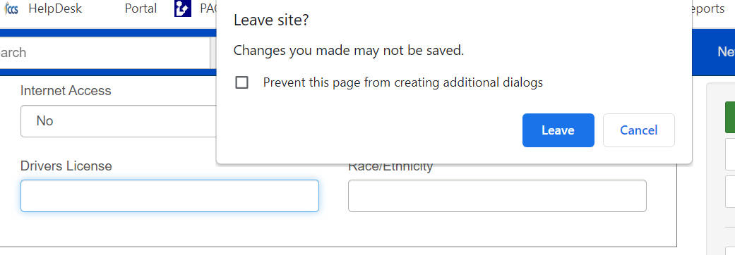
Claiming an Item
Custom Content Field Bug
"Enter" command > browser prompts you to leave site

Slide 11
Proposed Addition to the Circulation Manual
Circulation Technical Group October 8, 2021

Slide 12
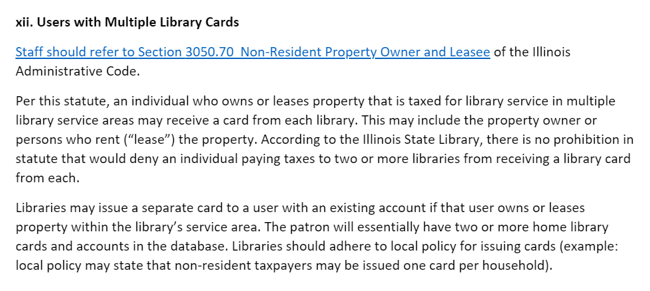
Claiming an Item
Proposed Segment

Slide 13
Claimed Item Workflows
Circulation Technical Group October 8, 2021

Slide 14
Claiming an Item
Claiming an Item
Libraries may claim their own items or an intra-CCS item without consulting the owning library
91% of claims are local
Libraries will check the Web Report, "Items with a Status of Claims" regularly.

Slide 15
Claiming an Item
Claiming an Item
Patron may have up to 5 active ("Current") claims before they are blocked

Slide 16
Claiming an Item
Claiming an Item
Polaris also records the patron's lifetime claim count ("Total Claims")

Slide 17
Claiming an Item
Resolving a Claim
A claim is resolved when
The item is found and checked in
The patron pays for the item
75% of resolved claims are resolved within 34 days

Slide 18
Claiming an Item
Manually Removing an Unresolved Claim
For claims that are not resolved, staff will eventually need to manually remove them from the patron's record so the item can be deleted
Important to manually resolve long-standing claims in order to help maintain collections and the database

Slide 19
Claiming an Item
Manually Removing an Unresolved Claim
Recommended workflow:
Mark claimed item as Lost

Slide 20
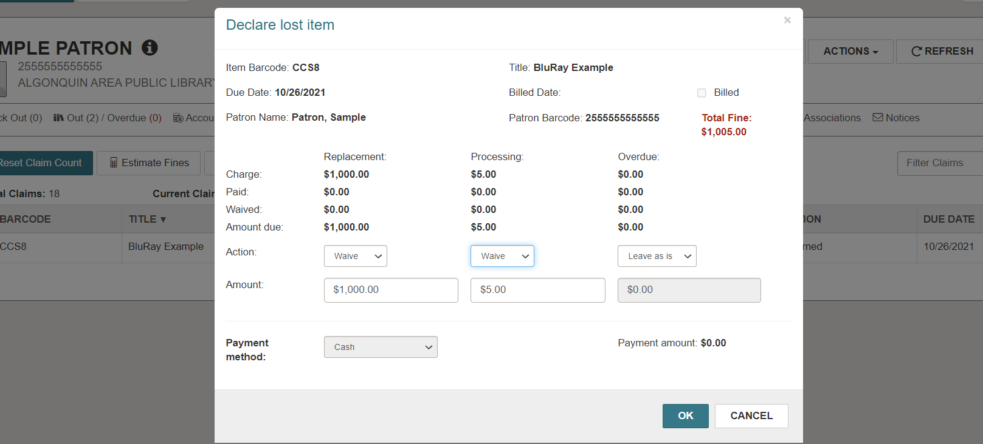
Claiming an Item
Manually Removing an Unresolved Claim
Recommended workflow:
Mark claimed item as Lost
Waive replacement fees

Slide 21
Claiming an Item
Manually Removing an Unresolved Claim
At what point should libraries manually remove an unresolved claim?
36% of active claims in database are 2+ years old

Slide 22
Claiming an Item
Manually Removing an Unresolved Claim
At what point should libraries manually remove an unresolved claim?
Recommendation (pending approval): An unresolved claim should be considered for manual removal from a patron's record
At the minimum, after one month
At the maximum, no later than one year

Slide 23
Claiming an Item
Discussion - Removing Unresolved Claims
Who can or should remove an unresolved claim?
The claiming library
The owning library

