Slide 1

CCS Updates
Circulation Technical Group
January 14, 2022

Slide 2
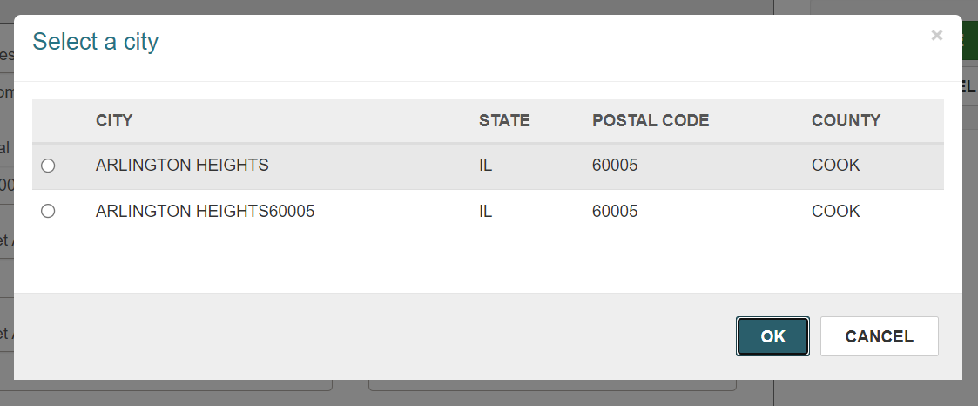
Claiming an Item
Zip Codes
If you spot an incorrect zip code, open a ticket with help@ccslib.org and CCS will clean it up!

Slide 3
Claiming an Item
Monthly Patron Maintenance
Monthly patron purge updated in 2021 to include users who:
  Have an account created 3+ years ago
  Do not have a Last Activity Date
Example: users who registered with the library but never used their card

Slide 4
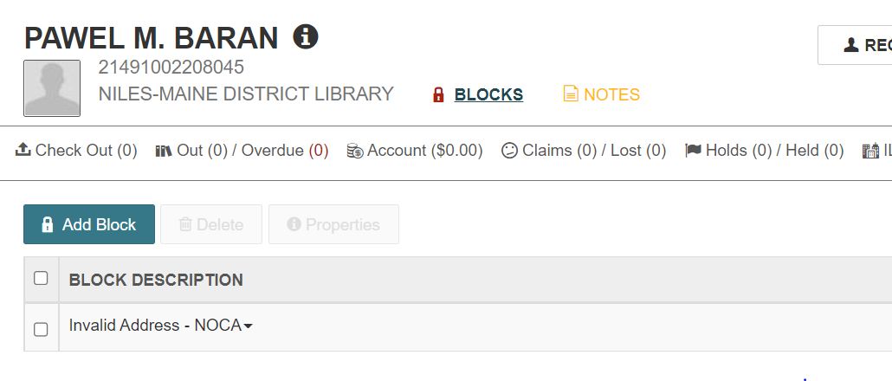
Claiming an Item
Reminder: Check Patron Blocks
When registering a user with an existing patron account, don't forget to check blocks.
If user was blocked due to NCOA but has verified new address with you, remove NCOA block.

Slide 5
Claiming an Item
Annual Fee Purge
2022 annual fee purge targeted for March
Waive all fees for all libraries posted more than 7 years ago, per Governing Board policy
Waive overdue fines for fine free libraries that have not yet participated in bulk waive

Slide 6
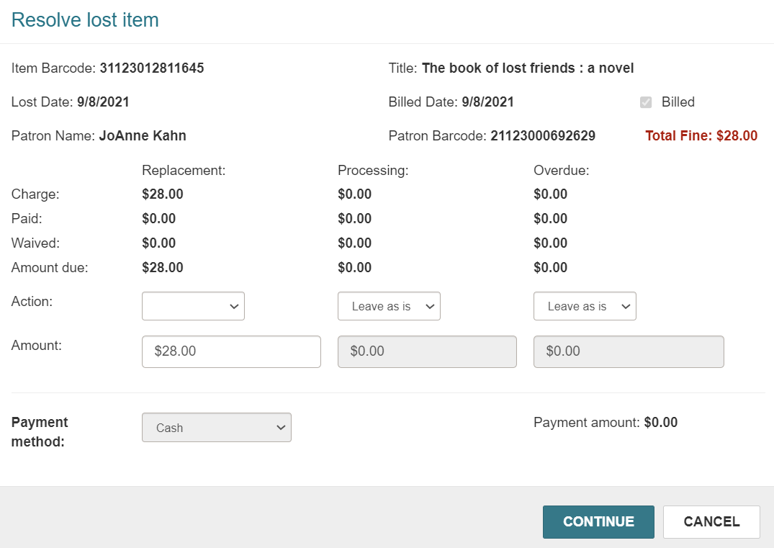
Claiming an Item
Lost Item Recovery Option
Option to automate actions when a lost item is returned
If interested in more information, email help@ccslib.org

Slide 7
DEMO: Print List of Checked Out/ Checked In Items
Circulation Technical Group
January 14, 2022

Slide 8
Claiming an Item
Print List of Checked Out Items
1. Open patron's record
2. Navigate to their Out/Overdue tab
3. Click the checkbox at the top of the list of items to select all
4. Click Print List

Slide 9
Claiming an Item
Print List of Checked In Items
1. Check items in
2. Select checkbox of items to include on list OR select checkbox at top of list to select all
3. Open the Actions menu
4. Click Print List

Slide 10
Notice Updates
Circulation Technical Group
January 14, 2022

Slide 11
Claiming an Item
Notice Updates
CCS will wrap up a project to make email notices more user-friendly by March.
Changes include:
  Increasing font size
  Using uniform font
  Removing redundant information
  Simplifying wording
  Adding links to library website and catalog

Slide 12
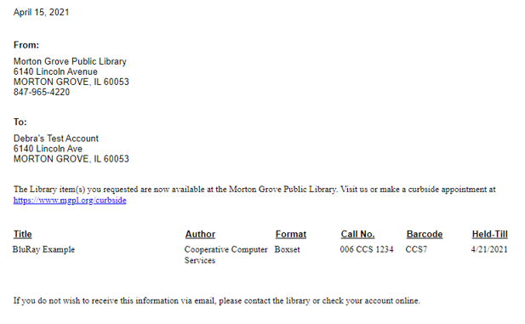
Claiming an Item
Notice Updates
Remove date, library address and patron address
Increase size 10 font and make uniform font face

Slide 13
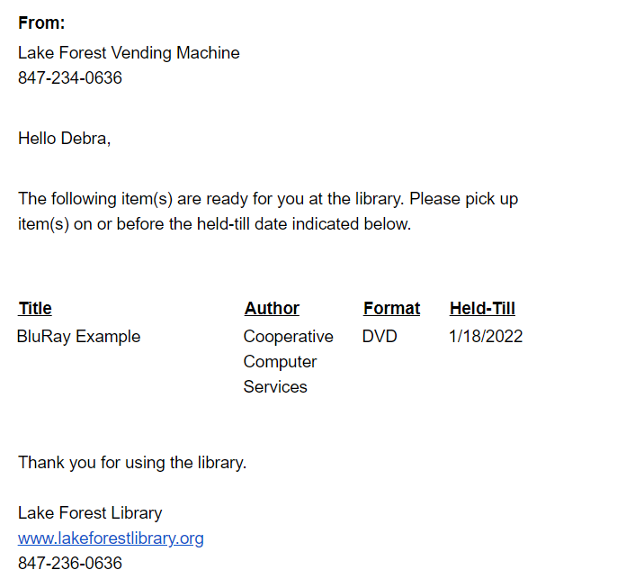
Claiming an Item
Notice Updates
Simplify library contact information and add in friendly greeting
Uniform font face and increase to size 14; remove unnecessary item info
Link to library's website, hours, and my account in footer

Slide 14
Claiming an Item
Notice Updates
Schedule
January: Gather final round of user feedback
February: Make final changes to notices; communicate changes with members via CCS News
March: Implement changes

Slide 15
Claimed Item Updates
Circulation Technical Group
January 14, 2022

Slide 16
Claiming an Item
Claimed Item Updates
Starting January 2022, CCS will delete unresolved claimed items aged 1 year or older as regular monthly item record maintenance
Circulation contacts received list of items eligible for first deletion (January 28)
Maintenance will take place during the last week of each month; use "Items with a Status of Claims" report to track eligible items

Slide 17
New Business
Circulation Technical Group
January 14, 2022

Slide 18
Claiming an Item
Intra-CCS Missing on Holdshelf
Contact the patron to see if they have the item.
Check your stacks for the item.
Contact the Owning Library within 14 days to see if it is at their location. The Owning Library should check their stacks.
If the item cannot be located:
The Owning Library will check the item in to clear the Unclaimed status and change the circulation status to Missing.
https://www.ccslib.org/training/missing-holdshelf-local-and-intra-ccs-holds

