Slide 1

An Overview of the Diversity Audit Data Dashboard
Rachel Fischer

Slide 2
The Purpose
Analyze the level of diversity of the topics included in each collection.
Identify diverse items that other libraries own, but your library doesn’t own.
Notes:
The purpose of a diversity audit is to help your library to analyze the level of diversity within your collections, so that the library can become more inclusive and representative of the community it represents. This can be a very time-consuming process. Without the assistance of a vendor, it can be impossible to analyze a whole library. During this fiscal year, I have worked with Bob to create a data dashboard that analyzes the collections of all libraries in the consortium. A data dashboard is a tool that displays tables and graphs for the purpose of analyzing key performance indicators. This dashboard utilizes the subject headings in the CCS catalog to provide librarians with an easy way to analyze the level of diversity of the topics included in their collections, compare your collection to the population statistics, and identify diverse items that other libraries own that could be purchased by your library.

Slide 3
Topics Analyzed in the Dashboards
Geographic Subjects
Subject Matter
Geographic subject headings in the bibliographic records.
Categorized by continent.
Examples:
  Travel guides
  History of a region
  Fiction that takes place in a specific region (only if the heading is included in the record)
BIPOC subject headings
LGBTQIA+ subject headings
Disabilities/Neurodiversity subject headings
Religious minorities
Notes:
At this time, there are two diversity audit dashboards. The first dashboard analyzes the geographic subject headings in the records. Geographic headings are commonly found in non-fiction such as travel guides, history, or politics of a specific region. Geographic headings can also be found in fiction when the location plays an important role for the plot, like a mystery that takes place in Chicago. These headings are grouped by continent in the dashboard in order to easily limit the amount of data that is displayed. The second dashboard consists of the type of subjects that are analyzed in a diversity audit. These include: BIPOC (black, indigenous, and peoples of color), LGBTQIA+ headings, disabilities and neurodiversity headings, and religious minorities. There will be a significant amount of overlap between the ethnic headings and those that have geographic headings, but not all records have headings for ethnicities, and geographic regions without ethnic headings can’t be automatically analyzed as fitting in a specific ethnic category.

Slide 4
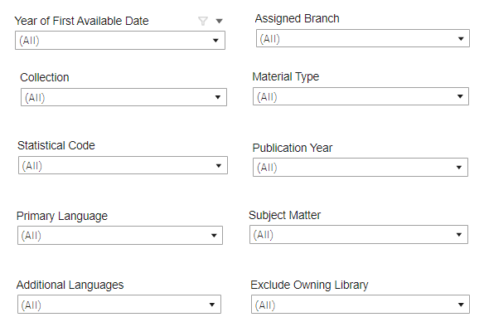
Filtering the Data
Notes:
The dashboard includes many filters that allow you to analyze different levels of data, like analyzing the whole consortium, analyzing your whole library, or analyzing just a selection area. At the top is the year of the first available date. This is the year that the circulation status of the item record was first changed to available from in-process. Using this filter will allow you to analyze the purchases from a specific year. The assigned branch filter will allow you to choose to analyze the data just from your library, a specific branch, or the whole consortium. The collection allows you to select from the adult, teen, and youth fiction, non-fiction, and multimedia collections. However, e-books have not been included due to the poor quality of subject headings in the records. Material type is the material type that is in the item record. If you select the collection before the material type, you will notice that it will diminish the amount of material types to only those found in the collection. Likewise for statistical code. If your library uses the statistical code of the item record, you will find this filter useful. Statistical code includes Dewey decades and genres. There are two language filters that will be useful for selectors of non-English language items, primary language and additional languages. This data comes from two fields in the bibliographic records so that you can identify bilingual or multilingual works easily. The publication year is the year the item was published. This comes from the bibliographic record. There are two filters that will be useful for selecting activities only. These should not be altered when analyzing the data, because it will cause inaccurate statistical calculations. Subject matter allows you to select a specific subject to narrow the list of titles in a table to, and exclude owning library, allows you to exclude the titles that your library owns so that you can select titles to purchase that the library doesn’t already own.

Slide 5
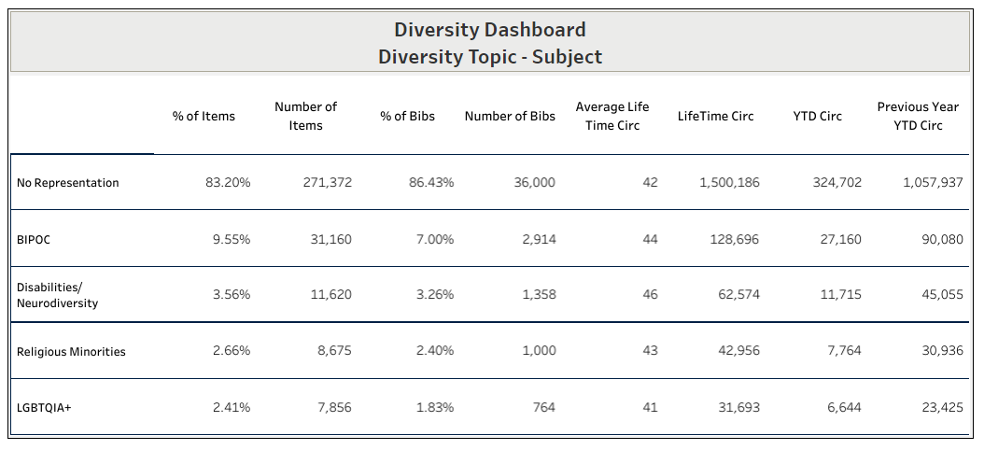
Notes:
The first table that you will see at the top consists of easily interpreted statistical data. This table is for the subject matter dashboard. The column of categories include No representation. No representation signifies the records that do not have a subject heading that fit within one of the diversity categories. For example, if these statistics represented all purchases from 2021 and 2022 for the whole consortium, 83% of the purchases were not in one of these categories, 9.5% of purchases were on BIPOC subjects, etc.. It could be possible that a title that is counted as no representation may include a diverse topic. However, if a cataloger did not add a subject heading to the record for it, it cannot be counted by the automated processes. If an item has subject headings that fit in more than one category, it will be counted in the statistics of more than one category. The first column of data is the percent of item records that fit within a specific category, next is the total number of item records in the category. The third column is the percent of bibliographic records within each category and the number of bibliographic records that were counted. The statistics for item and bibliographic records vary due to the number of additional copies in a library’s holdings. Also included in this table is the average life-time circulation of all items within each category, the total lifetime circulation of all items in the category, the year to date circulation and the previous year’s circulation.

Slide 6
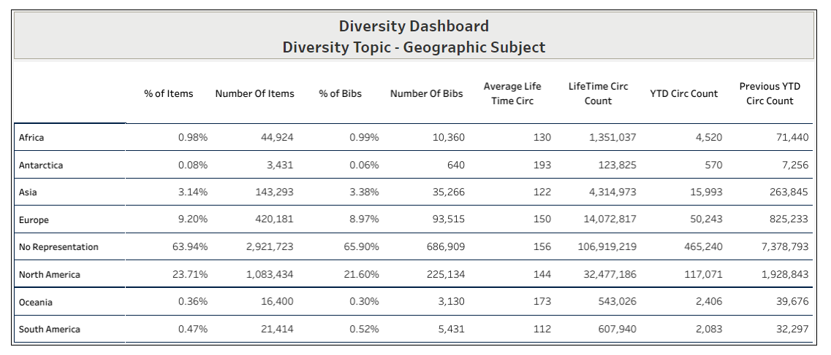
Notes:
This next table is the one from the geographic subject matter page. It lists the continents that each geographic heading belong to. This image depicts the data for the whole catalog. The average lifetime circulation count is really interesting to look at. You can see that South America has the lowest average lifetime circulation count. A selector could identify this for their department then create a goal to try to increase circulation with displays and promotions of fiction or movies that take place in that region.

Slide 7
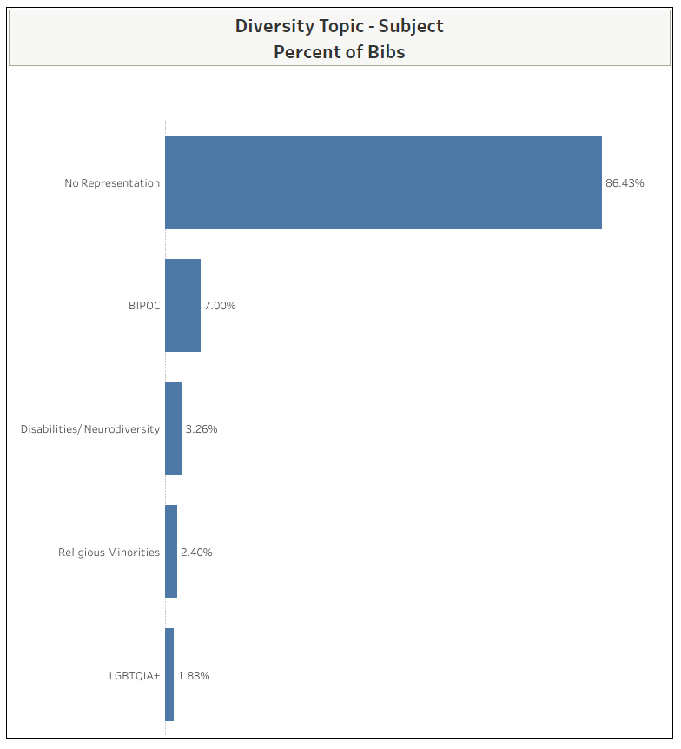
Notes:
The dashboard includes two bar graphs to visualize the data. If you need to create reports or presentations, you will be able to easily take a screenshot of the tables to use as needed. This one depicts the percentage of the collection that fits within each category using the statistics from the bibliographic record counts. If an record has subject headings that fit in more than one category, it will be counted in the statistics of more than one category. This graph shows that 7% of the total collection has BIPOC subject headings and 3.25% of the total collection has disabilities or neurodiversity subject headings, 2.4% have religious minorities subject headings, and 1.83% have LGBTQIA+ subject headings. However, the percentages will not add up to 100% due to items that fit in more than one category. The subject matter graph has an additional feature that allows you to drill down to subcategories. All you need to do is to click on a topic.

Slide 8
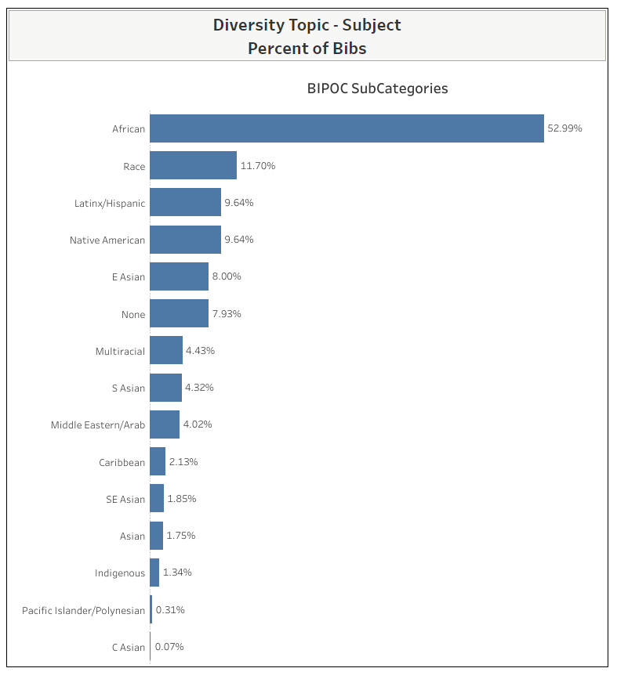
Notes:
Then the graph seamlessly switches to the subcategories within the chosen category. These are the subcategories that fit within the BIPOC category. The table represents the percentage of subject headings that belong to each subcategory within the BIPOC category. Some subject headings, like Caribbean ethnicities have been given two subcategories like African and Caribbean or Latinx and Caribbean. If you see the label none, it means that new subject headings have been identified that haven’t been categorized with a subcategory yet. I will need to monitor those headings and make sure that subcategories are assigned. I’ll be creating documentation that provides further information for the ethnicities that fit within each category.

Slide 9
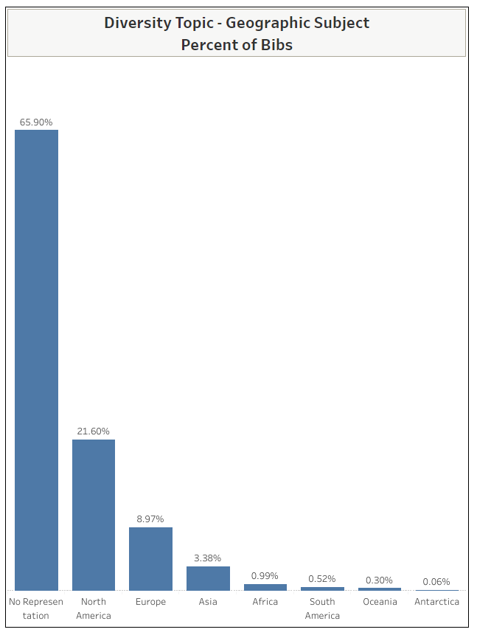
Notes:
This is the graph of the geographic subject headings by continent. Records with more than one geographic heading will be counted by more than one category. It does not have subcategories to drill down to.

Slide 10
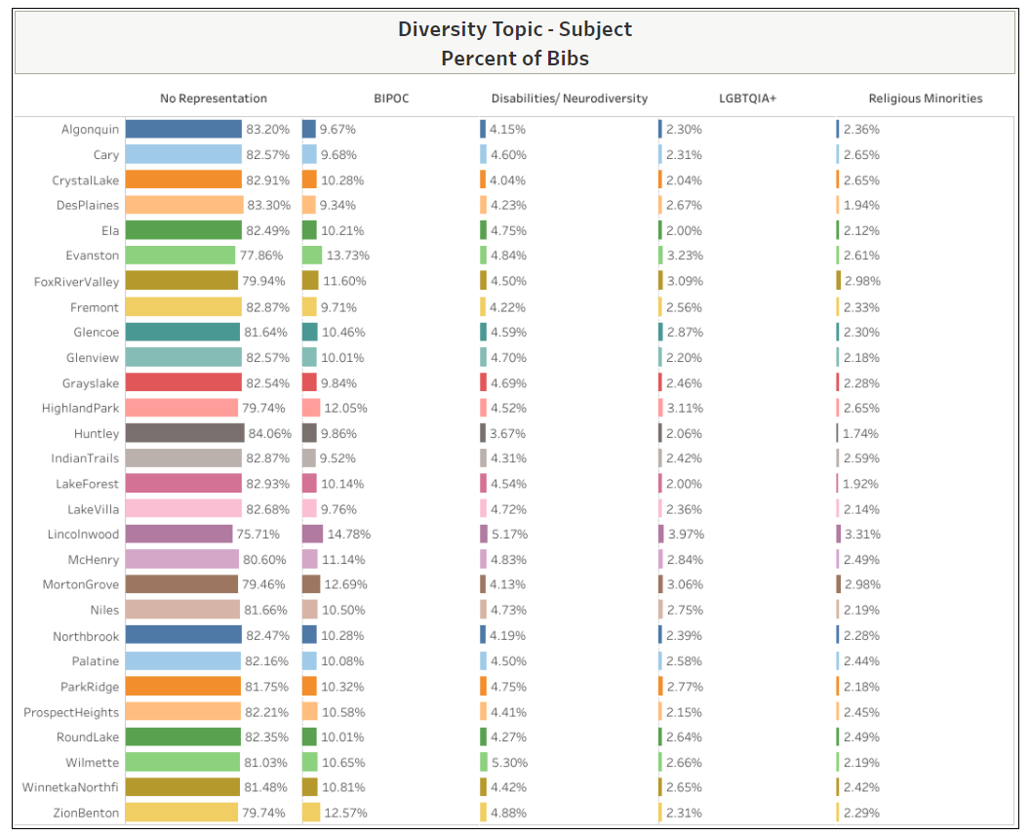
Notes:
During our first round of user testing, a participant requested the inclusion of a graph that would allow them to compare their library to other libraries in the consortium. The purpose of this graph is not to point fingers at the libraries that have less diversity than others. The demographics of the communities vary a lot. However, if you are interested in identifying communities with similar demographics as your library, you do have the option to compare the collections and select items to purchase from those collections. By selecting an assigned branch, you can narrow the number of libraries to view down to the number that you would like so that it is easier to view than viewing all 28 libraries.

Slide 11
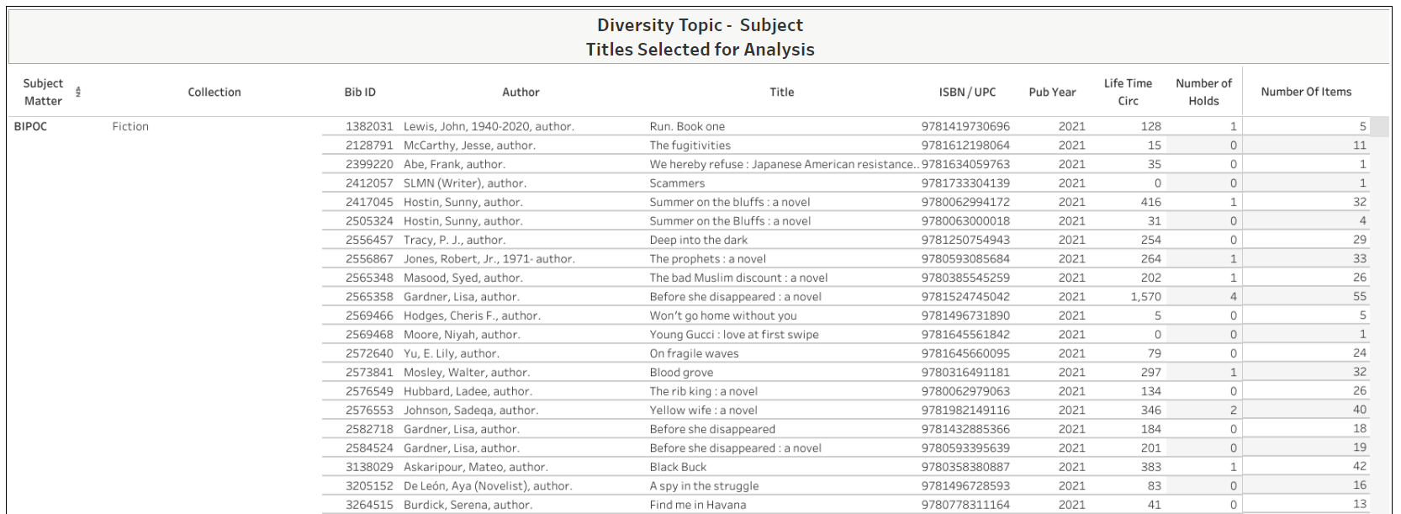
Notes:
Here’s a look at the table of titles that can be utilized for selecting items to purchase. When using the remove titles owned by your library filter, you can limit the list to only those titles you may be interested in purchasing that other libraries own. This table begins with the subject matter and collection in the first entry for that category. It has the BIB ID, which is the control number of the bibliographic record, so that you can quickly access the bibliographic record for more information or additional ISBNs. The ISBN and UPC column can only include one ISBN. So if that is the paperback ISBN, you can find the hardcover ISBN by using the control number to search for the bibliographic record. The publication year, lifetime circ, number of holds, and number of items are also included. This will help you to identify the most and least popular items. The columns can also be sorted in numerical order. The table can be exported so you can view it in Excel.

Slide 12
Limitations of the Dashboard
Automatically tabulates statistics from the subject headings.
It does not analyze the ethnicity of characters or authors.
Does not include on order records or eContent.
List of titles cannot eliminate all editions of the same title.
Notes:
There are several limitations that you should be aware of. Most importantly, the dashboard automatically tabulates statistics from the subject headings in the bibliographic records. So the data is only as good as the records are. When cataloging, headings can be left out even if a topic is included in a book. The catalogers who work for CCS libraries do an excellent job. However, summaries don’t always clearly explain the diverse elements in a plot, especially when it is just a characteristic of the character. The dashboard cannot include ethnicities of characters. For example, I read a fantasy recently that had gender fluid, gay, and asexual characters. However, the subject headings in the final record only described the book as fiction about magic. There was no indicator of anything else in the summary. I’m aware that diversity audits of authors are important. This is not something that can be accomplished by the current dashboard. However, we do have a small amount of data in the authority records that can be used to analyze a sample. So we do have future plans for creating a dashboard on author characteristics soon. As I previously mentioned, the filter to exclude the owning library can’t exclude all editions of the same title. It will only remove the record for the one that your library owns. So you may find the bibliographic records for other editions or publishers of items that you own in the list of titles that that your library doesn’t own.

Slide 13
What you can accomplish
Analyze the whole library.
Supplement a manual audit.
Compare the manual audit to the dashboard as a benchmark.
Track improvements over time.
Identify titles that will not be dead on arrival.
Identify titles that won’t require additional cataloging time, because the record already exists in the catalog.
Notes:
Despite these limitations, the data dashboard will provide you with a quick way for analyzing your collection or selection area so that you can speed up your diversity audit process. While it cannot analyze all of the details that a manual audit could, it can provide you with a way to analyze a larger amount of data than a manual audit could. Having the data stored in the dashboard will allow you to quickly and easily track improvements over time. When using the tables for selecting new diverse titles, it will help you to identify titles that are already popular at other libraries so that you know it won’t be dead on arrival. By using the list of titles not owned by your library, you will be helping the cataloging department too. If you purchase items owned by other libraries, the records already exist in the catalog and won’t require additional cataloging time.

Slide 14
Questions?

Slide 15
Case Study
Palatine Public Library’s Picture books
Notes:
Today, I’m going to briefly demonstrate how to use the dashboards to analyze Palatine Public Library’s Picture Books collection to identify an area of the collection that can be improved on and use the list of titles to select items to purchase.

Slide 16
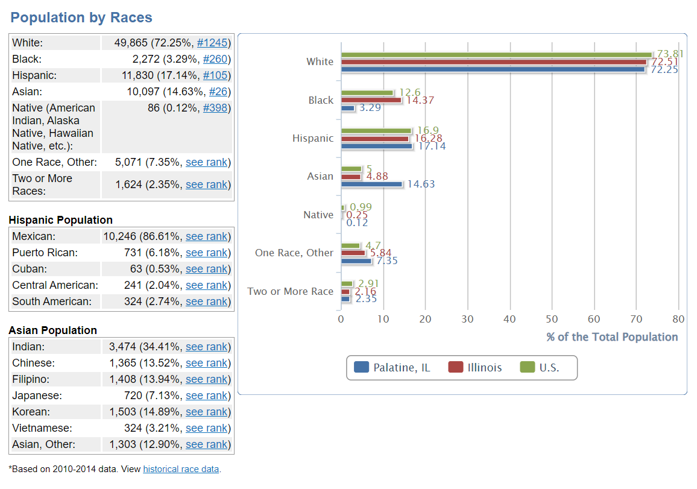
Source: usa.com
Notes:
An important part of the diversity audit process is to utilize the population statistics of your service area as a key performance indicator. By comparing the statistics displayed in the diversity audit dashboard to the population, you can identify topic areas that do not have as much coverage in your selection area. Then you can utilize the dashboard to identify items that represent that topic but aren’t owned by your library to purchase. From these statistics, you can see that Palatine has a sizeable Hispanic and Asian population. The Hispanic and Asian population are broken down into country of origin. The Hispanic population is mostly Mexican. The dashboard uses the regional terms of S Asian, E Asian and SE Asian. We can see that the Asian population is evenly split between S Asian and E Asian countries, with a significant amount of SE Asian representation as well. When selecting new picture books, we want to make sure that purchases for the collection include a certain percentage of items that represent those ethnic groups and geographic regions.
Review stats
34% S Asian
35.54% E Asian
17.15% SE Asian
12.9% Asian, Other

