Slide 1


Circulation/Interlibrary Loan
Advisory Group
MARCH 11, 2022

Slide 2




AGENDA
ILL Request Record Statuses (ACTION)
Patron Online Account Management (DISCUSSION)
ILL Lost item Procedures (ACTION)
NCOA Patron Management and Patron Registration Procedures (ACTION)

Slide 3




AGENDA
ILL Request Record Statuses (ACTION)
Patron Online Account Management (DISCUSSION)
ILL Lost item Procedures (ACTION)
NCOA Patron Management and Patron Registration Procedures (ACTION)

Slide 4
ILL Request Record Statuses
Proposal: Adjust ILL request record status of "Inactive" to "Requested"

Slide 5
ILL Request Record Statuses
ILL request statuses locked and could not be modified
Since ILL request record statuses differ from intra-CCS request statuses, potential for confusion

Slide 6
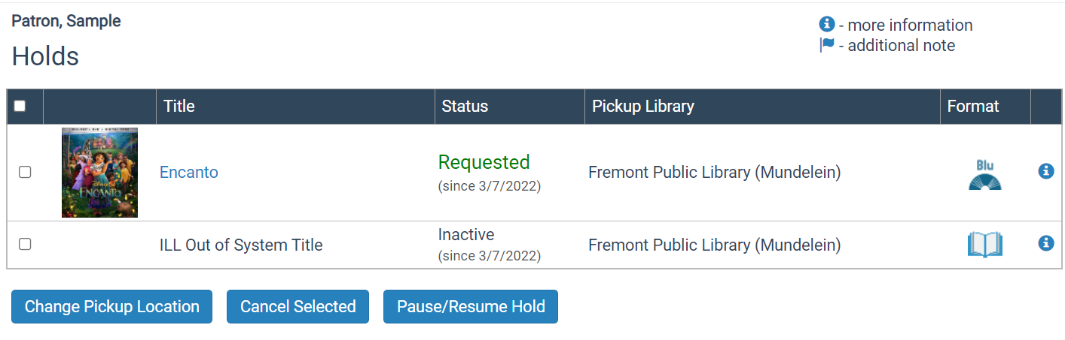
ILL Request Record Statuses

Slide 7
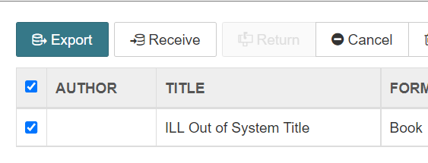
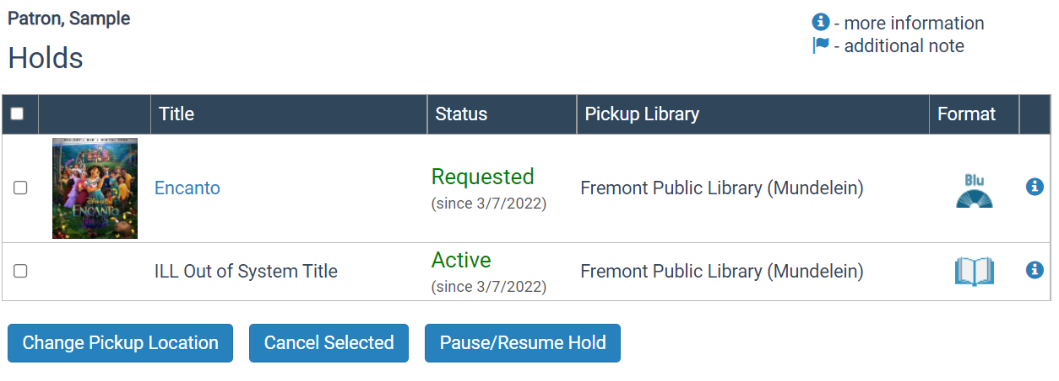
ILL Request Record Statuses

Slide 8
ILL Request Record Statuses
CCS now has a way to modify ILL request record statuses
Modifications will display to patrons in the PAC and to staff in Leap/the Client

Slide 9
ILL Request Record Statuses
Proposal: Adjust ILL request record status of "Inactive" to "Requested"

Slide 10
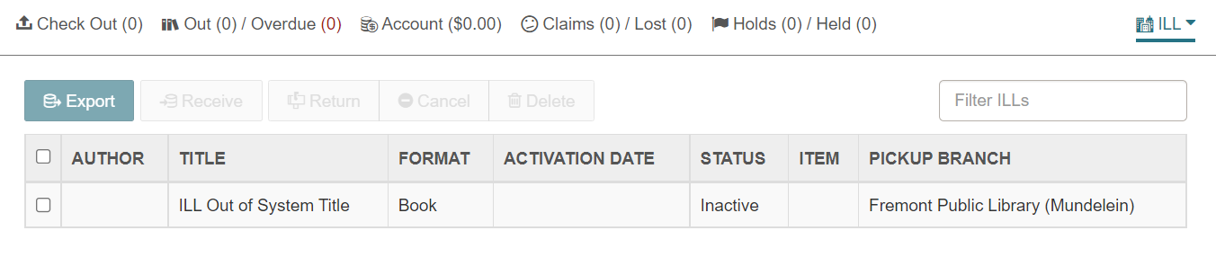
ILL Request Record Statuses
Proposal: Adjust ILL request record status of "Inactive" to "Requested"

Slide 11
ILL Request Record Statuses
Proposal: Adjust ILL request record status of "Inactive" to "Requested"
Pending intra-CCS holds and out-of-system ILLs will display with same status
Libraries no longer click "Export" when placing ILL request

Slide 12
ILL Request Record Statuses
Discussion:
What will impact to library workflow be if all libraries no longer use “Export” button?
If CCS adapts Vega Discover, display of ILL request statuses in the online catalog may change

Slide 13


AGENDA
ILL Request Record Statuses (ACTION)
Patron Online Account Management (DISCUSSION)
ILL Lost item Procedures (ACTION)
NCOA Patron Management and Patron Registration Procedures (ACTION)

Slide 14
Patron Online Account Management
Discussion: Determine if interest in exploring new PowerPAC address self-modification feature

Slide 15
Patron Online Account Management
As of Polaris 7.0, the PowerPAC includes a setting that allows patrons to:
Update their address via the PAC without staff verification OR
Submit an address change request to the library via the PAC
Can be activated at the System level or at the Branch level

Slide 16
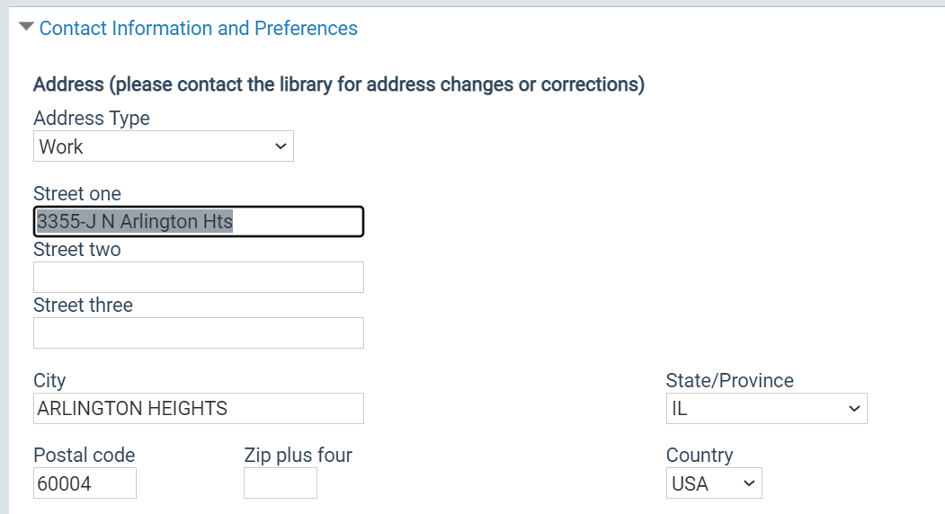
Patron Online Account Management
Update address without staff verification
Patron modifies address in PAC
Library staff not notified of change
Patron account not blocked

Slide 17
Patron Online Account Management
Update address with staff verification
Patron submits change to address in PAC
Library staff notified via email of change
Block placed on patron's account

Slide 18
Patron Online Account Management
Discussion
Would there be interest from libraries in allowing patrons to modify their address in the PAC without staff verification?
Would there be interest from libraries in allowing patrons to modify their address in the PAC with staff verification?
Should the setting be available to libraries on a branch-by-branch basis or should the decision be system-wide?
We are not yet sure what patron account options will look like in Vega Discover. Would there be value in this service if not available in Vega?

Slide 19

AGENDA
ILL Request Record Statuses (ACTION)
Patron Online Account Management (DISCUSSION)
ILL Lost item Procedures (ACTION)
NCOA Patron Management and Patron Registration Procedures (ACTION)

Slide 20
Lost & Paid ILL Procedures
Proposal: Recommend drafted Lost & Paid ILL procedures to ILL Technical Group

Slide 21
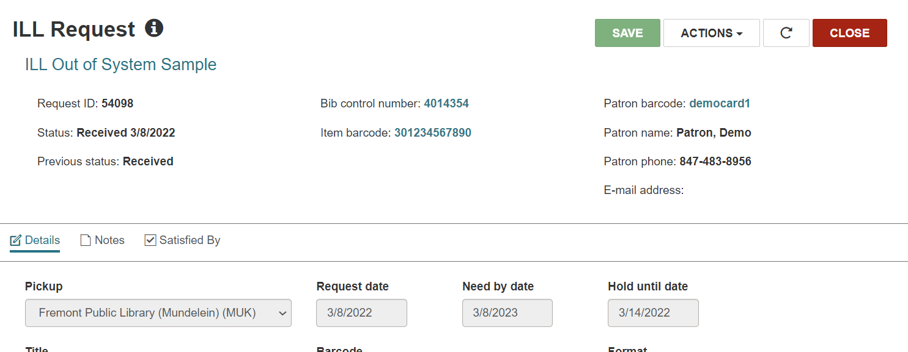
Lost & Paid ILL Procedures
All actions are tied to the ILL request record; the ILL item record cannot itself be deleted

Slide 22
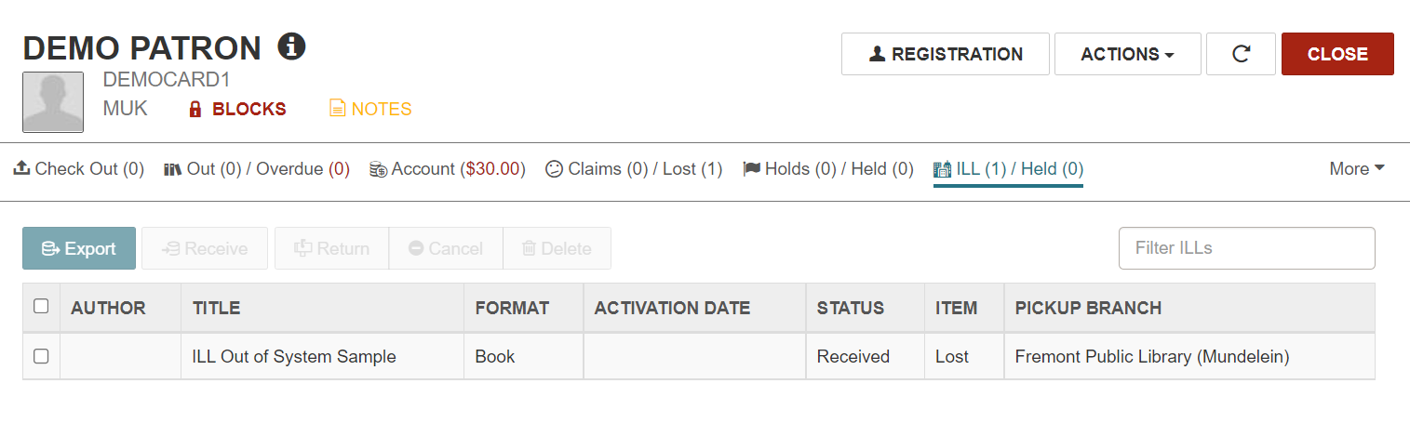
Lost & Paid ILL Procedures
All actions are tied to the ILL request record; the ILL item record cannot itself be deleted
ILL requests remain on a patron’s record until the item is checked in and the request marked as returned and deleted

Slide 23
Lost & Paid ILL Procedures
All actions are tied to the ILL request record; the ILL item record cannot itself be deleted
ILL requests remain on a patron’s record until the item is checked in and the request marked as returned and deleted
Staff can only return and delete an ILL request if the associated item is “Available”
As a result, staff are unable to modify the ILL request record if the item becomes Lost (roughly 0.5% of ILL checkouts)

Slide 24
Lost & Paid ILL Procedures
Proposal: Recommend drafted Lost & Paid ILL procedures to ILL Technical Group

Slide 25

AGENDA
ILL Request Record Statuses (ACTION)
Patron Online Account Management (DISCUSSION)
ILL Lost item Procedures (ACTION)
NCOA Patron Management and Patron Registration Procedures (ACTION)

Slide 26
NCOA Patron Management
Proposal: Recommend addition on managing patrons reviewed via NCOA to “Re-Registering or Updating a Patron” procedures.

Slide 27
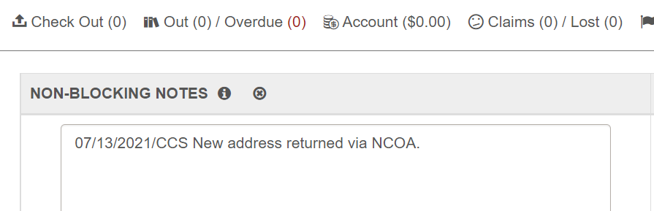
NCOA Patron Management
Patrons reviewed by NCOA and reported as having a new address will have a non-blocking note added to their record.

Slide 28
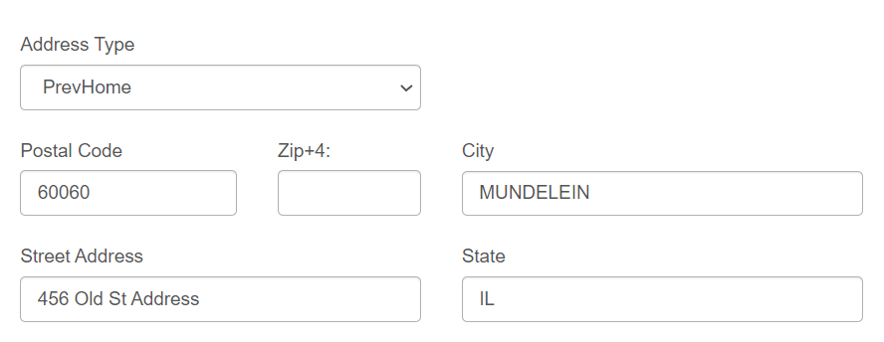
NCOA Patron Management
Additionally, the new address is appended to their record. Their old address is retained under a “PrevHome” field.

Slide 29
NCOA Patron Management
If the user now resides in a different CCS library service area, staff at that library will encounter this data when re-registering the patron for a new card.

Slide 30
NCOA Patron Management
I am proposing that if the patron was reviewed via NCOA and has now officially verified their new address with the library, the library will:
Remove the patron’s old address.
Remove the patron’s non-blocking NCOA note.

Slide 31
NCOA Patron Management
Discussion
Would the patron’s new home library need to know the user was once reviewed via the NCOA service?
Could staff easily remove the NCOA segment without disrupting other notes?
Would the patron’s new home library need to know their previous address?
CCS does not need to retain either field.

Slide 32
NCOA Patron Management
Proposal: Recommend addition on managing patrons reviewed via NCOA to “Re-Registering or Updating a Patron” procedures.

Slide 33
Next Meeting
June 10, 2022 (9:30am) via Zoom

