Slide 1
Circulation/ILL Advisory Group
SEPTEMBER 9, 2022

Slide 2
Overview of Circulation/ILL Advisory Group

Slide 3
Circ/ILL Advisory Group
Advisory groups consult with CCS on potential system configuration changes, assist with research and testing, and recommend policy changes and best practices to their associated technical groups.
Advisory group members are expected to:
•Use their expertise and knowledge to represent the CCS community
•Participate in 4 advisory group meetings per year
•Participate in 4 associated technical group meetings per year
•Engage in online, asynchronous conversation and research between meetings
•Work with CCS staff to present findings and recommendations as needed.

Slide 4
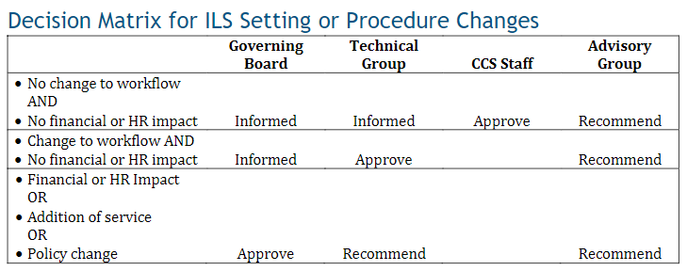

Slide 5
Circ/ILL Advisory Group
2022-2023 Meeting Dates
Friday, September 9, 2022 (9:30am)
Friday, December 9, 2022 (9:30am)
Friday, March 17, 2023 (9:30am)
Friday, June 9, 2023 (9:30am)

Slide 6
Interlibrary Loan and Item Editing Permissions

Slide 7
Background
The ILLBBM permission group does not come with item editing permissions (including item price)
To modify an item record's price field, staff must be part of Cataloging 1, Public Services Item Editing, or Circulation Managers permission group

Slide 8
Background
If the item becomes Lost and the ILL item record does not have a price assigned, Polaris will apply the default to the bill
ILL staff may want to modify the price after receiving an ILL request to reflect the true price of the item
Staff who are in the ILLBBM permission group but not in an item editing permission group will not be able to edit the item price

Slide 9
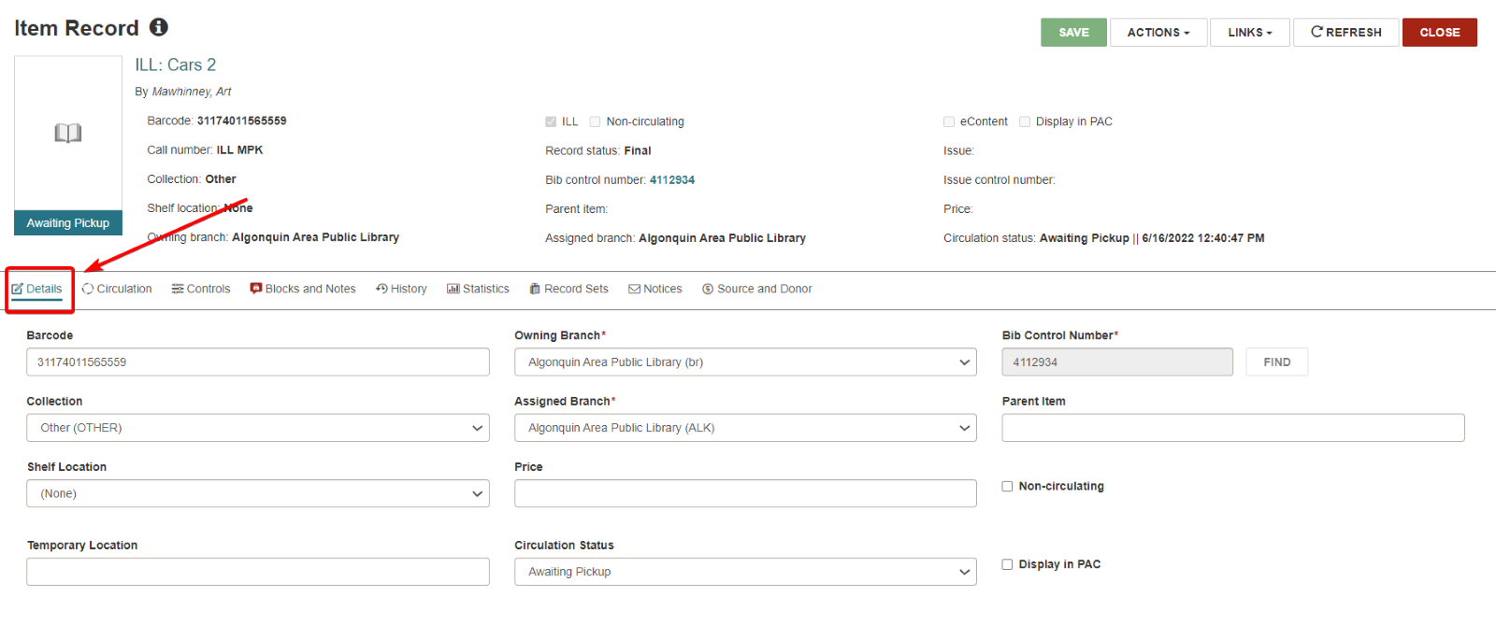
Item Editing Permissions
If item editing permissions are added to the ILLBBM group, staff would be able to edit the Details tab of all item records assigned to their library

Slide 10
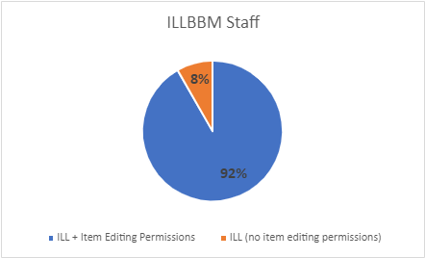
Item Editing Permissions
As of August 28, 628 staff are in the ILLBBM permission group.
Of those staff, roughly 92% are also part of a group with item editing permissions (576 staff).
Roughly 8% of ILLBBM staff do not currently have item editing permissions (52 staff).

Slide 11
Options to Discuss
1. Should item editing permissions be added to the ILLBBM group?
With this option, any staff who is part of the ILLBBM permission group will be able to edit the Details tab for items assigned to their library
2. Should ILLBBM permissions be left as-is?
With this option, libraries can continue to add staff to an existing permission group with item editing permissions as needed

Slide 12
Children of Separated Parents and Multiple Library Cards

Slide 13
Background
In the section addressing users with multiple library cards, the CCS Circulation Manual does not explicitly mention children of separated parents
Children of separated parents was used as an example during the previous Circ/ILL Advisory discussion on users with multiple library cards; the group was unanimous that there are valid situations where users may have multiple cards in the database

Slide 14
Background
Response from State Library and RAILS during initial discussion:
There are no existing statutes that deny an owner of multiple properties from receiving a card from each library they pay taxes to
Additionally, there are no state statutes relating to library card access for children of separated parents; access is up to local library policy
CCS is re-verifying with RAILS and the State Library

Slide 15
Revised Entry to CCS Circulation Manual
2.xii Users with Multiple Library Cards
Staff should refer to Section 3050.70 Non-Resident Property Owner and Leasee of the Illinois Administrative Code.
Per this statute, an individual who owns or leases property that is taxed for library service in multiple library service areas may receive a card from each library. This may include the property owner or persons who rent (“lease”) the property, or children of separated parents who each reside in different library service areas. According to the Illinois State Library, There is no prohibition in statute that would deny an individual paying taxes to two or more libraries from receiving a library card from each. Library card access for children of separated parents can be determined by local library policy.
Libraries may issue a separate card to a user with an existing account if that user owns or leases property within the library’s service area. Libraries may also issue a separate library card to a child of separated parents if the child has an existing account at a different library and such access follows local library policy. The patron will essentially have two or more home library cards and accounts in the database. Libraries should adhere to local policy for issuing cards (example: local policy may state that non-resident taxpayers may be issued one card per household).
Drafted revisions in red

Slide 16
Migration Training

Slide 17
Background
The next library migration will likely use a blended training strategy
Blended training uses both virtual asynchronous training (pre-recorded videos, software simulations, PDF handouts) and in-person synchronous training sessions
We have not before migrated a library using blended training and need to figure out the most effective approach
Additionally, we would like to be able to provide recommendations for internal training to the incoming libraries.

