Slide 1
CCS Circulation Technical Group Meeting
October 7, 2022

Slide 2
CCS Updates and
New Business

Slide 3
CCS Updates
CCSB Patrons and Collections
On Sirsi ILS, reciprocal borrowers were reported to collections with submission branch CCSL
On Polaris, CCS does not submit to collections
CCS did a sweep for reciprocal borrower patrons with a collection agency block
Identified about 300 patrons and will remove block in bulk
Listserv Guidelines
Makes sure we ensure all participants have a positive experience
https://www.ccslib.org/listserv-guidelines

Slide 4
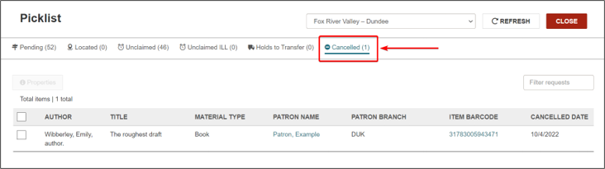
CCS Updates
New for 7.3 - Cancel Held Holds
In 7.3, patrons and staff will be able to cancel Ready-for-Pickup holds
Picklist workform will have a new "Cancelled" tab to show staff which holds to pull

Slide 5
Damaged and Missing Item Reminders

Slide 6
Damaged and Missing Item Reminders
Items with missing parts (like an audiobook)​
Please don't send on intra-CCS ILL for a hold​
Please don't trap and check out item if you see it's missing a part​. Refer to: In-Transit Items Damaged and Missing Parts How-To page (https://www.ccslib.org/training/transit-items-damaged-and-missing-parts) ​
Missing Items​
Use "Missing" circulation status (do not check out to an in-house card)
The "Missing" circulation status will suppress item from PAC and make it ineligible to fill holds

Slide 7
SMS Text Receipt Option

Slide 8
SMS Text Receipt Option
Polaris can send a patron SMS text checkout receipt
Can enable by branch
If enabled for you, Polaris will send text receipt when a patron checks out at your location

Slide 9
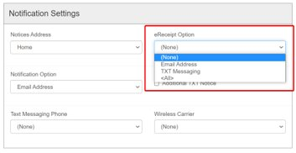
SMS Text Receipt Option
  In the patron's registration workform, staff have option to select:
    (None)
    Email Address
    TXT Messaging
    <All>
  Staff set up Text Messaging Phone and Wireless Carrier fields as well

Slide 10
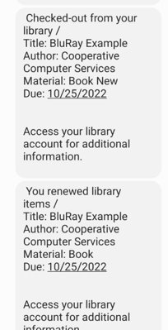
SMS Text Receipt Option
  Will send separate text for each item checked out or renewed​
  Will send fine receipt

Slide 11
SMS Text Receipt Option
Email help@ccslib.org if interested in enabling

Slide 12
Users with Multiple Library Cards:
Updated Draft

Slide 13
Users with Multiple Library Cards:
Updated Draft
  Background:
  Revisions to existing section in Circulation Manual
  Adds language to include dependents of separated parents
  RAILS confirmed no state statutes prohibit multiple libraries from issuing cards to a dependent if their parents live in different library service areas
  Circ/ILL Advisory Group voted to recommend draft changes at September meeting

Slide 14
2.xii Users with Multiple Library Cards
Staff should refer to Section 3050.70 Non-Resident Property Owner and Leasee of the Illinois Administrative Code.
Per this statute, an individual who owns or leases property that is taxed for library service in multiple library service areas may receive a card from each library. This may include the property owner or persons who rent (“lease”) the property, or dependents of separated parents who reside in different library service areas. According to the Illinois State Library, There is no prohibition in statute that would deny an individual paying taxes to two or more libraries from receiving a library card from each. Library card access for dependents of separated parents can be determined by local library policy.
Libraries may issue a separate card to a user with an existing account if that user owns or leases property within the library’s service area. Libraries may also issue a separate library card to a dependent of separated parents if the dependent has an existing account at a different library and such access follows local library policy. The patron will essentially have two or more home library cards and accounts in the database. Libraries should adhere to local policy for issuing cards (example: local policy may state that non-resident taxpayers may be issued one card per household).

Slide 15
Reporting System Down Issues

Slide 16
Reporting System Down Issues
  For system performance or system down issues, call the CCS main line at 847-483-8600
  Especially important to call during evenings and weekends! CCS has staff on-call during non-business hours

