Slide 1

Measuring Your Collection:
How to get started with Collection Diversity Audits
Carly Thompson, Librarian: Palatine Public Library District
Betsy Mahoney, Assistant Director: Six Mile Regional Library District
Violet Jaffe, Collection Services Manager: Palatine Public Library District

Slide 2

Planning
Who is your Team?
What will you measure?
How long will this take?
What tool will you use?
Why are you doing this?

Slide 3

Nitty Gritty
Spreadsheet vs. Form
How to find info about the book and author
Tallying results
Sharing your results

Slide 4
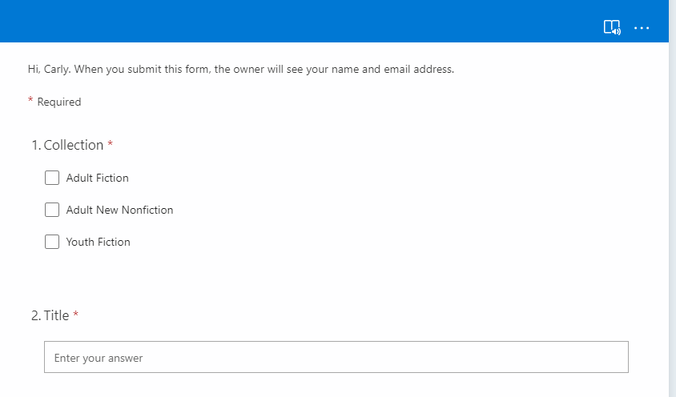
Audit Form

Slide 5
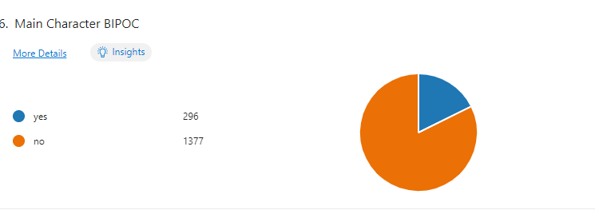
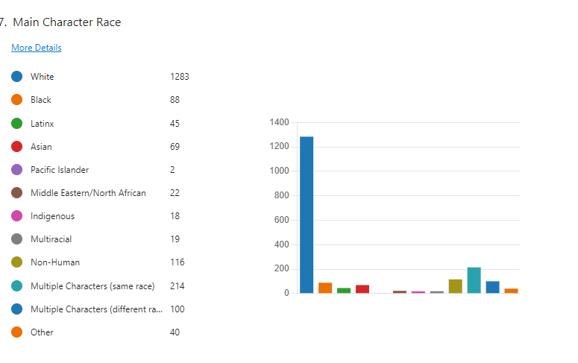
Results

Slide 6
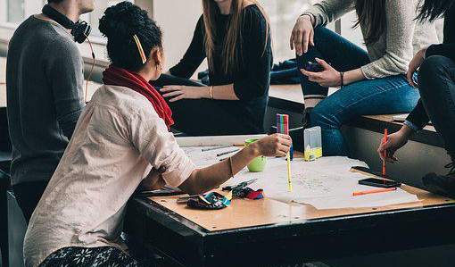
Next Steps
Establish goals for your future collection
Evaluate the method and metrics you used for the collection audit
Audit the materials your library is purchasing

Slide 7

Purchase Audits
Which areas/collections you will audit?
    It does not have to be everything!
Create the auditing tool
    Don't reinvent the wheel – use what you created for the collection audit

Slide 8
Purchase Audit Form & Results
Character/Subject | Purchased Materials 2020-21 | Purchased Materials 2021-22 | 62040 Census demographics
African American/Black | 10.6% | 13.2% | 11.9%
Asian | 4.1% | 8.1% | .2%
Biracial | 1.4% | 1.3% | 3%
Latinx | 3.4% | 7.1% | 8.3%
Middle Eastern/North African | 1.3% | 1.6% | (not collected)
Native American/Indigenous | 1.3% | 1.8% | .2%
Native Hawaiian/Pacific Islander | (not collected) | .2% | 0%
White | 52.2% | 58.4% | 78%
SMRLD Audit Form

Slide 9
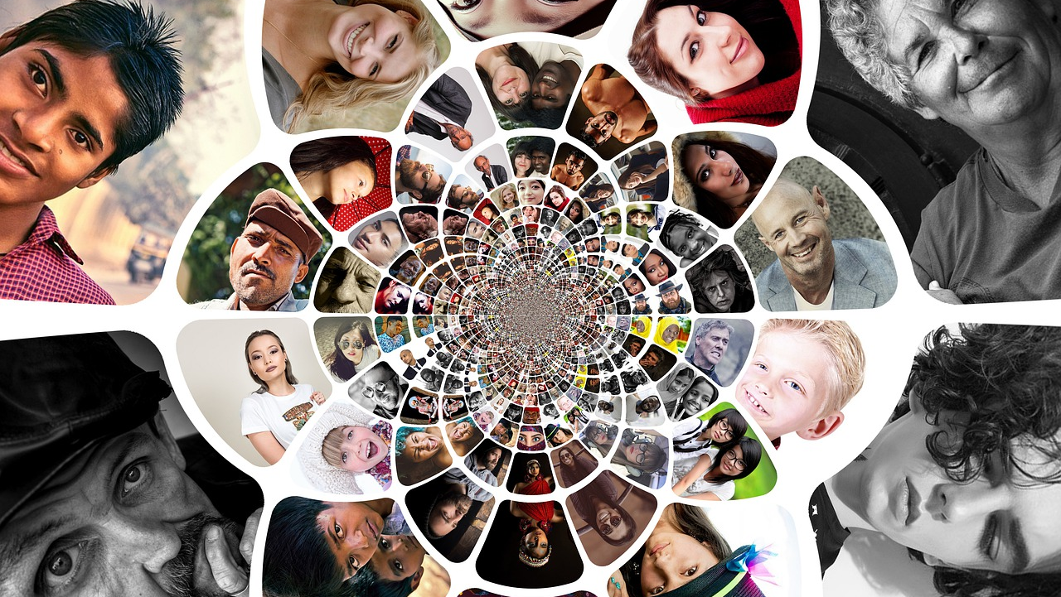
Notes:
Violet's slide

Slide 10
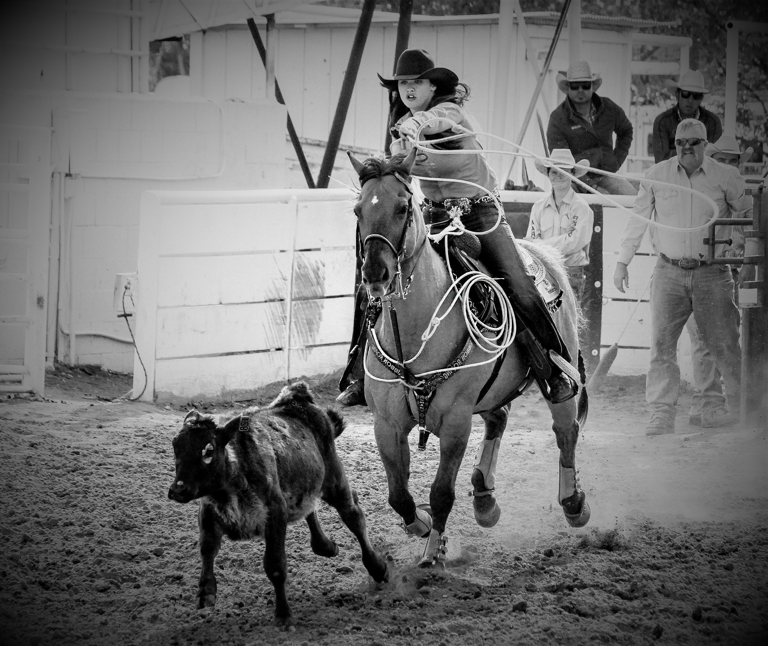
Wrangling Selectors
Clarify the "why"
Set reasonable, measurable goals
Schedule updates
Put everything in writing
Check in often
Expect lots of questions!

Slide 11
Diversity Goals and Instructions for Selection
When ordering items, check if they meet any of our criteria for diversity and add the abbreviation for the appropriate terms in the notes field. Please add each term that applies. Selectors will ensure 25% of newly ordered titles (individual titles, not all copies) will fulfill one or more of our defined points of diversity for the following collections in regular and large type print as well as audiobook/Playaway.

Slide 12

Define Your Collections
Fiction (all ages, all genres)
Youth Picture Book
Youth Easy Reader
Biography for all age groups
Nonfiction (all ages) for the following Deweys:
100s
200s
300s
600s
700s
800s
900s

Slide 13
Terms with abbreviations to use in order notes
IS - Intersectional subject
OV - Own voices
BS - BIPOC subject
BA - BIPOC author
LS - LGBTQIA+ subject
LA - LGBTQIA+ author
NS - Neurodiverse subject
NA - Neurodiverse author
DS - Disability subject
DA - Disability author

Slide 14
Guide for using the terms
Intersectional subject - Gender, sexuality, race, disability, religion, or social class overlap in the content. At least 2 of the topics must be included. Example: Black lesbian main character
Own Voices - Author from a marginalized or under-represented group writing about their own experiences/from their own perspective, rather than someone from an outside perspective writing as a character from an underrepresented group
BIPOC subject - Main character is Black, Indigenous, or a Person of Color.
BIPOC author - Author is Black, Indigenous, or a Person of Color
LGBTQIA+ subject - Main character lesbian, gay, bisexual, transgender, queer or questioning, intersex, or asexual
LGBTQIA+ author - Author self-identifies as lesbian, gay, bisexual, transgender, queer or questioning, intersex, or asexual
Neurodiverse subject - Main character has ADHD, Autism, Dyspraxia, Dyslexia, or Tourette Syndrome
Neurodiverse author - Author self-identifies as having ADHD, Autism, Dyspraxia, Dyslexia, or Tourette Syndrome
Disability subject - Main character has physical or mental disabilities. Must be a significance part of the character. Example: a main character has bipolar disorder
Disability author - The author has physical or mental disabilities

Slide 15

Notes:
Communicate: Tell all stakeholders, director, board. Ask to present about it to your board. Consider a press release. Make sure you keep talking about it.

Slide 16
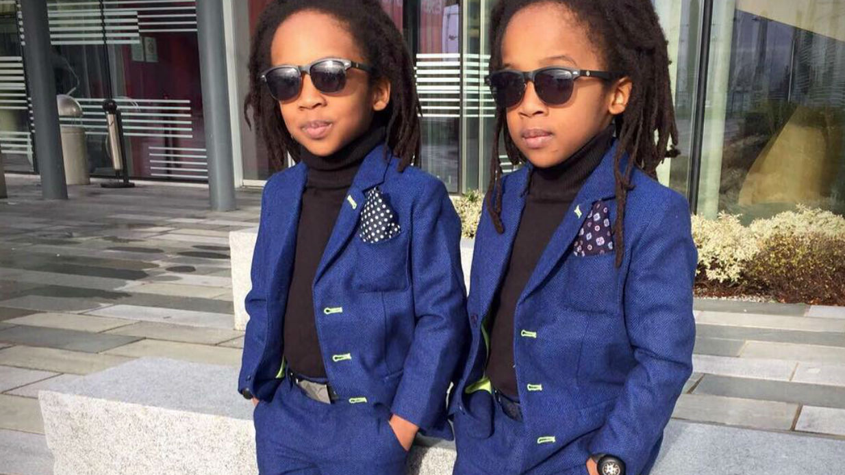
Replicate

Slide 17
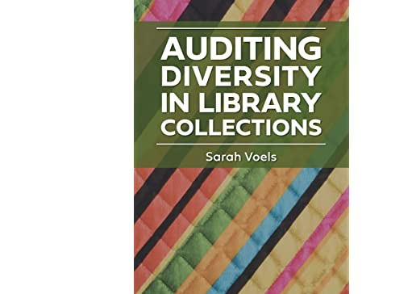
Before getting started…

Slide 18

Can We Talk?

Slide 19
Contact Us!
Carly Thompson, Librarian: Palatine Public Library District
cthompson@palatinelibrary.org
Betsy Mahoney, Assistant Director: Six Mile Regional Library District
betsymahoney@smrld.org
Violet Jaffe, Collection Services Manager: Palatine Public Library District
vjaffe@palatinelibrary.org

