Slide 1
Removing Bias in Cataloging

Slide 2













What is the problem?

Slide 3
Why does it matter?
Not accurate
Portrays history as only the story of those in power
“Others” certain groups, stories, and events
By correcting this issue:
  All can feel included and represented in the collection
  Different perspectives and stories help all readers understand experiences outside their own
  Recognize shared history can hopefully build the community together
  Circulation of diverse topics and materials will likely improve

Slide 4
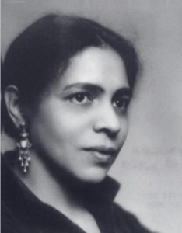

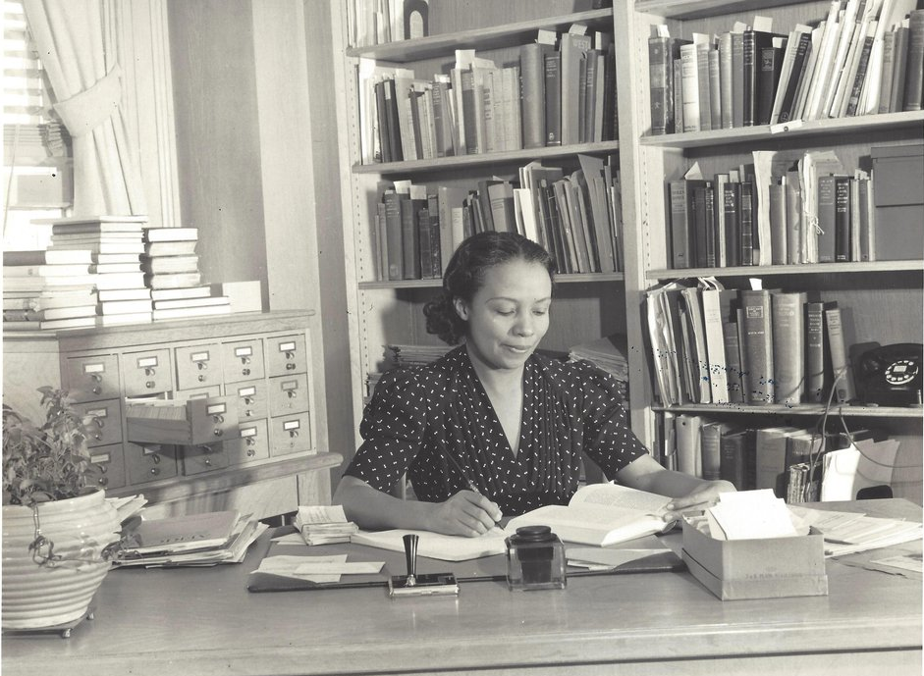
Precedents for Change
  Nella Larsen, NYPL librarian at Schomburg Center
  Dorothy Porter, Howard University librarian
  Jess deCourcy Hinds and her Bard High School Early College, Queens Campus students

Slide 5
The Audit
Start with digital audit
  I ran a shelf list for the entire 300s collection
  Build a spreadsheet to sort items for review and to track decisions
    If I was debating any item for more than a few minutes based on the info available in this phase, it was put in the review category
Pull the items you are considering moving
    Working with the physical books gives a lot more context to make your decision
    Weed as you go to remove outdated or offensive titles and ease workload

Slide 6
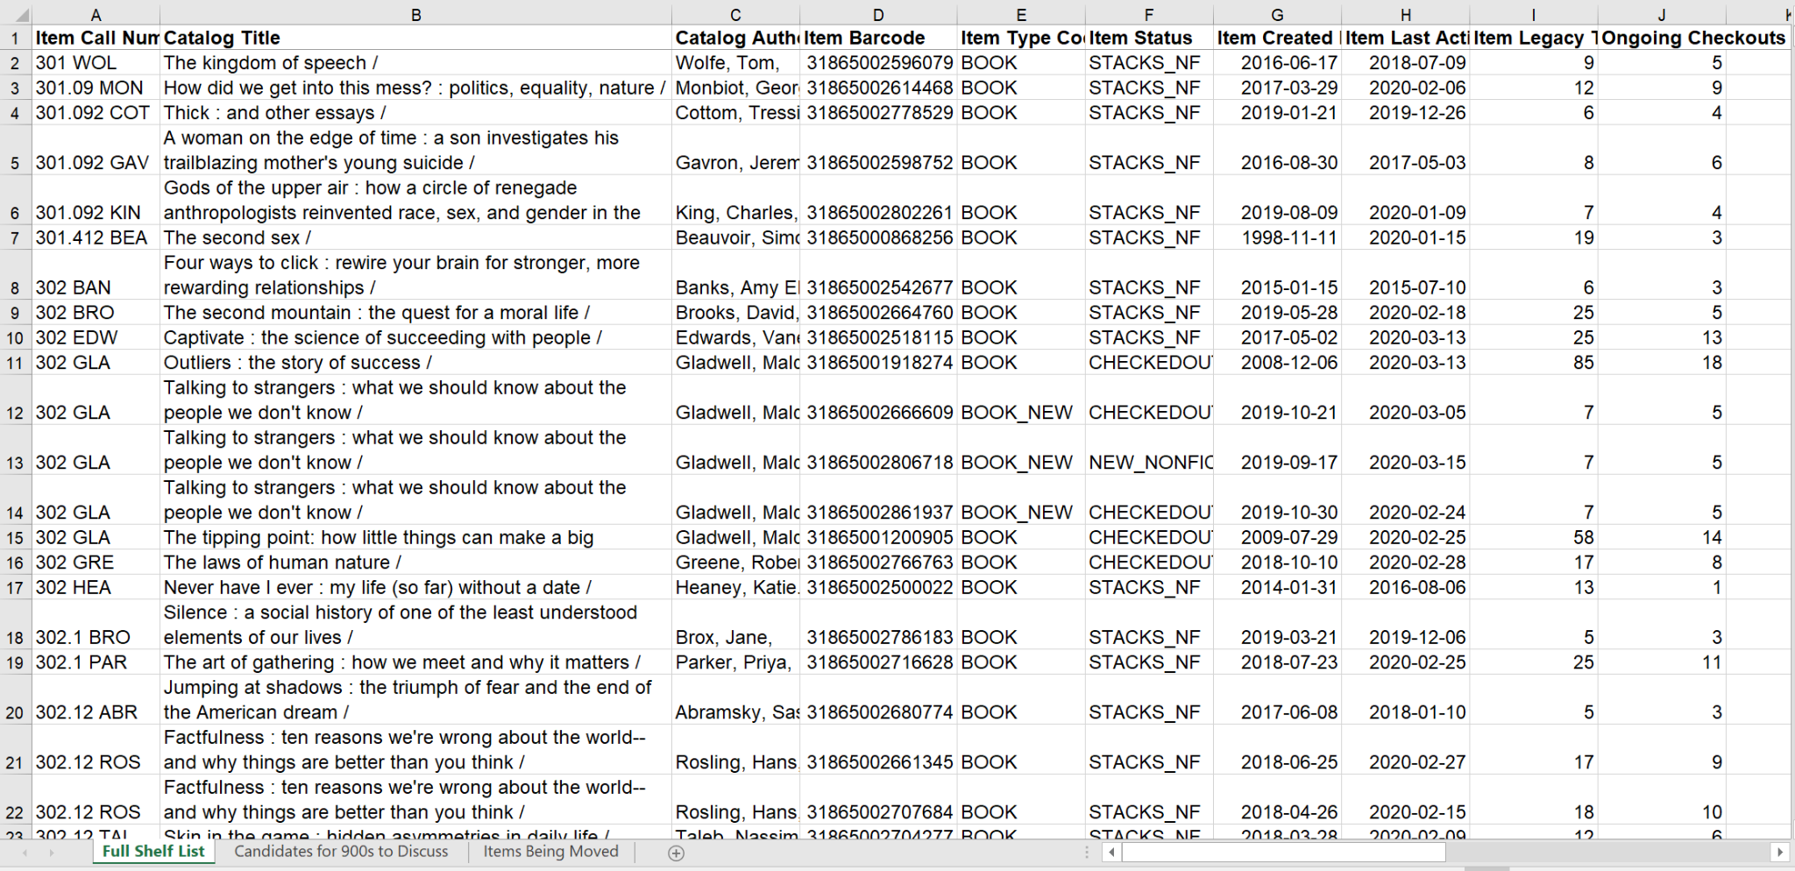
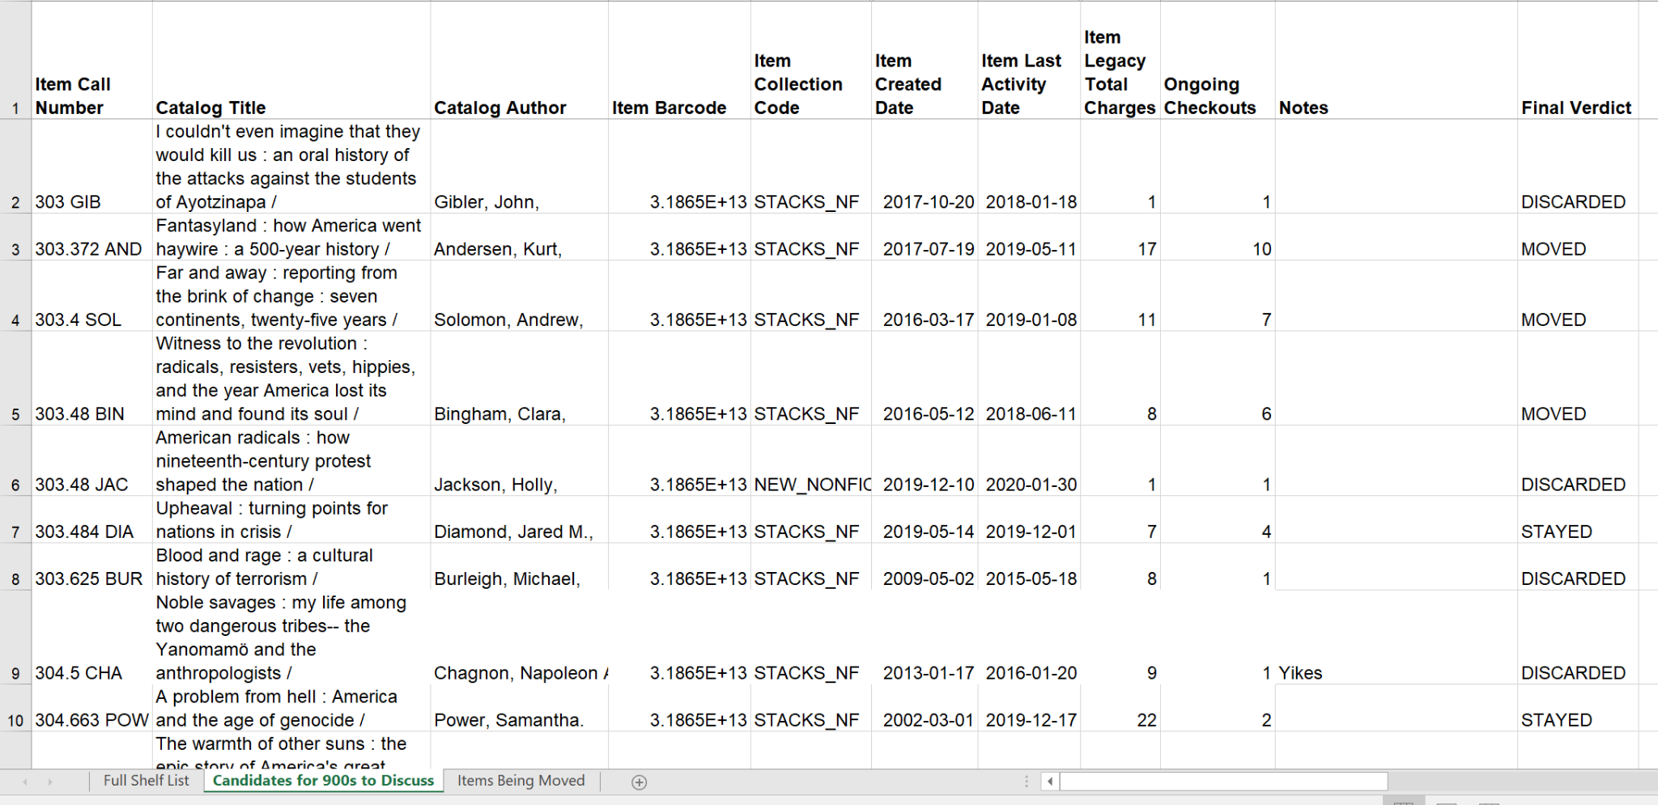
Sample Audit Spreadsheet

Slide 7
Ready To Move
Unlike phase one (digital audit), no need to move through entire phase two before moving onto phase three
  You already have the books pulled, no need to move items back and forth for continuous sorting
  As I went through each cart, I sorted books into Discard, Move, and Keep piles
    Also notated the decision for each item in spreadsheet
Assign new call numbers to items being moved
  Examples and explanations of my system on next slide for some tips
  Created new call numbers for each book within the 900s numbers of the Dewey Decimal System
    Noticed trends as I moved through the process, did not try to create a new system before starting or the entire project would have stalled
Will need to keep an eye on 900s spacing, might need to weed or shift there

Slide 8
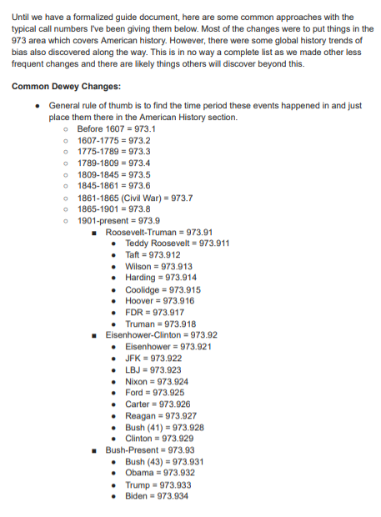
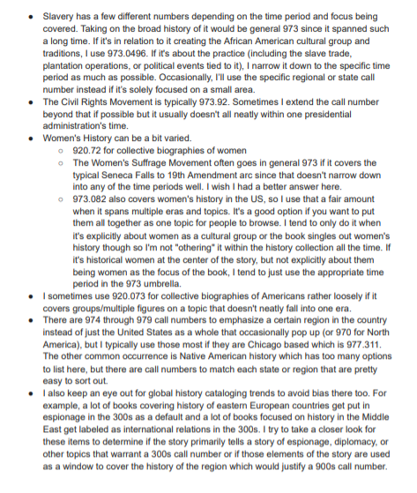
New 900s Practices and Notes

Slide 9
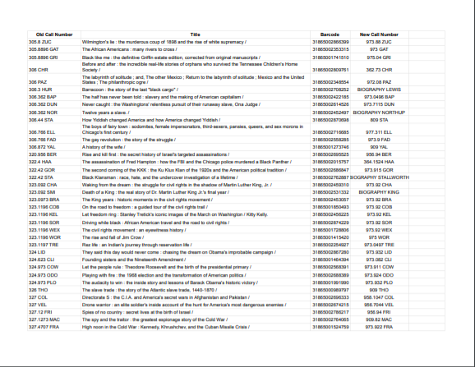
Items Moved Sample

Slide 10
Final Thoughts
No system is perfect, but as information professionals we should always strive to improve systems as best we can.
While you might need management approval, you don’t need to wait for the Dewey Decimal System to officially change to change your cataloging. Adapt the rules and methods to best suit your library going forward.
Changes have already been made as technology and trends evolved.
This was done at a small library, mostly by one person with some assistance to speed up relabelling, discarding, etc. You do not need a massive team to do this.
Build on my project as much as possible.
Good luck!

Slide 11
Questions?
Meghan O’Keefe
meghan.okeefe@aapld.org
847-458-3165

