Slide 1
What Can the Cataloging Maintenance Center (CMC) Do for CCS?
Dr. Pamela Thomas, CMC/IHLS
November 16, 2023
9:30 a.m.
Notes:
Good morning! I am going to talk about the free cataloging services that the CMC provides to all libraries in Illinois.

Slide 2
agenda
INTRODUCTION
CRITERIA AND GUIDELINES
CMC TEAM & CONTACT INFORMATION
SUMMARY
Notes:
Here is today’s agenda. I will provide a brief introduction about the CMC, criteria and guidelines, introduce you to the CMC team along with contact information, and then provide a brief summary. I will also take questions at the end of the presentation.

Slide 3
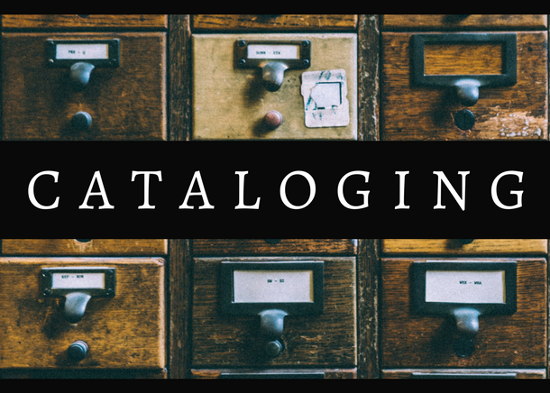
introduction
CMC, circa 2001
State-funded
CMC mission
Free cataloging to all Illinois libraries
This Photo by Unknown Author is licensed under CC BY-SA-NC
Notes:
The CMC has been in existence since 2001. It is funded through the state library. The mission of the Cataloging Maintenance Center (CMC) is to provide cataloging support to Illinois library system members, which means that the CMC offers free cataloging services to all libraries in Illinois, even standalone libraries.

Slide 4
criteria
Libraries must be a library system member
Local authors, genealogy, history, or special collections
  Most modern world languages
  Braille
Training
Database cleanup
Notes:
The requesting library must be a library system member (many standalone libraries are for resource sharing purposes): Illinois Heartland Library System (IHLS), Reaching Across Illinois Library System (RAILS), or Chicago Public Library (CPL) System. Eligible collections for original or copy cataloging include local authors, genealogy, local history, and special collections (as defined by your library; for example: community cookbooks, government documents, world languages, etc.). Eligible collections of material in most modern world languages can be accommodated. We can also catalog braille materials. (I realize that braille is not a language.) Local publishers are not eligible for free cataloging. The CMC provides training using Moodle on the SHARE training website. We currently offer courses on Cataloging 3D Objects, Kits, and Realia; Subject Analysis; Cataloging Basics; RDA Book Training; and RDA Video and Audio Recordings Training. We also present monthly webinars, Online with the CMC, from August-May; this fiscal year, we are covering topics from book repair to digitizing photos. Is your database full of minimal records or missing OCLC numbers? Then, the CMC staff can help. Please email the CMC, cmc@illinoisheartland.org to discuss your database cleanup project. The CMC has enhanced or identified bibliographic record merges in more than 17,000 records for the PrairieCat cleanup project. I will discuss the Consortia of Academic and Research Libraries in Illinois (CARLI) cleanup project in a few minutes.

Slide 5
guidelines
Determine eligibility, cmc@illinoisheartland.org
ILDS
Property stamp your items!
Library classification?
Site visits
Turnaround time
Create original records
No item/holding records
Local author information
Create name authority records
Notes:
You can contact the CMC to determine if your item or items are eligible for free cataloging. When sending items through delivery, please provide contact information and make sure your items are identified/property stamped for your location. Ship all items marked with the current ILDS label. What library classification would you like added to the OCLC record? Put that in the notes section on the ILDS label. You can send one item or as many items that will fit in a box. The box should not weigh more than 40 pounds. In some circumstances, CMC staff may be able to visit your library to complete the cataloging. Travel by CMC staff will be on a limited basis, depending on several factors (i.e., availability of staff, distance, size of the collection to be cataloged, condition of the collection, etc.). Wi-Fi capability is required. Items will be cataloged in the order they are received with turnaround time varying depending on the scope of the project and other factors. Most items will be returned within 30 days (current turnaround time is 2 weeks). However, if you have an item that needs to be cataloged quickly, just add Rush to the Notes section on the ILDS label and we will catalog your item right away. CMC staff will create an original bibliographic record in OCLC or will supply an existing OCLC record. An export file of bibliographic records will be sent to your library to import into your local catalog/database in a .dat format. CMC staff will not create item or holding records for individual copies. When sending items written by local authors, please provide information about the author's relationship to the state of Illinois (current or previous resident of Illinois, works or worked in Illinois, etc.) and any other pertinent information, since the majority of the CMC staff can create name authority records in OCLC, and any and all information is helpful.

Slide 6
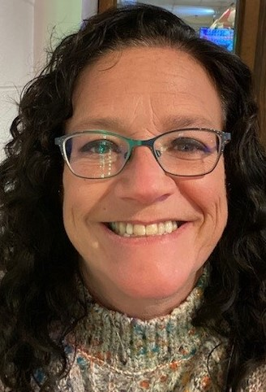
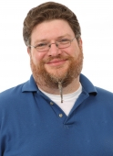
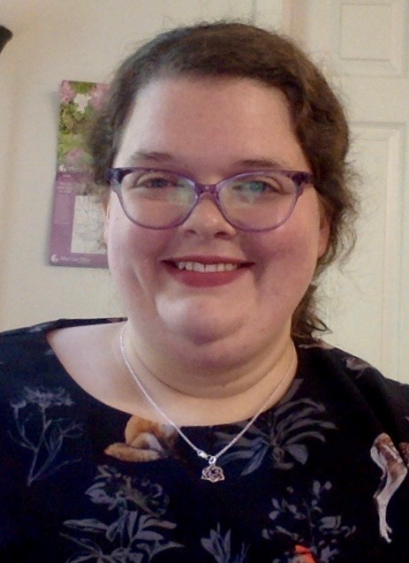
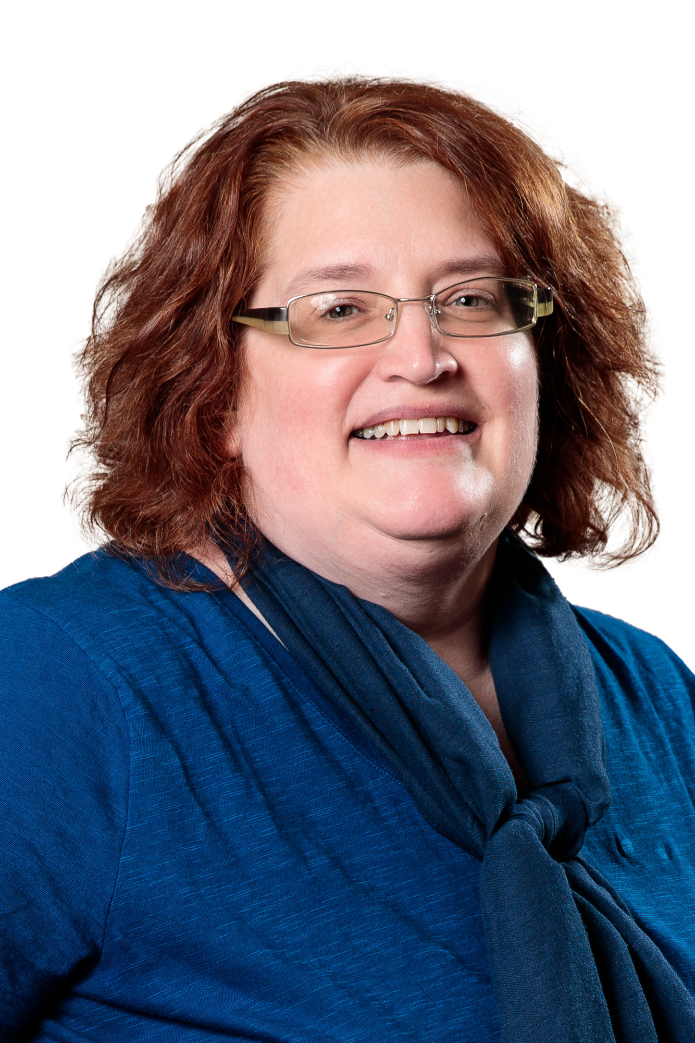
meet our team
Barb scoby
Eric mckinney
Mary cornell
Dr. pamela thomas
cataloger
cataloger
cataloger
bibliographic grant manager
Notes:
We just finished interviewing for a metadata cataloger, who will start in early December.

Slide 7
contact information
Barbera (Barb) Scoby, bscoby@illinoisheartland.org
Eric McKinney, emckinney@illinoisheartland.org
Mary Cornell, mcornell@illinoisheartland.org
Dr. Pamela Thomas, pthomas@Illinoisheartland.org
Notes:
Here is the contact information for all of us.

Slide 8
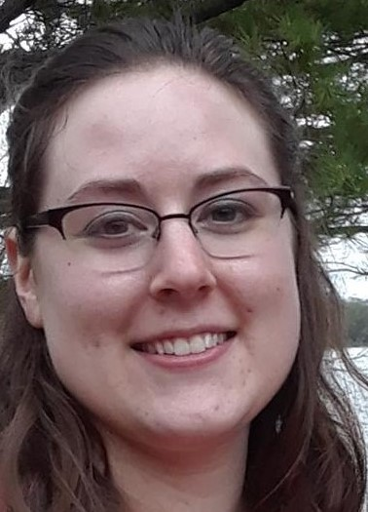
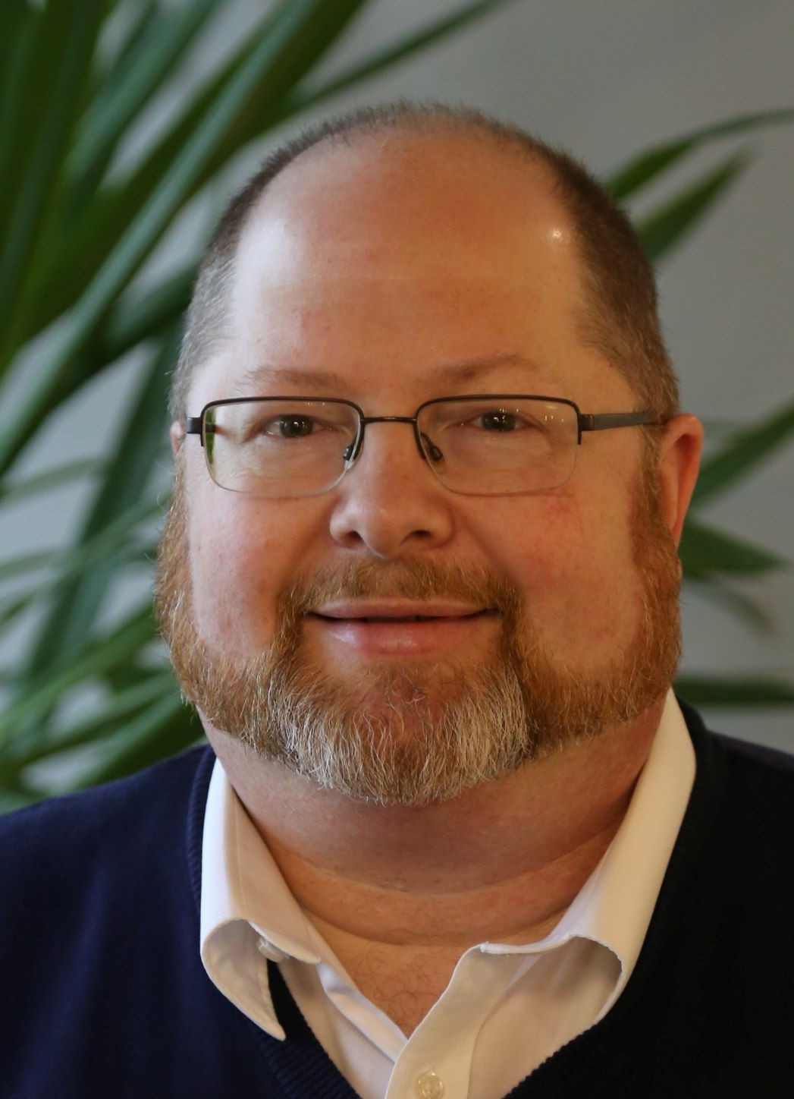
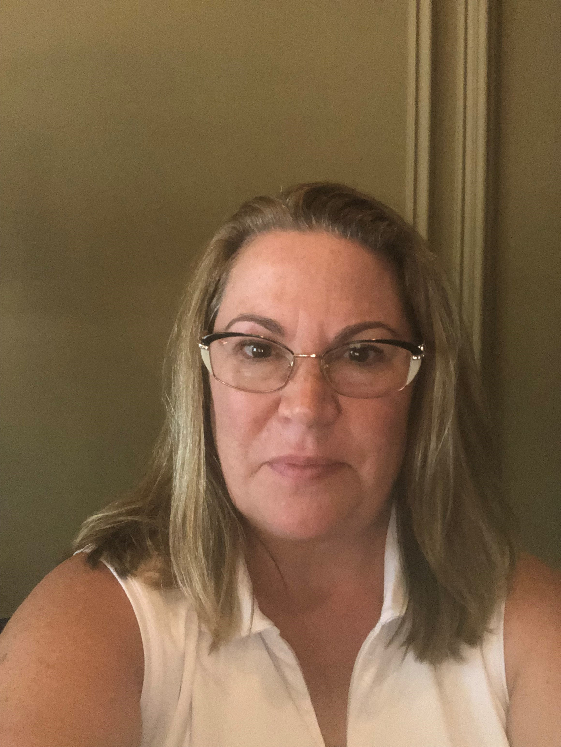
meet our extended team
Katie roberts
Blake walter
Bonnie dauer
special project cataloger
special project cataloger
special project cataloger
Notes:
Katie, Blake, and Bonnie are our full-time, temporary, special project catalogers, working on the Alma cleanup project. In September 2021, the CMC hired three temporary, full-time catalogers to merge, edit, update, and/or delete duplicate records in the Consortium of Academic and Research Libraries in Illinois (CARLI) database. To date, 25,862 bibliographic records have been edited; 2,951,376 records have been deleted, and 174,269 records have been merged. We finished interviews for a new special project cataloger (replacing Bonnie), who will start later this month.

Slide 9
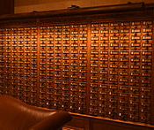
summary
If an item fits the criteria (local author, local history, local genealogy, or special collection), then the CMC will catalog your items for free!
This Photo by Unknown Author is licensed under CC BY-SA

Slide 10
thank you
Dr. Pamela Thomas
pthomas@illinoisheartland.org
cmc@illinoisheartland.org
https://www.illinoisheartland.org/cmc
Notes:
Thank you! Here is my contact information, the CMC email, and our website.

Slide 11
Questions?
Notes:
Any questions?

