Slide 1

Des Plaines Public Library
20,000 picture books, 5,000 discards,
90 shelving bins, 40 crates, 5 teams,
and a partridge in a pear tree
As experienced by Stephanie Spetter, Head of Youth Services

Slide 2
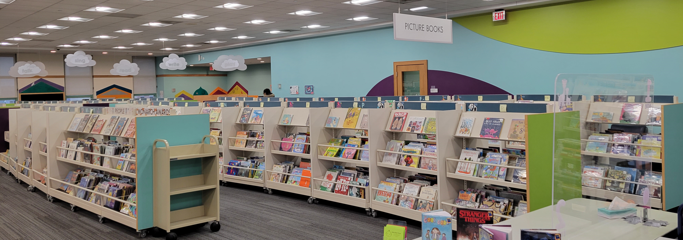
WHAT THE DPPL PICTURE BOOK COLLECTION LOOKS LIKE TODAY

Slide 3
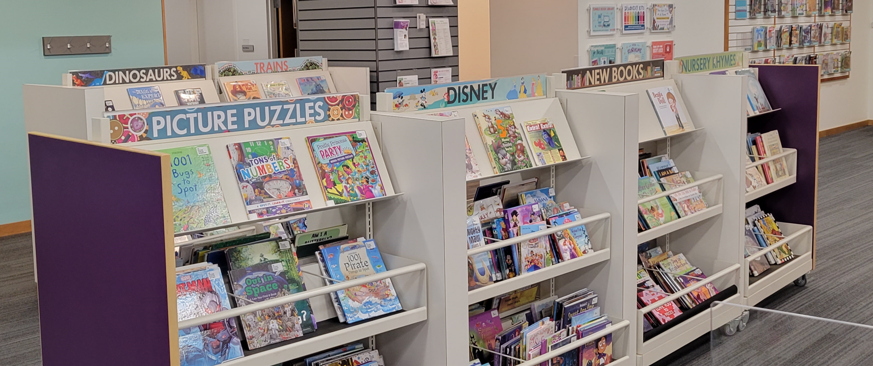
Currently at 17 Boutique Bins, hoping for 1 more in 2023

Slide 4
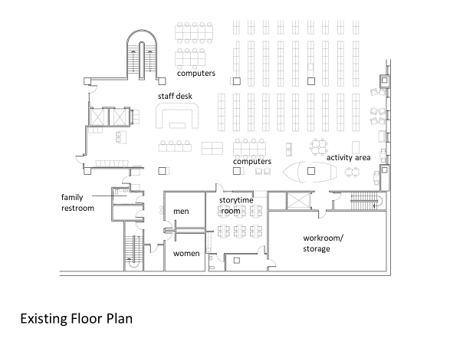

Slide 5
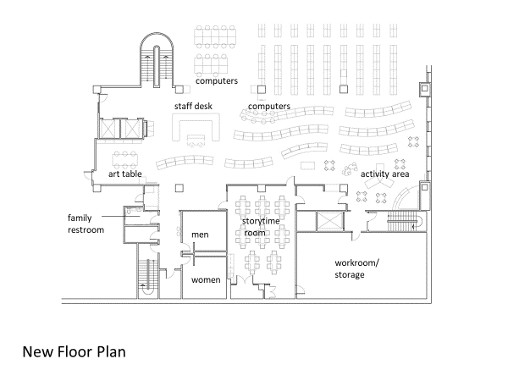

Slide 6
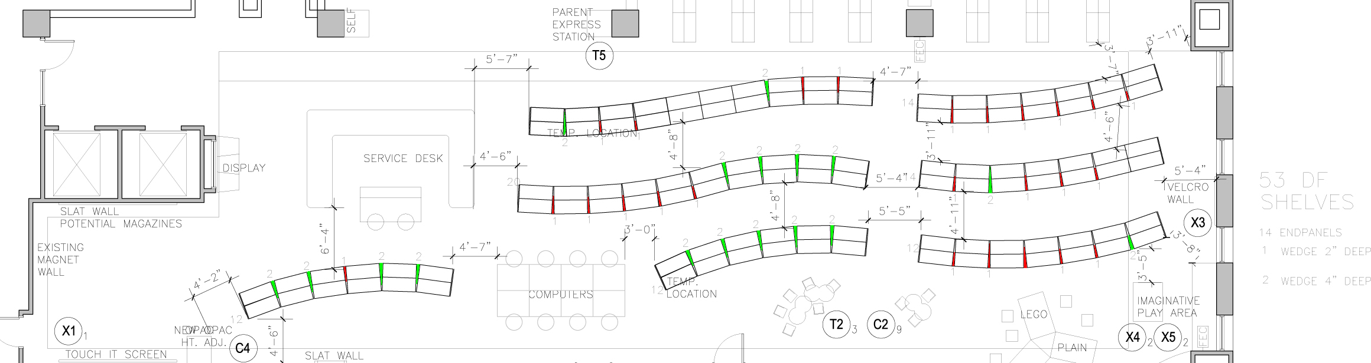

Slide 7
IMPORTANT ISSUES TO CONSIDER
BUY-IN.
  We could not make a move without Cataloging, Circulation, and Technical Services on board. Arranged meetings with all stakeholders individually, then as a group.
LEAD TIME
  It took us almost three years to thoughtfully and carefully bring the collection to a place where it was manageable for the project and so there would be no re-classification of the items we would not keep.
PROCESSING
  Spine labels on forward-facing materials – not a good fit
  Re-cataloging by location
MONEY. It's not cheap.
  We used a combination of community grant funds, partnership/donated funds, and library dollars.

Slide 8
Subject considerations for "BOUTIQUE BINS"
Number of bins available (spatially) for planned location
Discussion among YS team members
Most-requested themes
Space for highlighting NEW Picture Books
We started with 12 Boutique Bins:
  NEW, Disney, Superheroes, Trains, Royalty, Dinosaurs, Mother Goose/Nursery Rhymes, ABC's, 123's, Concepts (shapes and colors), Pop-ups, PB with Audio.
  Then added Monarch, Water Travel, Air Travel, Cars & Trucks, and most recently: People and Picture Puzzles.
  Removed Pop-ups.

Slide 9
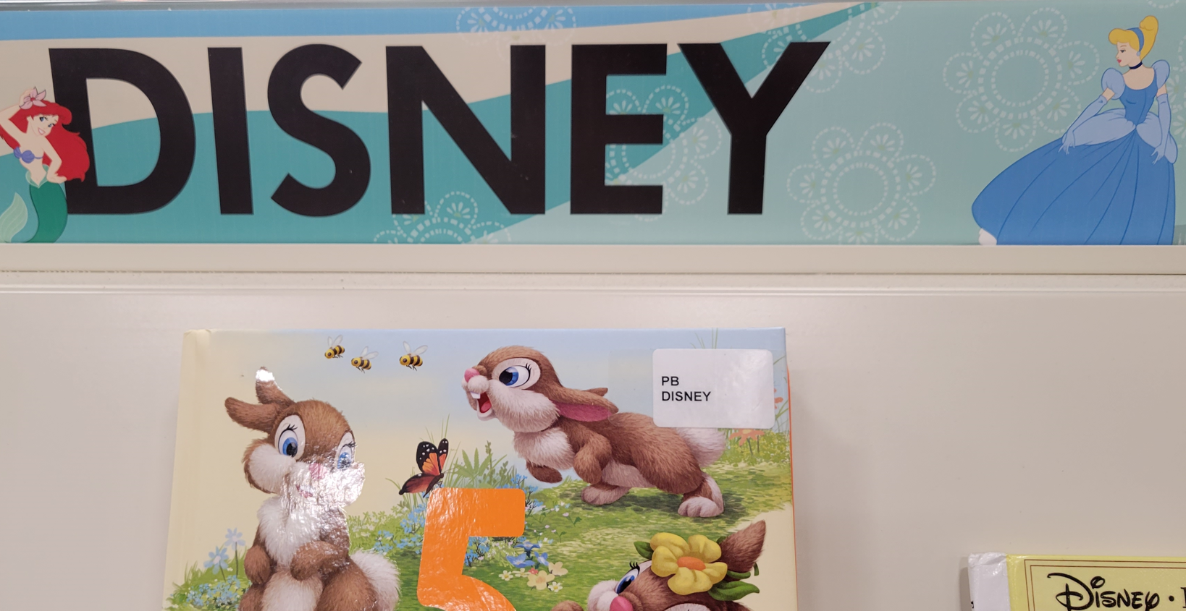


Slide 10
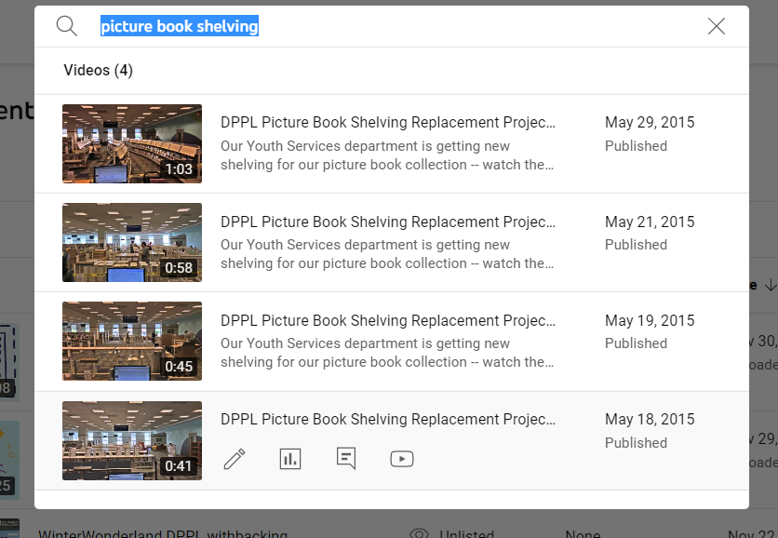
YouTube time-lapse videos documented the process

Slide 11
PICTURE BOOK HOLDINGS 2010-2017
holdings​ | ​ | ​ | ​ | ​ | ​ | ​ | ​
2010​ | 2011​ | 2012​ | 2013​ | 2014​ | 2015​ | 2016​ | 2017​
0​ | 0​ | 0​ | 0​ | 0​ | 0​ | 180 ​ | 194 ​
0​ | 0​ | 0​ | 0​ | 0​ | 0​ | 153 ​ | 173 ​
0​ | 0​ | 0​ | 0​ | 0​ | 0​ | 120 ​ | 149 ​
0​ | 0​ | 0​ | 0​ | 0​ | 0​ | 183 ​ | 229 ​
0​ | 0​ | 0​ | 0​ | 0​ | 0​ | 298 ​ | 473 ​
0​ | 0​ | 0​ | 0​ | 0​ | 0​ | 103 ​ | 123 ​
0​ | 0​ | 0​ | 0​ | 0​ | 0​ | 61 ​ | 105 ​
0​ | 0​ | 0​ | 0​ | 0​ | 0​ | 182 ​ | 219 ​
0​ | 0​ | 0​ | 0​ | 0​ | 0​ | 105 ​ | 180 ​
0​ | 0​ | 0​ | 0​ | 0​ | 0​ | 171 ​ | 214 ​
0​ | 0​ | 0​ | 0​ | 0​ | 0​ | 154 ​ | 219 ​
16,416 ​ | 18,301 ​ | 19,525 ​ | 20,012 ​ | 18,861 ​ | 17,751 ​ | 15,900 ​ | 14,395 ​
​ | ​ | ​ | ​ | ​ | ​ | ​ | ​
16,416 ​ | 18,301 ​ | 19,525 ​ | 20,012 ​ | 18,861 ​ | 17,751 ​ | 17,610 ​ | 16,673 ​

Slide 12
PICTURE BOOK CIRCULATION 2016-2017
 |  | 2010 | 2011 | 2012 | 2013 | 2014 | 2015 | 2016 | 2017
JPB123 | J Picture Book - 123 | 0 | 0 | 0 | 0 | 0 | 0 | 883 | 1,089
JPBABC | J Picture Book - ABC | 0 | 0 | 0 | 0 | 0 | 0 | 994 | 1,020
JPBCONCEPT | J Picture Book - Concepts | 0 | 0 | 0 | 0 | 0 | 0 | 884 | 1,081
JPBDINOS | J Picture Book - Dinosaurs | 0 | 0 | 0 | 0 | 0 | 0 | 1,664 | 2,273
JPBDISNEY | J Picture Book - Disney | 0 | 0 | 0 | 0 | 0 | 0 | 4,063 | 5,818
JPBNURSERY | J Picture Book - Nursery | 0 | 0 | 0 | 0 | 0 | 0 | 504 | 550
JPBPOPUP | J Picture Book - Pop Up | 0 | 0 | 0 | 0 | 0 | 0 | 878 | 1,330
JPBROYALTY | J Picture Book - Royalty | 0 | 0 | 0 | 0 | 0 | 0 | 1,137 | 1,033
JPBSUPER | J Picture Book - Superheroes | 0 | 0 | 0 | 0 | 0 | 0 | 1,364 | 2,210
JPBTRAINS | J Picture Book - Trains | 0 | 0 | 0 | 0 | 0 | 0 | 1,740 | 2,435
JPBWITHCD | J Picture Book - with CD | 0 | 0 | 0 | 0 | 0 | 0 | 1,086 | 1,449
72 | J Picture Book | 61,011 | 64,533 | 67,548 | 62,160 | 57,339 | 67,331 | 70,257 | 70,422
 |  |  |  |  |  |  |  | 85,454 | 90,710

Slide 13
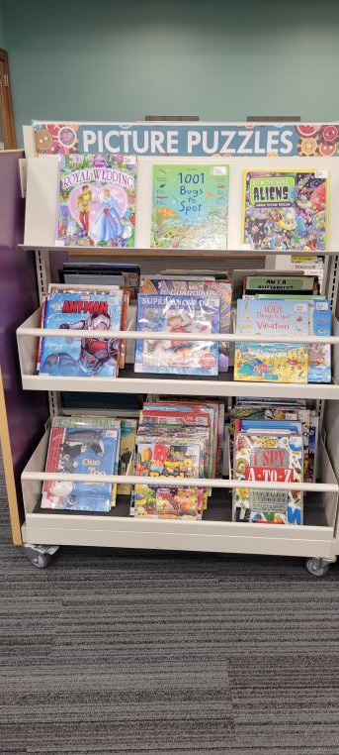
COSTS CIRCA 2015-2016
(LFI) Bin shelving project: bins, wedges, end panels, remove and dispose of existing shelving, installation of new shelving
$90,606
(Product Architecture) Architect fees:
$10,023
(Rent-A-Crate) Storage of PB collection during demo/installation:
40 crates for 2 weeks
$1,846.00

Slide 14
Since 2016...
The bins were so popular and so good for circ that we shifted the entire PB collection and converted to Boutique Bins at the front of the alpha-org collection.
Moved Concepts (shapes/colors), ABC's, and 123's to those first three bins.
Moved Pop-up books collection to furniture in Play corner and converted to Picture Puzzle bin.
Rearranged configuration of original Boutique Bin area when Fire Marshall said it was blocking access to restroom hallway
Leftover shelving: hoping for additional bin coming in 2023 (fingers crossed).
Generally, 1 year with no circ in the bins = weed

Slide 15
MANY THANKS TO ORIGINAL TEAM AND SUCCESSORS
Courtney O'Keefe Schroeder, Preschool Liaison Librarian
Susan Farid, Head of Circulation
Virginia Holler, Circulation Manager
Michelle Meyer-Edley, Technical Services Manager
John Lavalie, Cataloging and Metadata Specialist
The exceptional teams of DPPL Pages, Clerks, and Materials Processors
Steph Wolferman, Preschool Liaison Librarian
Cheryl Gladfelter, Preschool Liaison Librarian
Lynne Rubio, Manager of Acquisitions & Cataloging
Laurie Papadourakis, Circulation Manager
Fernando Martin, Page Supervisor
Dana Jenkins, Materials Services Manager

Slide 16


Slide 17
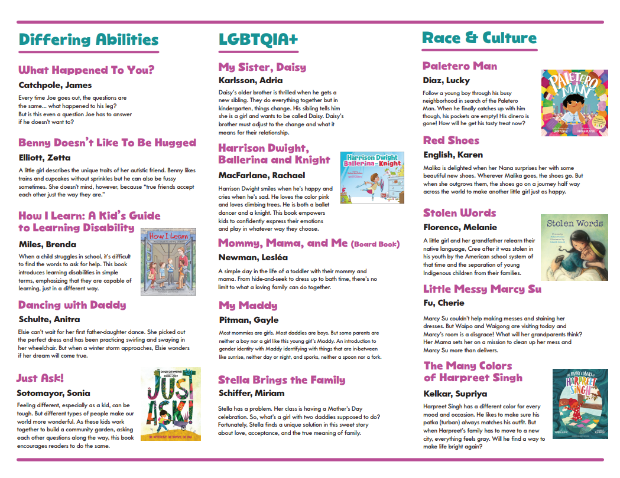

Slide 18


