Slide 1
CCS Circulation Technical Group Meeting
January 13, 2023

Slide 2
Web Report Updates

Slide 3
Web Report Updates
Monthly Patrons Expiration Date Next Month
Starting Feb 1, will include a tab for patrons who expire in two months
Example: Feb 1 report will have one tab of patrons who expire in March and a second tab of patrons who expire in April

Slide 4
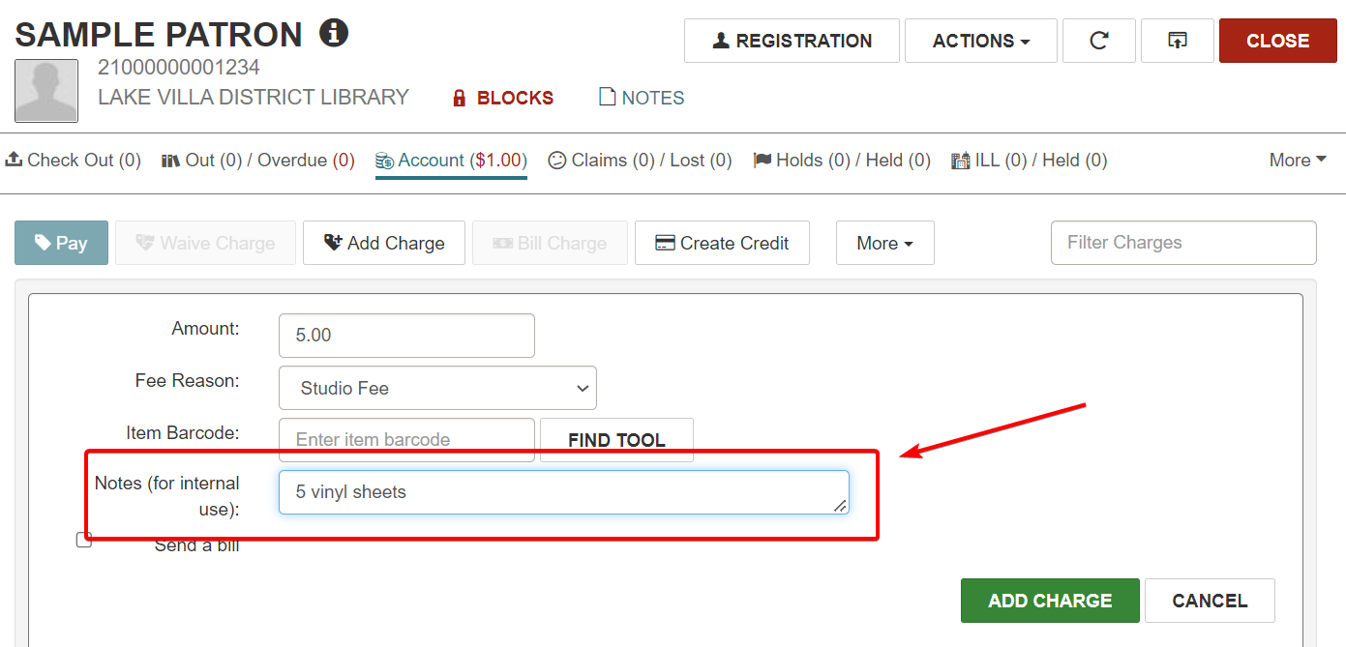
Web Report Updates
Daily/Monthly Detail Payment Reports
Now includes Charge transaction notes

Slide 5
Web Report Updates
Daily/Monthly Detail Payment Reports
Now includes Charge transaction notes

Slide 6
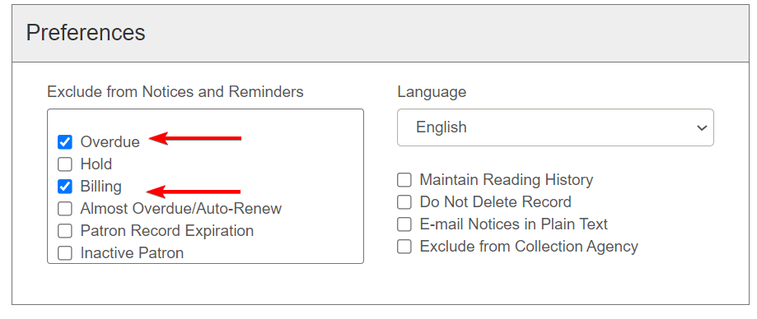
Web Report Updates
Patrons Opted Out of Overdues or Bills
Weekly report lists patrons who are excluded from receiving Overdue or Billing notices
Items checked out to excluded patrons will never progress to Lost
To clean up records, de-select checkboxes next to "Overdue" and/or "Billing"

Slide 7
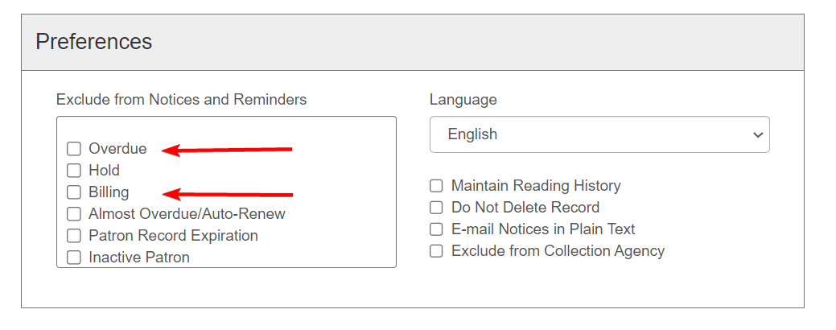
Web Report Updates
Patrons Opted Out of Overdues or Bills
Weekly report lists patrons who are excluded from receiving Overdue or Billing notices
Items checked out to excluded patrons will never progress to Lost
To clean up records, de-select checkboxes next to "Overdue" and/or "Billing"

Slide 8
Circulation Department Distribution Lists

Slide 9
Circulation Department Distribution Lists
What are department distribution lists?
Email address that distribute messages to selected staff at your library
More effective way to communicate/ask circulation-related questions with a library than emailing individual staff
Example: shelf checks, damaged items

Slide 10
Circulation Department Distribution Lists
Next Steps:
CCS will reach out to Library Circulation Contacts to gather email addresses for distribution list
CCS will create distribution lists
CCS will post distribution list information to website and send communication when they are ready to use
Going Forward:
Libraries will notify CCS if staff need to be added or removed from the list

