Slide 1
CCS Interlibrary Loan Technical Group Meeting
February 23, 2023

Slide 2
FY2023-2024 Meetings

Slide 3
FY2023-2024 Meetings
Time to start planning for next fiscal year!
Elections at May 18, 2023 meeting
Nominations needed for:
Vice-Chair/Chair Elect
Secretary
Reach out to me (mlanders@ccslib.org) if you have any questions about serving as an officer!

Slide 4
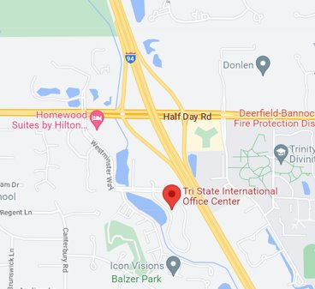
FY2023-2024 Meetings
Meeting Location
Mix of virtual and in-person meetings
August 2023 = virtual
February 2024 = virtual
May 2024 = in-person
New CCS office location:
200 Tri-State International
Lincolnshire, IL

Slide 5
ILLINET Web Report

Slide 6
ILLINET Web Report
ILLINET Survey Due March 31, 2023
Report on data from July 1, 2021 – June 30, 2022
Web Report, "ILLINET," will help you complete survey
Select "Display Archive"
Download report dated 7/1/2022

Slide 7
Column A (Line Number) and Column B (Line Description) correspond to ILLINET question number

Slide 8
Column C (Amount) gives the number to enter or add to the survey response for that question.

Slide 9
Column D (Notes) provides important information about survey question or amount
Instruct you to use OCLC data only
Instruct you to add Polaris data to OCLC data
Provides notes you can copy-and-paste into survey

Slide 10
ILLINET Web Report
Q: Why do numbers in ILLINET Web Report differ from other CCS Web Reports?
A: Most CCS Web Reports look at checkouts. Some questions on the ILLINET survey are looking for data on requests/supplies.
The ILLINET Web Report counts items sent or received via intra-CCS loan, regardless if they were checked out or not.

