Slide 1
CCS Circulation Technical Group Meeting
April 14, 2023

Slide 2
FY2023-2024 Meetings

Slide 3


FY 2023-2024 Meeting Locations
Finalizing dates for next year's meetings
Mix of virtual and in-person meetings
July 2023 : Virtual
October 2023 : In-Person
January 2024 : Virtual
April 2024 : In-Person

Slide 4
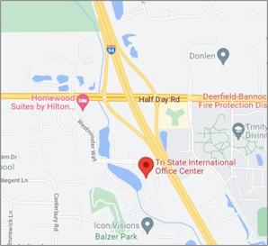

FY 2023-2024 Meeting Locations
New CCS Office Location:
200 Tri-State International
Lincolnshire, IL 60069

Slide 5
Patron Note Fields

Slide 6
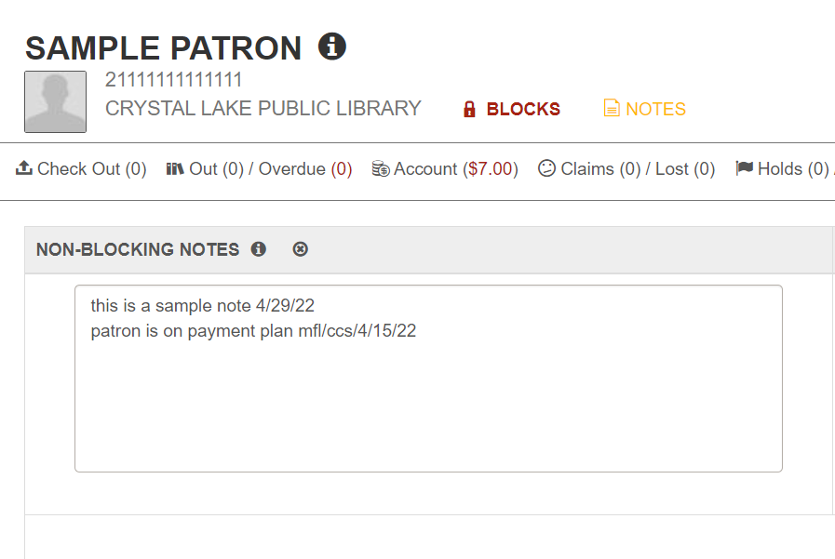
Patron Note Fields
Patron Note fields can support up to 4,000 characters

Slide 7

Patron Note Fields
What can staff do to keep the note fields clean?
Remove notes when resolved
Clean up old notes using Web Report, "Legacy Patron Notes"
Avoid formatting notes with lots of spaces or returns, like lists

Slide 8
Circulation Report Guidelines

Slide 9

Circulation Report Guidelines
Background:
Staff ask which reports they should use and how frequently
CCS does not have this information codified
CCS along with the Circulation/ILL Advisory Group developed report guidelines

