Slide 1
Circulation Technical Group
July 14, 2023

Slide 2
Polaris 7.4 Setting Changes (ACTION)

Slide 3
Canceling Holds in Held Status
Default: Patrons and staff are not able to cancel a Ready-for-Pickup hold. The held item must be checked in to be removed from the patron's record
New: Patrons and staff can cancel a Ready-for-Pickup hold. The hold will be added to a Picklist tab to be pulled.

Slide 4
Canceling Holds in Held Status
Proposed motion:
Enable staff and patrons to cancel hold requests in Held status.

Slide 5
Combined Picklist View
Default: Leap Picklist has separate tabs for Unclaimed, Holds to Transfer, and Canceled holds
Default Picklist View

Slide 6
Combined Picklist View
New: Leap Picklist has a Holds to Action tab that combines any held hold that needs to be pulled
Combined Picklist View

Slide 7
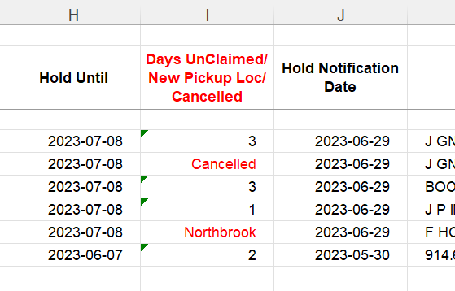
Combined Picklist View
The combined picklist view includes a “Type” column which will list if the hold is unclaimed, canceled, or is a transfer.
The Daily Clean Hold Shelf Web Report would also include both canceled held holds and holds to transfer.
Picklist
Web Report

Slide 8
Combined Picklist View
Proposed motion:
Enable the combined Picklist holds view in Leap.
Combined Picklist View

Slide 9
Warren-Newport Migration Update

Slide 10
Warren-Newport Go-Live Schedule
Aug 31
Warren-Newport offline
Sep 1-Sep 4
All CCS libraries offline
Sep 5
CCS libraries online
Sep 6
Warren-Newport online

Slide 11
Warren-Newport Go-Live Preparation
Offline closed dates in place
CCS working on additional details – watch for updates!
Offline circulation webinar scheduled for August 16 (10:00am) - register on L2

Slide 12
Offline Review

Slide 13
Offline Circulation Review
Remote Offline = used when can connect Polaris remote server
Example = library migration
Local Offline = used when cannot connect to Polaris remote server
Example: library loses internet connection

Slide 14
Offline Circulation Review
Remote Offline
Local Offline
Use Staff Client
Files stored on Polaris remote desktop
CCS can access and upload files
Download local offline client on computer
Files stored locally on that computer
Staff need to upload files

Slide 15
Offline Circulation Review: Local Offline
Resources:
Using Local Offline
Uploading Local Offline Transactions
Demo uploading local offline transactions

