Slide 1
Warren-Newport Migration Go-Live Review and Offline Demo
September 2023

Slide 2
Review of Go-Live Schedule

Slide 3
Agenda
Review of Go-Live Schedule
Overview of Remote Offline
Library Offline Checklist

Slide 4
Go-Live Schedule
August 31
September 1
September 2
September 3
September 4
September 5
September 6

Slide 5
Go-Live Schedule
Thursday, August 31 (Day)
Warren-Newport begins using offline circulation
All other CCS libraries remain online in Polaris
Innovative syncs production data to training before libraries open
August 31
September 1
September 2
September 3
September 4
September 5
September 6

Slide 6
Go-Live Schedule
Thursday, August 31 (Evening)
At close, libraries will disable sorters
At close, libraries will either disable self-checks or move into offline mode
Telephony disabled
ECommerce options in the PAC will be disabled
August 31
September 1
September 2
September 3
September 4
September 5
September 6

Slide 7
Go-Live Schedule
Thursday, August 31 (Evening)
At 9:30pm, production PowerPAC is redirected to training PowerPAC
At 9:30pm, SIP authentication is switched to the training database
CCS finishes preparing end-of-the-month Web Reports
August 31
September 1
September 2
September 3
September 4
September 5
September 6

Slide 9
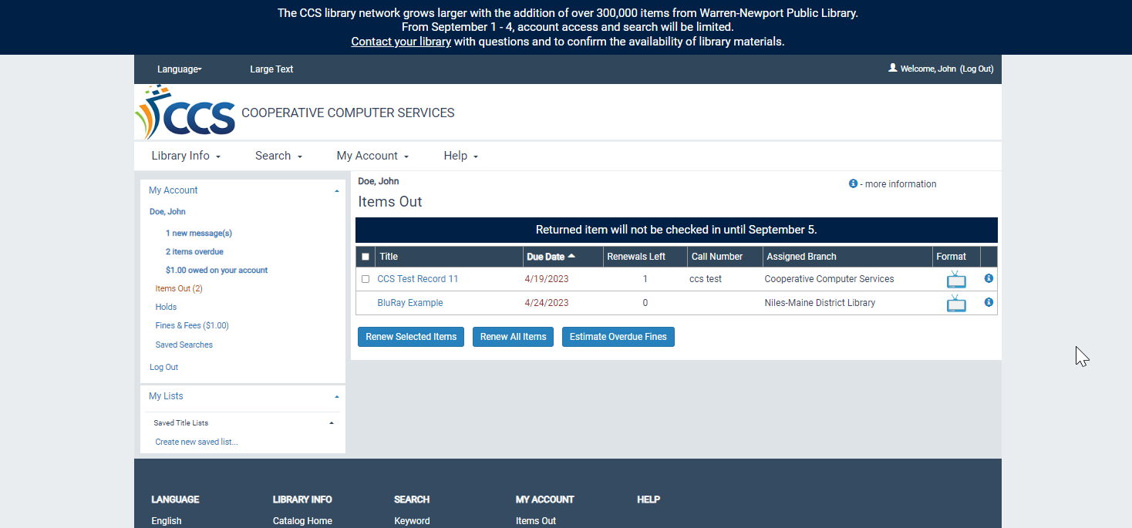

Slide 11
Go-Live Schedule
Friday, September 1 – Monday, September 4
All other CCS libraries begin use remote offline circulation on September 1
All libraries offline September 1 – September 4
*In a January 2019 survey, for downtime spanning multiple days, like adding a library, 63% of respondents preferred concentrating downtime on weekends and 37% preferred weekdays.
August 31
September 1
September 2
September 3
September 4
September 5
September 6

Slide 12
Available Services During Offline
Checking out materials
Checking out items on the hold shelf
Patron registration (optional)
Hourly non-holdable material check-in (optional)
Training PowerPAC search functions
Training Leap/Client search functions
Database/SIP Authentication against training (except for Warren-Newport)

Slide 13
Unavailable Services During Offline
Materials check-in (including delivery)
Running the picklist
Processing Holds (checking in expired holds, placing new holds)
Modifying patron records
Paying fees
Creating ILL or on-the-fly records
Technical Services functions (Adding/editing items, bibs, etc.)
API Services

Slide 14
Unavailable Services During Offline: API
Axis360
BiblioCommons
Boopsie
CapriaMobile
CenTec
CincoBooks
CloudLibrary
Communico
Comprise
Creativebug
CuriosityStream
Ebsco Stacks
Ebsco
Evanced
Explore More IL
Hoopla
Kanopy
LibraryMarket
Libro
LinkedIn
Lynda
NoveList
PatronPoint
ReadSquared
Solus
SpringShare
Syndetics Unbound
Vega
Zoobean
These vendors may authenticate via API. Libraries can confirm with the vendor directly about services for your library.

Slide 15
Go Live Support
For urgent issues, call CCS at (847) 483-8600
For non-urgent questions, email help@ccslib.org
When in doubt, call CCS!

Slide 16
Go-Live Schedule
Monday, September 4 (Evening)
CCS and Innovative do QA when processing is complete
CCS loads remote offline files
Redirect to training PAC removed; SIP authentication switches back to production
August 31
September 1
September 2
September 3
September 4
September 5
September 6

Slide 17
Go-Live Schedule
Tuesday, September 5
CCS libraries (except for Warren-Newport) online at start of day
Libraries turn sorters, self-checks back on and load self-check offline files
Warren-Newport continues to use remote offline circulation
August 31
September 1
September 2
September 3
September 4
September 5
September 6

Slide 18
Go-Live Schedule
Wednesday, September 6
Warren-Newport live on Polaris! WNPL staff start using production Leap and Staff Client at start of day
August 31
September 1
September 2
September 3
September 4
September 5
September 6

Slide 19
Questions?

Slide 20
Remote Offline Review

Slide 21
For Go Live, staff will use:
Remote Offline

Slide 22
Offline transactions are stored in an offline file on the Polaris server
Once database access is restored, the offline files are loaded into the database by CCS staff
Staff review error report as needed
Remote Offline Transactions

Slide 23
[Remote Offline Demo]

Slide 24
Library Offline Checklist

Slide 25
Prepare for Offline
Registering new patrons in offline? Email help@ccslib.org with the workstation name by August 30
Install the Polaris remote desktop connection on computers used for offline circulation
Review and test remote offline procedures by end of day on Wednesday, August 30
Share instructions for using remote offline with staff who will be checking out materials
Test printing receipts in Polaris offline to ensure printers are set up correctly
Confirm staff working August 31-September 5 are subscribed to CCS News

Slide 26
Resources
"Warren-Newport Public Library Migration," CCS Website https://www.ccslib.org/warren-newport-public-library-migration
"Using Remote Offline," CCS Website https://www.ccslib.org/training/using-remote-offline
CCS Help Desk https://ccslib.freshdesk.com/ or email help@ccslib.org

Slide 27
Questions?

