Slide 1
Circulation Technical Group
January 19, 2024

Slide 2
CCS Updates

Slide 3
CCS Updates
Polaris upgrade to 7.5 scheduled for 10pm Monday, February 26
Update to the survey on age-restricted materials from November
Mount Prospect-Waukegan migration – Go Live on Tuesday, October 1

Slide 4
CCS Updates
Circulation distribution emails are ready to use!
Staff can begin using them today
List of distribution email addresses is available on our website
https://www.ccslib.org/training/circulation-distribution-emails
How To > Department – Public Services > Circulation

Slide 5
CCS Updates
Patron record clean up: In-House Use Cards
Web Reports excludes use stats from patron code In-House Use
Clean up activity: check patron records with stat class "In-House Use" and verify they have patron code "In-House Use"

Slide 6
CCS Updates
Use Leap Find Tool – search patron records by Statistical Class = In-House Use.

Slide 7
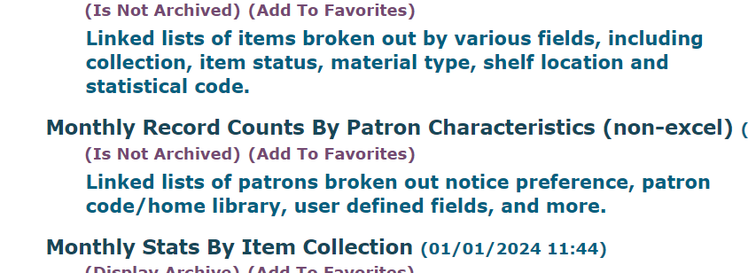
CCS Updates
Use Monthly Record Counts by Patron Characteristics Web Report > Patron Code and Statistical Class

Slide 8
7.5 Leap Functionality for Damaged Circulation Status

Slide 9
7.5 Leap Functionality for Damaged Circulation Status
Setting an item to "Damaged" currently requires item to be checked in/Available and for staff to manually change circulation status and/or apply fees
Limitations based on staff permissions, item assigned branch

Slide 10
7.5 Leap Functionality for Damaged Circulation Status
New damaged item-related functionality in Polaris 7.5
Staff can declare an item damaged from check in or the patron account to:
Change item circulation status to “Damaged”
Add block to item record
(Optionally) Charge replacement fee, processing fee to patron account
(Optionally) Generate manual bill notice for item

Slide 11
[DEMO]

Slide 12
7.5 Leap Functionality for Damaged Circulation Status
Fees applied using Declare Damaged will automatically qualify for collections submission
Adopting functionality would free up current "Damaged" circ status for other use
If adopted, Web Reports would not change – reports that include Damaged item information will continue to do so

Slide 13
7.5 Leap Functionality for Damaged Circulation Status
Why do we need to decide between current way and new functionality?
New functionality comes with built-in circulation status, separate from existing circ status
If using both current and new, will need to manage two separate "Damaged" circulation statuses

Slide 14
Revisions to Damaged Procedures

Slide 15
Revisions to Damaged Procedures
Revisions separate the how-to from the procedure where possible
Damaged procedures focus on when to apply local procedure, when to work with another library, and expectations in those situations, then direct staff to relevant how-to as needed
Intent is that this division will allow us to address new Leap functionality separate from procedures if needed in the future

Slide 16
Revisions to Damaged Procedures
Summary of clarifying language added:
In the "Summary" section - clarifying that blocks and blocking notes can be added to local and reciprocal patrons, as per the Circulation Manual
In the "A Note About Fees" section - referencing Governing Board Policy
In the "A Note About Fees" section - clarifying application of processing fees

