Slide 1
Circulation Technical Group
April 12, 2024

Slide 2
CCS Updates

Slide 3
CCS Updates
CCS Technical and Advisory Group Information Session Webinar
May 1, 2024 (1:00-2:00pm)
Register on L2
Find More IL Update

Slide 4
Patron Record Merge Review

Slide 5
Patron Record Merge Review
Where can I find information about patron record merges?
CCS Circulation Manual https://www.ccslib.org/member-tools-a-z
Patron Merging Guidelines how-to page https://www.ccslib.org/training/patron-merging-guidelines

Slide 6
Patron Record Merge Review
One or both patron records are not registered to your library
The patron records are registered to two different libraries
The patron names do not match
The patron addresses do not match
When to Merge
When not to Merge
Both patron records registered to your library
Record matches on:
Patron's registered library
Name
Address
Birthdate (if available)
Drivers License (if available)

Slide 7
Patron Record Merge Review
One or both patron records are not registered to your library
The patron records are registered to two different libraries
The patron names do not match
The patron addresses do not match
When not to Merge
If unable to match on the required fields, place a note on the patron(s) record(s) until you can check in with the involved libraries.

Slide 8
Post-Migration Merging
Staff will encounter patron records with duplicate barcodes because of merged databases
If comfortable, staff may merge duplicate patron records if you encounter them
In addition to the barcode, continue to use the general merge criteria for determining if the record should be merged (ex/ address should still match)

Slide 9
If there are any doubts...
...Err on the side of caution and do not merge. Use notes to indicate the potential duplicate and reach out to other parties as needed.

Slide 10
Patron Blocks

Slide 11
Patron Blocks
Soft Blocks
Hard Blocks

Slide 12
Patron Blocks
Act as alerts to staff
Do not prevent the patron from checking out or renewing
Soft Blocks

Slide 13
Patron Blocks
Patron has hold(s) ready for pickup
Patron owes money under their max fine threshold (amount set by patron’s home library)
Patron has overdue items under their max overdue limit
Soft Blocks

Slide 14
Patron Blocks
Will prevent the patron from checking out
May also prevent renewals
Hard Blocks

Slide 15
Patron Blocks
Patron owes money over their max fine threshold
Patron’s library card is expired
Patron has been sent to collections
Patron has a long overdue item*
Library staff have manually added a block*
*may allow renewals based on library settings
Hard Blocks

Slide 17
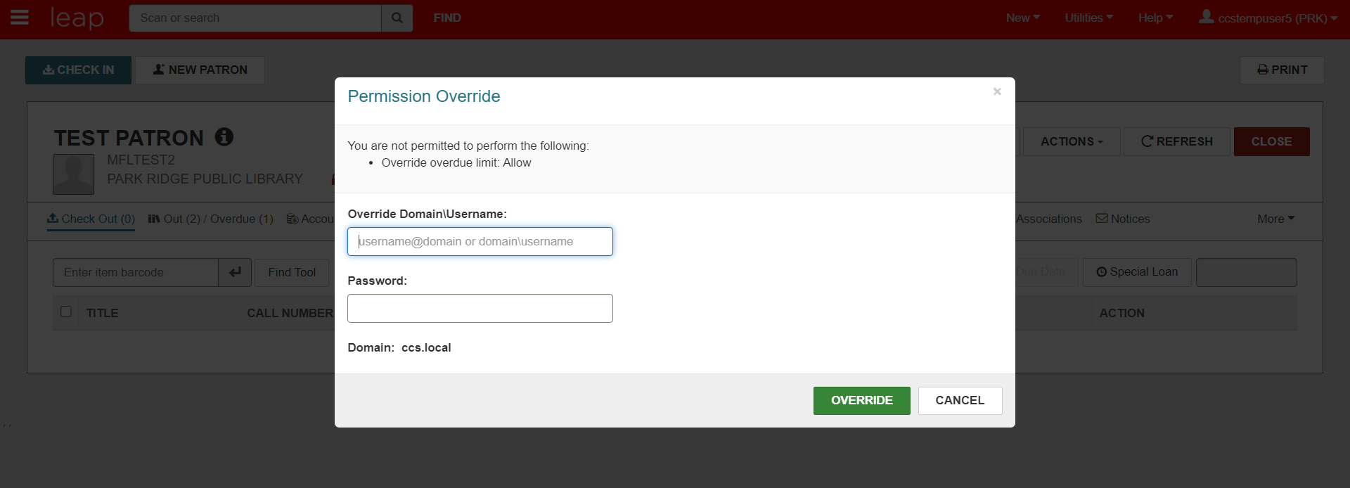

Slide 18
Soft Block for Fees

Slide 19
Hard Block for Fees

Slide 20
Patron Blocks at Self-Checks
In addition to system-driven conditions (expired card, owe over max fee limit), self-checks can block for the following conditions:
Most Libraries Block for:
Library Assigned Blocks
Collection Agency Block
Blocking Note
Uncommon Settings:
Verify User Block
Free Text Block
Associated Patron Blocks

Slide 21
Display Circulation Status

Slide 22
Display Circulation Status
Display Items how-to page: https://www.ccslib.org/training/display-items
Item given circulation status of Display by staff
Change status individually or in bulk
Depending on permissions, can change status in item record/item bulk change or from Check In workform

Slide 23
Item record header
Bib record items tab

Slide 24
PowerPAC “Find It” view

Slide 25
Display Circulation Status
When checking out at a service desk, staff need to clear the Display status first
Items with a Display status do not appear on the picklist
Items with a Display status are not counted as available copies

Slide 26
[Leap Demo]

Slide 27
Options!
Display circ status may be an option for you if...
Your library does a lot of checkouts via self-check
You want the status to clear once it's check out or check in
Other options
Using a "Display" shelf location
Leaving items as-is when they're on display

Slide 28
Student Bulk Registration

Slide 29
Student Bulk Registration
CCS can work with a library to bulk register student cards

Slide 30
Student Bulk Registration
School provides library list of student names and info
CCS runs a report of potential dupes
Library reviews list to remove dupes
CCS creates bulk registration transaction file
CCS tests on training database
CCS uploads bulk registration to production database
Library issues library cards to school/students

Slide 31
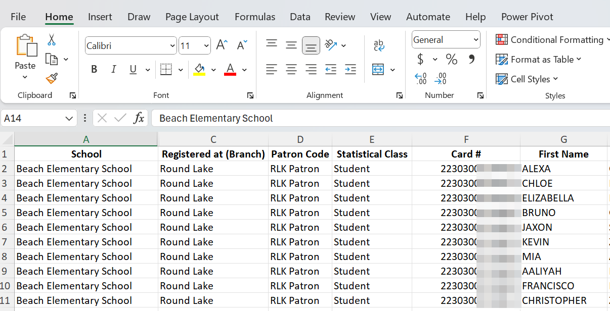
Student Bulk Registration
School provides library list of student names and info

Slide 32
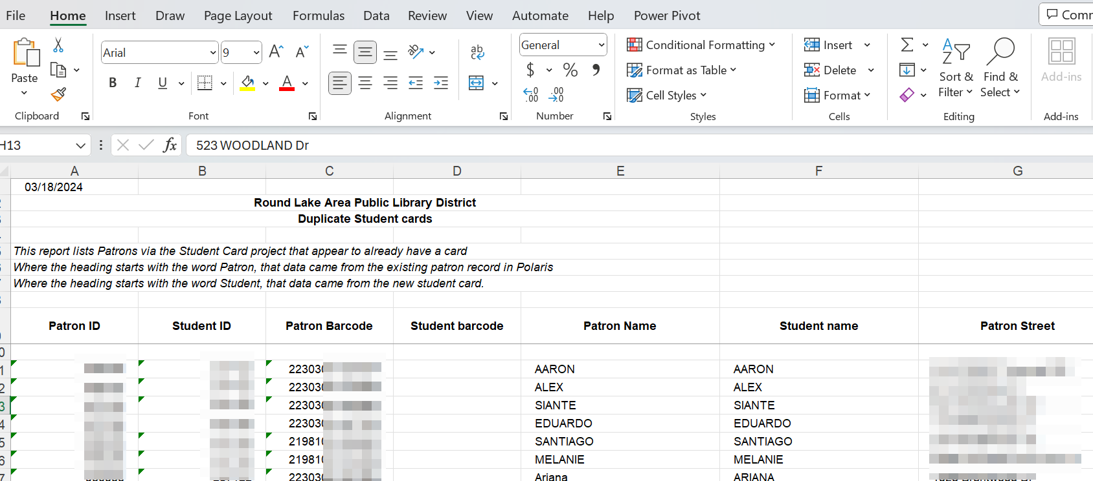
Student Bulk Registration
CCS runs a report of potential dupes
Library reviews list to remove dupes

Slide 33
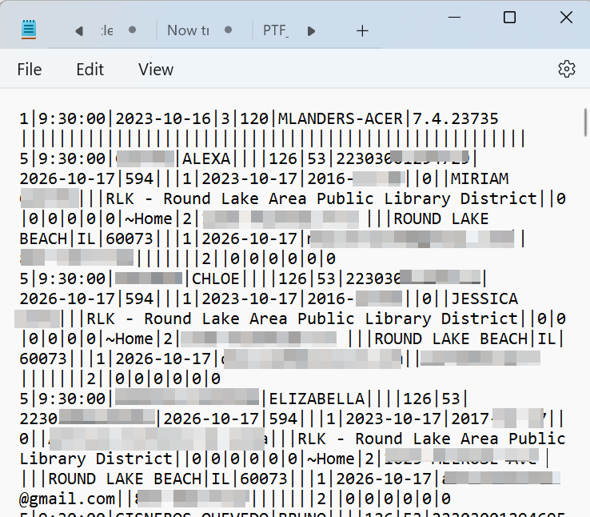
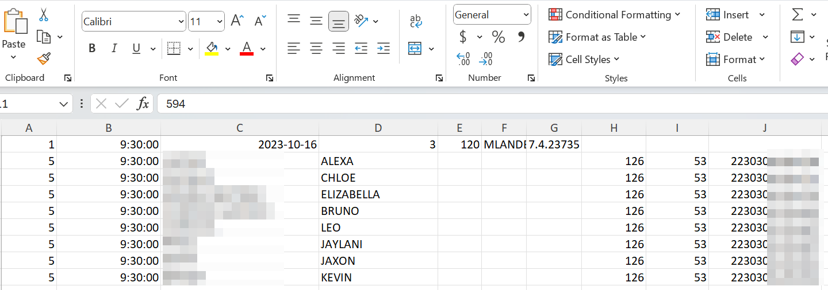
Student Bulk Registration
4. CCS creates bulk registration transaction file

Slide 34
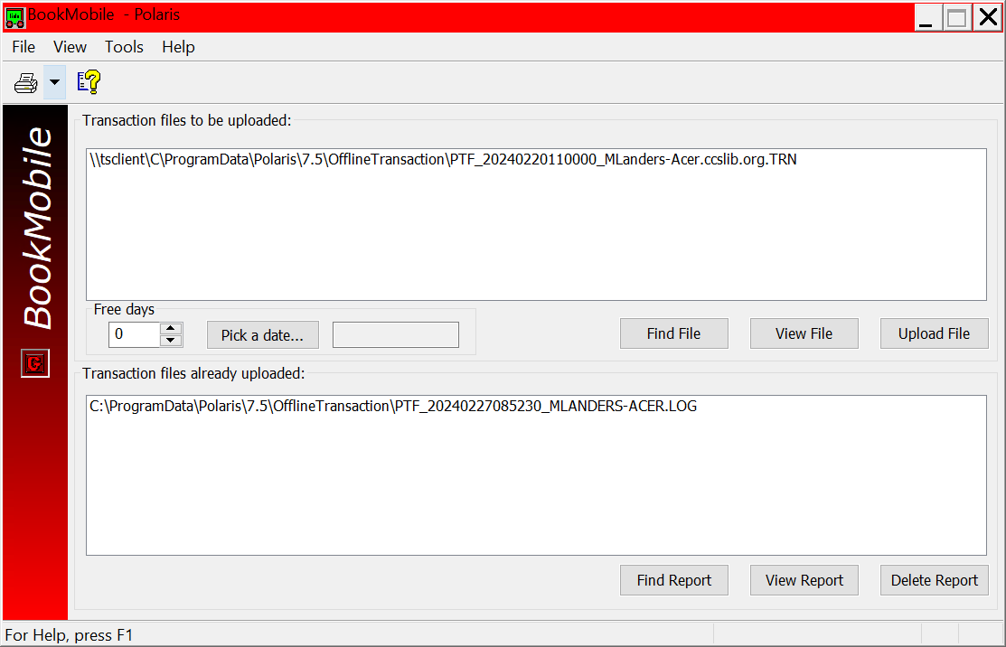
Student Bulk Registration
5. CCS tests on training database

Slide 35
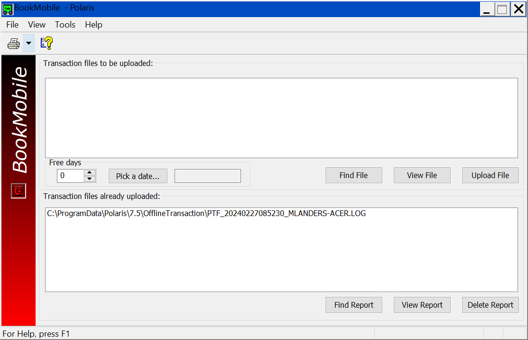
Student Bulk Registration
6. CCS uploads bulk registration to production database

Slide 36
Student Bulk Registration
7. Library issues library cards to school/students

Slide 37
FY24-25 Officer Elections

Slide 38
FY24-25 Officer Elections
Vice Chair/Chair Elect
Secretary

Slide 39
Future Planning

Slide 40
Future Planning
What would you like to see for the Circulation Technical Group?
3 mins: Think of ideas (both practical and no-limits!)
5 mins: Post ideas to sheets
7 mins: “Second” stickers

Slide 41
Future Planning
What do you like about meetings? What can be improved?
Physical or Virtual Space
Meeting Structure
What kinds of activities would you like to see?
Activities
Guest speakers
Discussions
Continuing Ed topics
Polaris Topics
General Library or Circulation Topics
Any other ideas!

Slide 42
Future Planning
What do you like about meetings? What can be improved?
Physical or Virtual Space – Meeting Ideas sheet
Meeting Structure – Meeting Ideas sheet
What kinds of activities would you like to see?
Activities – Activities sheet
Guest speakers – Activities sheet
Discussions – Discussions sheet
Continuing Ed topics – Continuing Ed sheet
Polaris Topics
General Library or Circulation Topics
Any other ideas! – Other sheet

