Slide 1
Circulation Technical Group
October 11, 2024

Slide 2
CCS Updates

Slide 3
Introductions

Slide 4
Introductions
Name, library, your role at the library
(Optional) Book/movie/podcast/tv show/audiobook/ album you’ve enjoyed recently

Slide 5
Merging Patrons

Slide 6
Post-Migration Merging
CCS identifies patron records with duplicate barcodes and run auto-merges in cycles
If records do not match on key points, will exclude from merge. Reasons for exclusion include:
  Last name does not match
  First name does not match
  City does not match
  Street number does not match
CCS staff will manually review and (if appropriate) merge excluded records

Slide 7
Post-Migration Merging
Staff will encounter patron records with duplicate barcodes during merge project
If comfortable, staff may merge duplicate patron records if you encounter them
In addition to the barcode, continue to use the general merge criteria for determining if the record should be merged (ex/ address should still match)

Slide 8
General Patron Record Merges
What if it appears to be the same person with two different barcodes?
Can the patron confirm their record information? (Example: former address)
Do other fields like birthdate match?
Are there any relevant notes or blocks?

Slide 9
General Patron Record Merges
What if it appears to be the same person with two different barcodes?
Can the patron confirm their record information? (Example: former address)
Do other fields like email and birthdate match?
What if the patron is not there to verify their information...

Slide 10
General Patron Record Merges
One or both patron records are not registered to your library
The patron records are registered to two different libraries
The patron names do not match
The patron addresses do not match
When to Merge
When not to Merge
Both patron records registered to your library
Record matches on:
  Patron's registered library
  Name
  Address
  Birthdate (if available)
  Drivers License (if available)

Slide 11
General Patron Record Merges
One or both patron records are not registered to your library
The patron records are registered to two different libraries
The patron names do not match
The patron addresses do not match
When not to Merge
If unable to match on the required fields, place a note on the patron(s) record(s) until you can check in with the involved libraries.

Slide 12

If there are any doubts...
...Err on the side of caution and do not merge. Use notes to indicate the potential duplicate and reach out to other parties as needed.

Slide 13
Patron Record Merge Review
Where can I find information about patron record merges?
CCS Circulation Manual
https://www.ccslib.org/member-tools-a-z
https://www.ccslib.org/training/circulation-manual
Patron Merging Guidelines how-to page
https://www.ccslib.org/training/patron-merging-guidelines

Slide 14
Claims Review

Slide 15
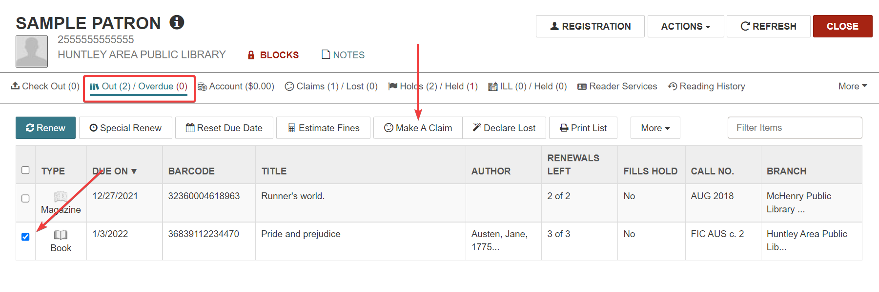
Making a Claim
Claimed Items: Making a Claim

Slide 16
CCS Policies on Claims Returned
Patrons can have up to 5 current claims. They will be blocked if they exceed 5 current claims
Libraries can claim an intra-CCS loan item without consulting the owning library
Libraries will consult a Claims Returned report regularly to check for claimed items
CCS Governing Board Policies
CCS Circulation Manual

Slide 17
Resolving Claims
A claim will remain current until staff resolve the claims.
How are claims resolved?
  The item is checked in
  The item is manually declared Lost and the patron charged
What if a claim is not resolved?
  If the claim has not been resolved after 1 year, CCS will delete the claimed item
  Ahead of the 1 year mark, libraries can decide if they will charge the patron for the claim
  Use the "Items with a Status of Claims" report to track eligible items
Claimed Items: Resolving Claims

Slide 18
Claims Returned Resources
CCS Circulation Manual
https://www.ccslib.org/member-tools-a-z
https://www.ccslib.org/training/circulation-manual
CCS Governing Board Policies
https://www.ccslib.org/governing-documents
Claimed Items: Making a Claim
https://www.ccslib.org/training/claimed-items-making-claim
Claimed Items: Resolving Claims
https://www.ccslib.org/training/claimed-items-resolving-claims

Slide 19
September Library Card Sign-Up Month Wrap Up

Slide 20

Library Card Sign-Up Month
How did your library promote September Library Card Sign-Up Month?
Ideas for next year?

Slide 21
Library News

Slide 22
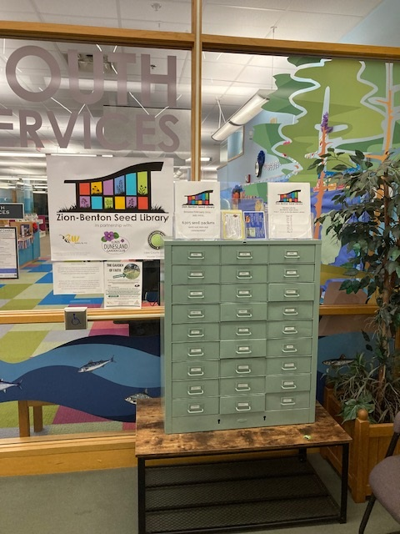
Zion-Benton Public Library's seed library

