Slide 1
Circulation Technical Group
January 10, 2025

Slide 2
CCS Updates

Slide 3
CCS Updates
Vernon Area Public Library migration
Polaris 7.7 upgrade
FY25-26 officer elections at April meeting

Slide 4
Issuing Notices to Alt Email Address

Slide 5
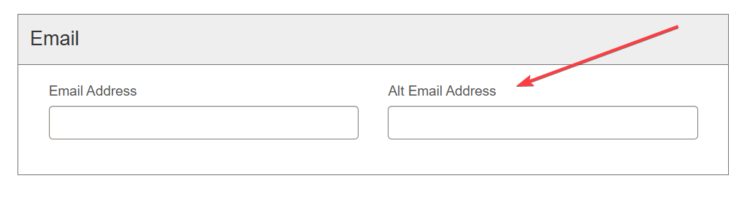
Issuing Notices to Alt Email Address
Current setting:
Patron record Alt Email address only used with ereceipts
Patron registration workform email fields

Slide 6
Issuing Notices to Alt Email Address
Use of Alt Email (as of Jan 3, 2025)
12,148 patrons have an Alt Email address (2.12% of patrons)
7,817 patrons have unique address in Alt Email

Slide 7
Issuing Notices to Alt Email Address
Potential Action
A setting is available that will allow us to issue email notices to Alt Email addresses
Should we enable this setting?
(Libraries will not be required to collect Alt Email address)

Slide 8
Issuing Notices to Alt Email Address
If approved, what would enabling the setting look like?
Set future date to enable setting
CCS will share list of patrons with Alt Emails with libraries
Libraries can send communication to patrons if desired

Slide 9
Polaris 7.7 Soft Block Suppression Option

Slide 10
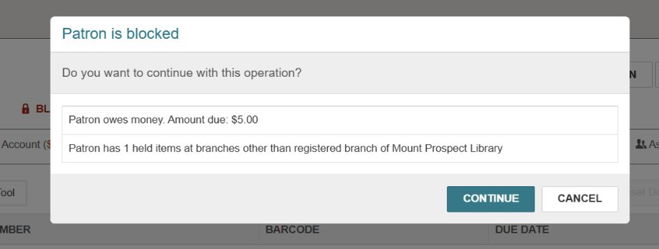
7.7 Soft Block Suppression Option
When checking out or placing a hold, Polaris will display a pop-up alert if the patron has blocks.
This includes both hard blocks (conditions that stop circulation) and soft blocks (alerts for holds and minor fees)

Slide 11
7.7 Soft Block Suppression Option
A new feature in version 7.7 allows us to suppress soft block alerts
Libraries can decide individually if they want to suppress soft blocks and (if so) which ones
When enabled, staff will not see the one or more of the following soft blocks:
Money Owed — Patron owes money, but not enough to be blocked
Held Item — Patron has an item or items on hold
Unread Messages — Patron has unread messages in PAC from library (this is rarely used)

Slide 12
7.7 Soft Block Suppression Option
Soft block alerts currently suppressed for all libraries in Training Leap (https://ccs-training.polarislibrary.com/leapwebapp)
Open help desk ticket (help@ccslib.org) if you want to suppress soft blocks in production and, if so, which ones
Verify all departments are in agreement

Slide 13
Polaris 7.7 Find Tool Updates

Slide 14
7.7 Find Tool Updates
Save default filter
Rerun recent searches

Slide 15
Manually Removing a Collection Agency Block

Slide 16
Manually Removing a Collection Agency Block
When?
Your library stopped participating in collections with Unique but still have patrons with collection agency blocks
Why?
Since account updates are not being sent to Unique, the patron's collection agency block is not automatically updated

Slide 17
Manually Removing a Collection Agency Block
Who?
Staff who are part of the Circulation Managers permission group can manually remove a collection agency block
How?
https://www.ccslib.org/training/manually-removing-collections-block

