Slide 1
PAS Technical Group
June 26, 2025

Slide 2
CCS Updates

Slide 3
CCS Updates: Discovery Layer
Anticipate Governing Board vote at September meeting
Record sets and new discovery layer: won't have solid answer until fall!
If access to PAC, existing links will continue to open in PAC
Vega Discover: uses Polaris bib record sets to create Showcases; however, may need to recreate/migrate existing sets into Vega
Bibliocore: will need to rebuild using Bibliocore's tools
CCS will work with vendor and libraries on transition

Slide 4
CCS Updates: Upcoming Enhancements
Improved Display Functionality
Temporary shelf locations that automatically revert back at check in
Dated Patron Notes
Improved patron note field view that tracks creator and a date/time
Improved Exact Searching in Leap
Allows search to ignore initial articles if typed in the search string

Slide 5
CCS Updates: Vernon Migration
Offline and Go Live schedule finalized
Thurs, Aug 28: Vernon offline
Fri, Aug 29: All other CCS libraries offline
Wed, Sept 3: All libraries resume Polaris operations; Vernon live with CCS!
During offline period, Innovative will redirect SIP and PAC to our training database
Staff will also have view-only access to training Leap

Slide 6
CCS Updates: Vernon Migration
Available Services
Unavailable Services
Checking out materials
Checking out items on the hold shelf
Patron registration (optional)
Hourly non-holdable material check-in (optional)
Training PowerPAC search functions
Training Leap/Client search functions
Database/SIP Authentication against training (except for Vernon)
Materials check-in (including delivery)
Running the picklist
Processing Holds (expired holds, placing new holds)
Modifying patron records
Paying fees
Creating ILL or on-the-fly records
Technical Services functions (Add/edit items, bibs, etc.)
API Services

Slide 7
CCS Updates: Vernon Migration
Available Services
Unavailable Services
Checking out materials
Checking out items on the hold shelf
Patron registration (optional)
Hourly non-holdable material check-in (optional)
Training PowerPAC search functions
Training Leap/Client search functions
Database/SIP Authentication against training (except for Vernon)
Materials check-in (including delivery)
Running the picklist
Processing Holds (expired holds, placing new holds)
Modifying patron records
Paying fees
Creating ILL (incl FMI) or on-the-fly records
Technical Services functions (Add/edit items, bibs, etc.)
API Services

Slide 8
FY25-26 Officer Elections

Slide 9

FY25-26 Officer Elections
Vice Chair/Chair Elect
Secretary

Slide 10
End of Term Due Dates

Slide 11
End of Term Due Dates
Option for school or teacher cards if valid only during school year
Uses patron code to set hard due date at end of school year (ex/ ALK Educational, PRK Teacher)
Checkouts will not exceed end of term date; option to automatically reset once past end of term date

Slide 12
Web Reports Highlights

Slide 13
Library Idea Exchange

Slide 14
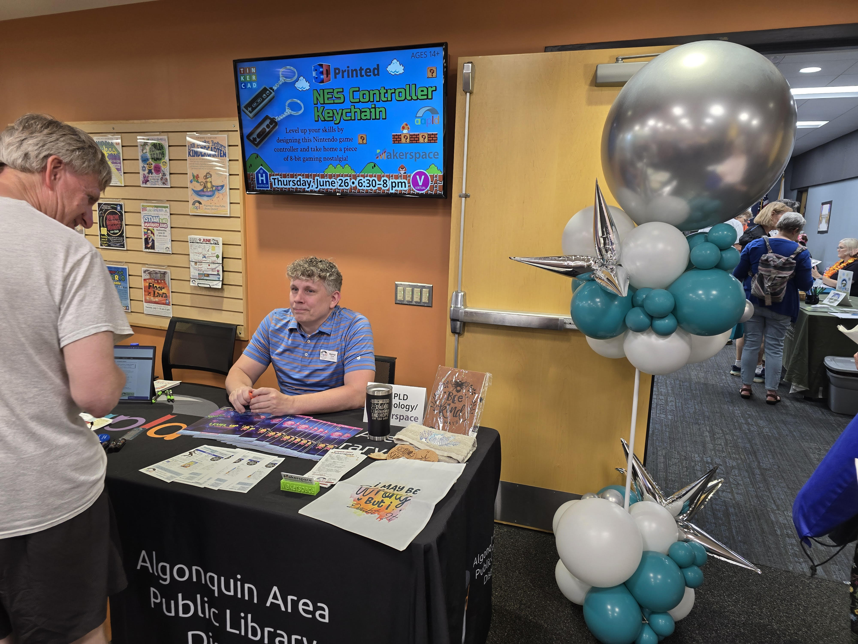
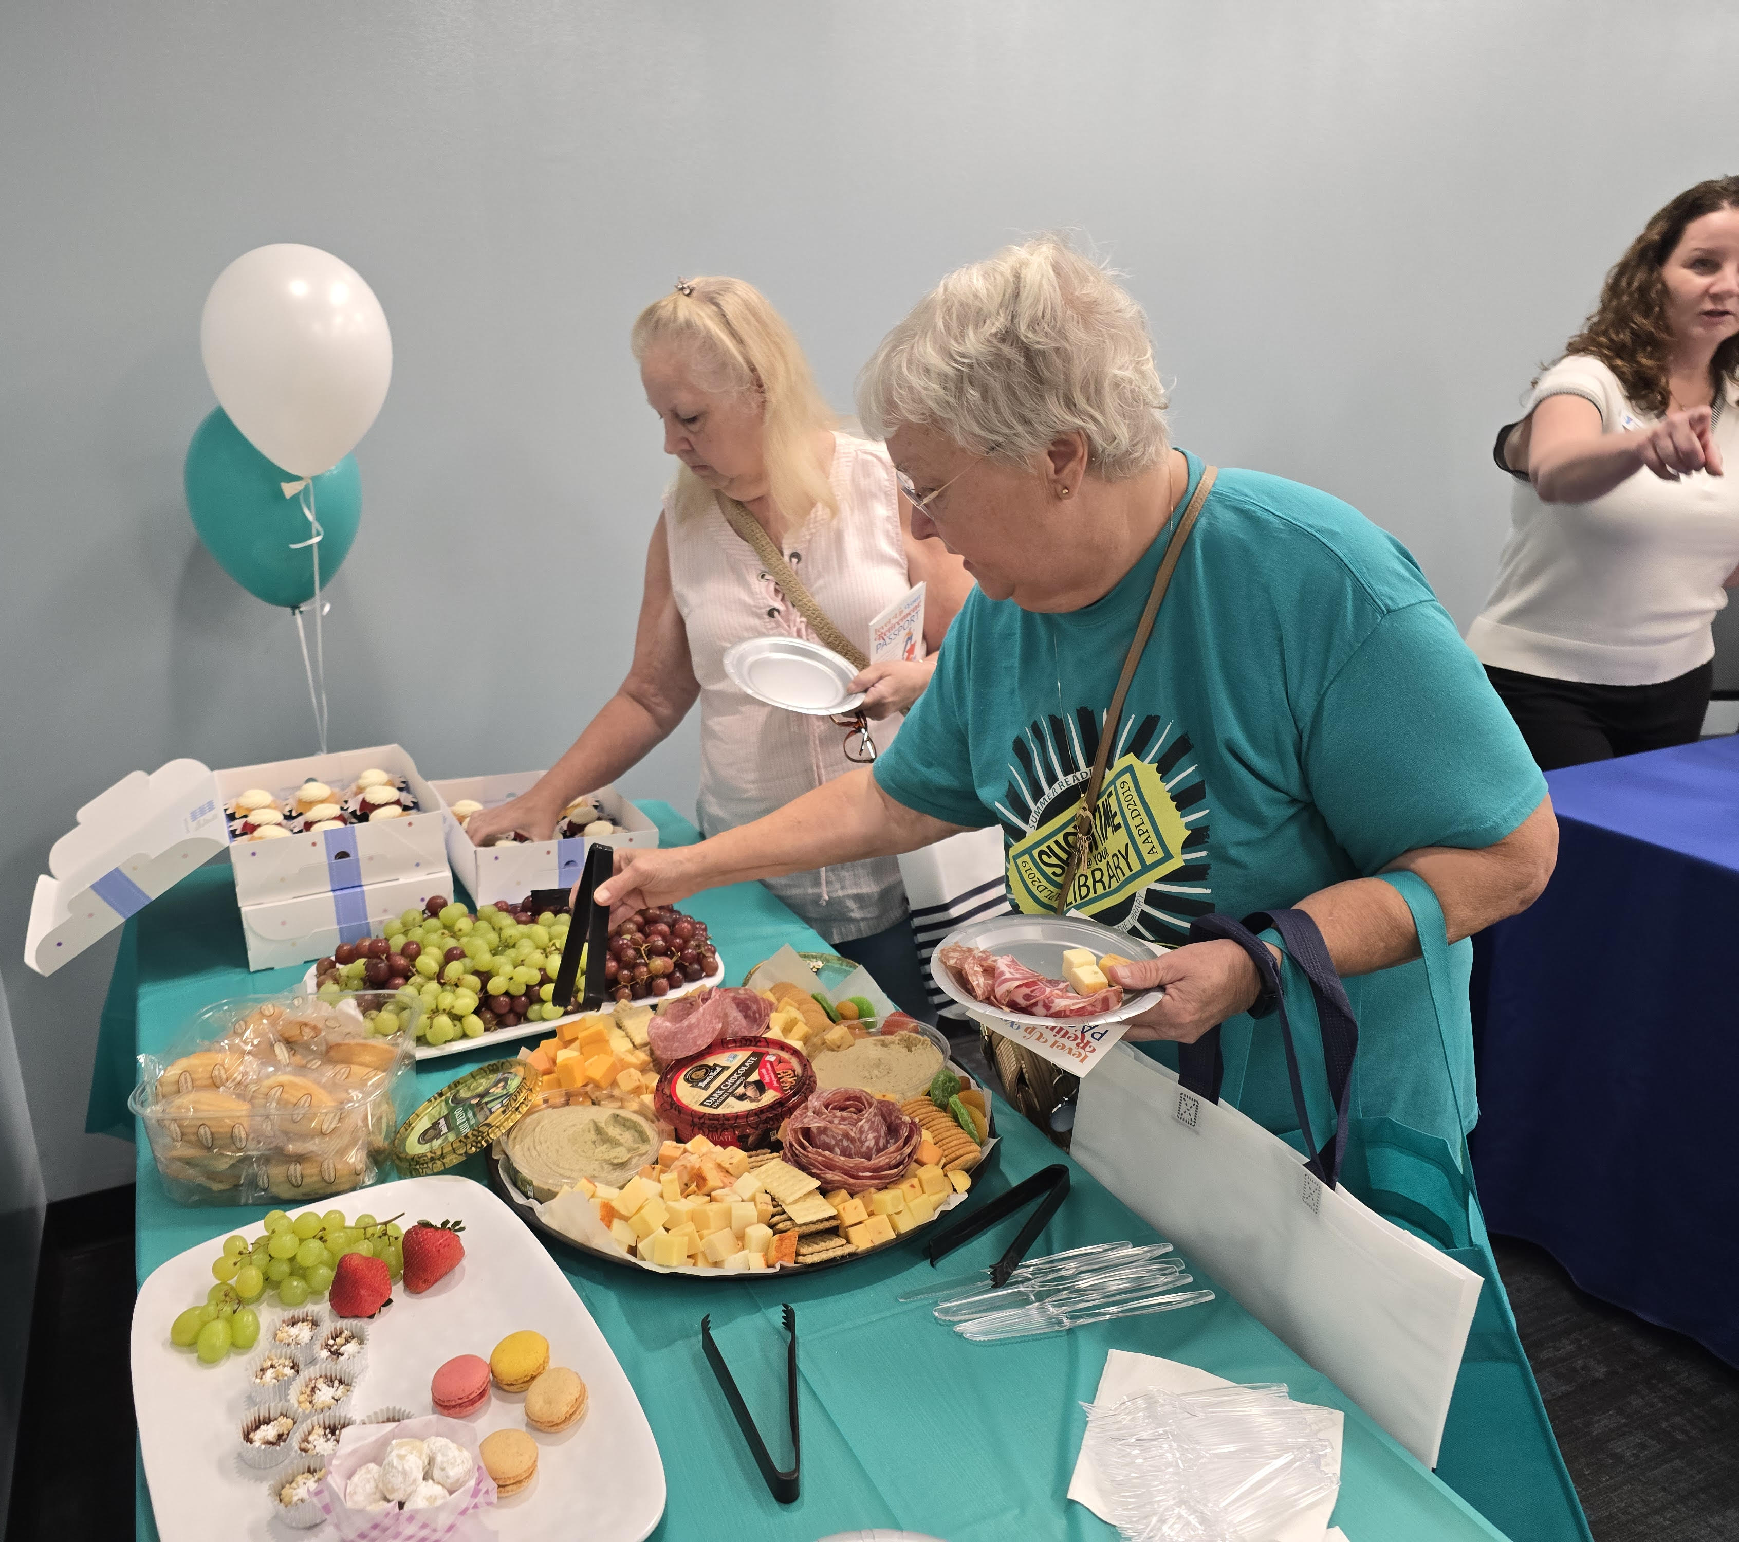
Algonquin Area Public Library Retirement Fair

Slide 15
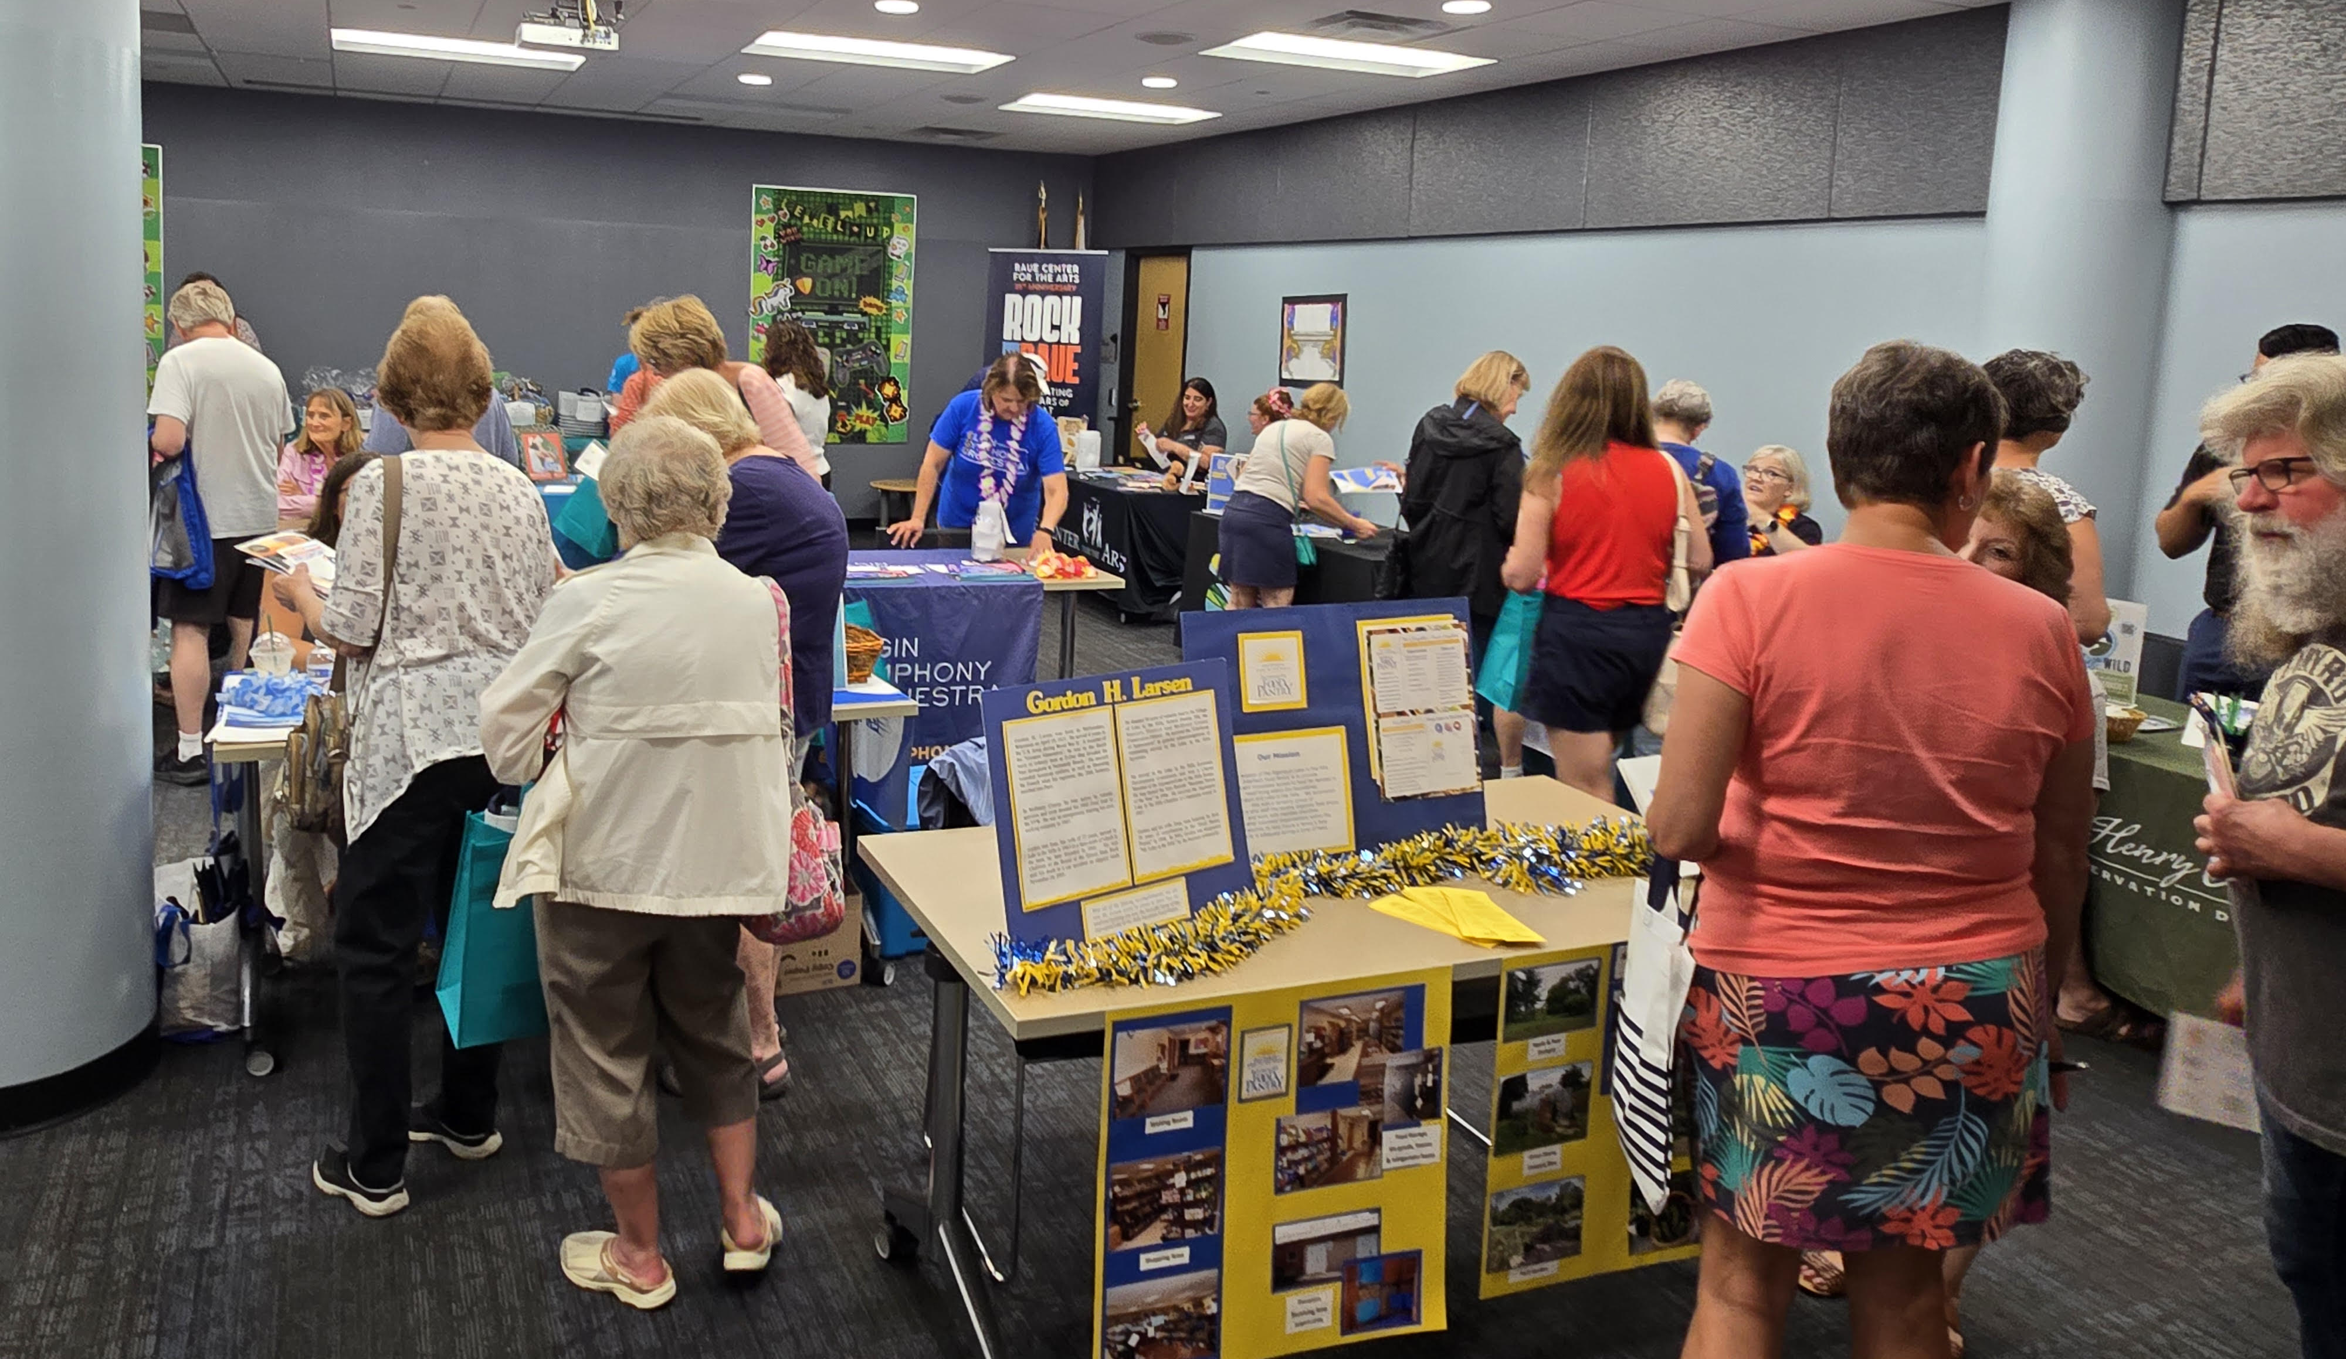

Slide 16
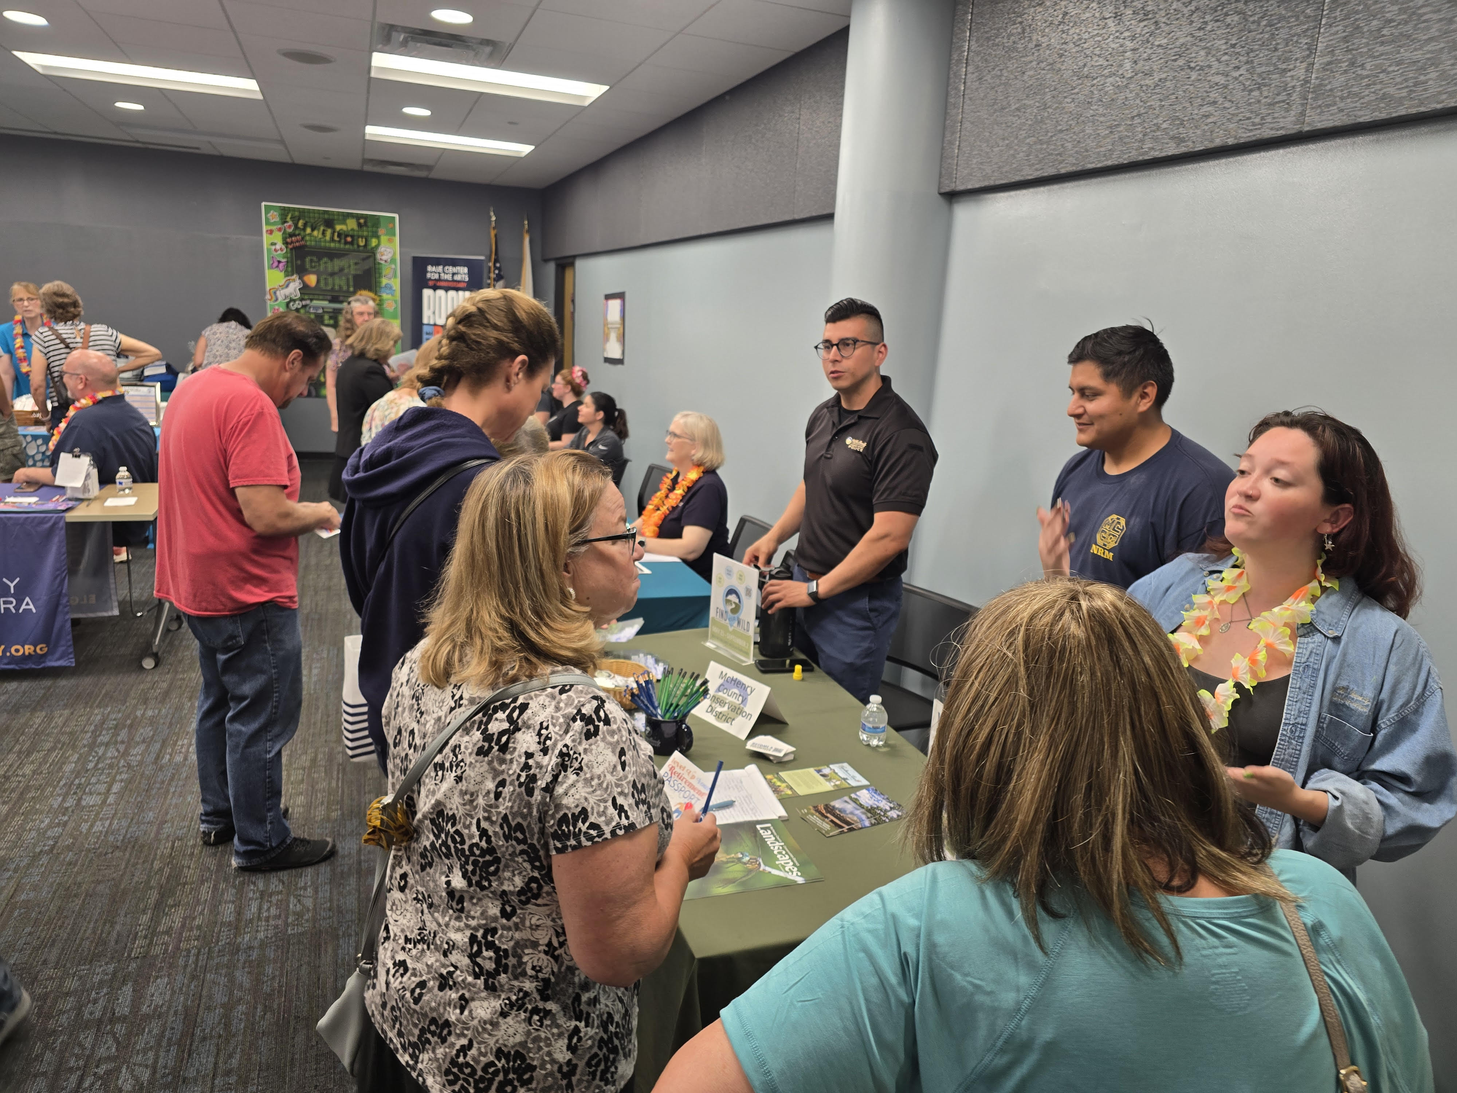
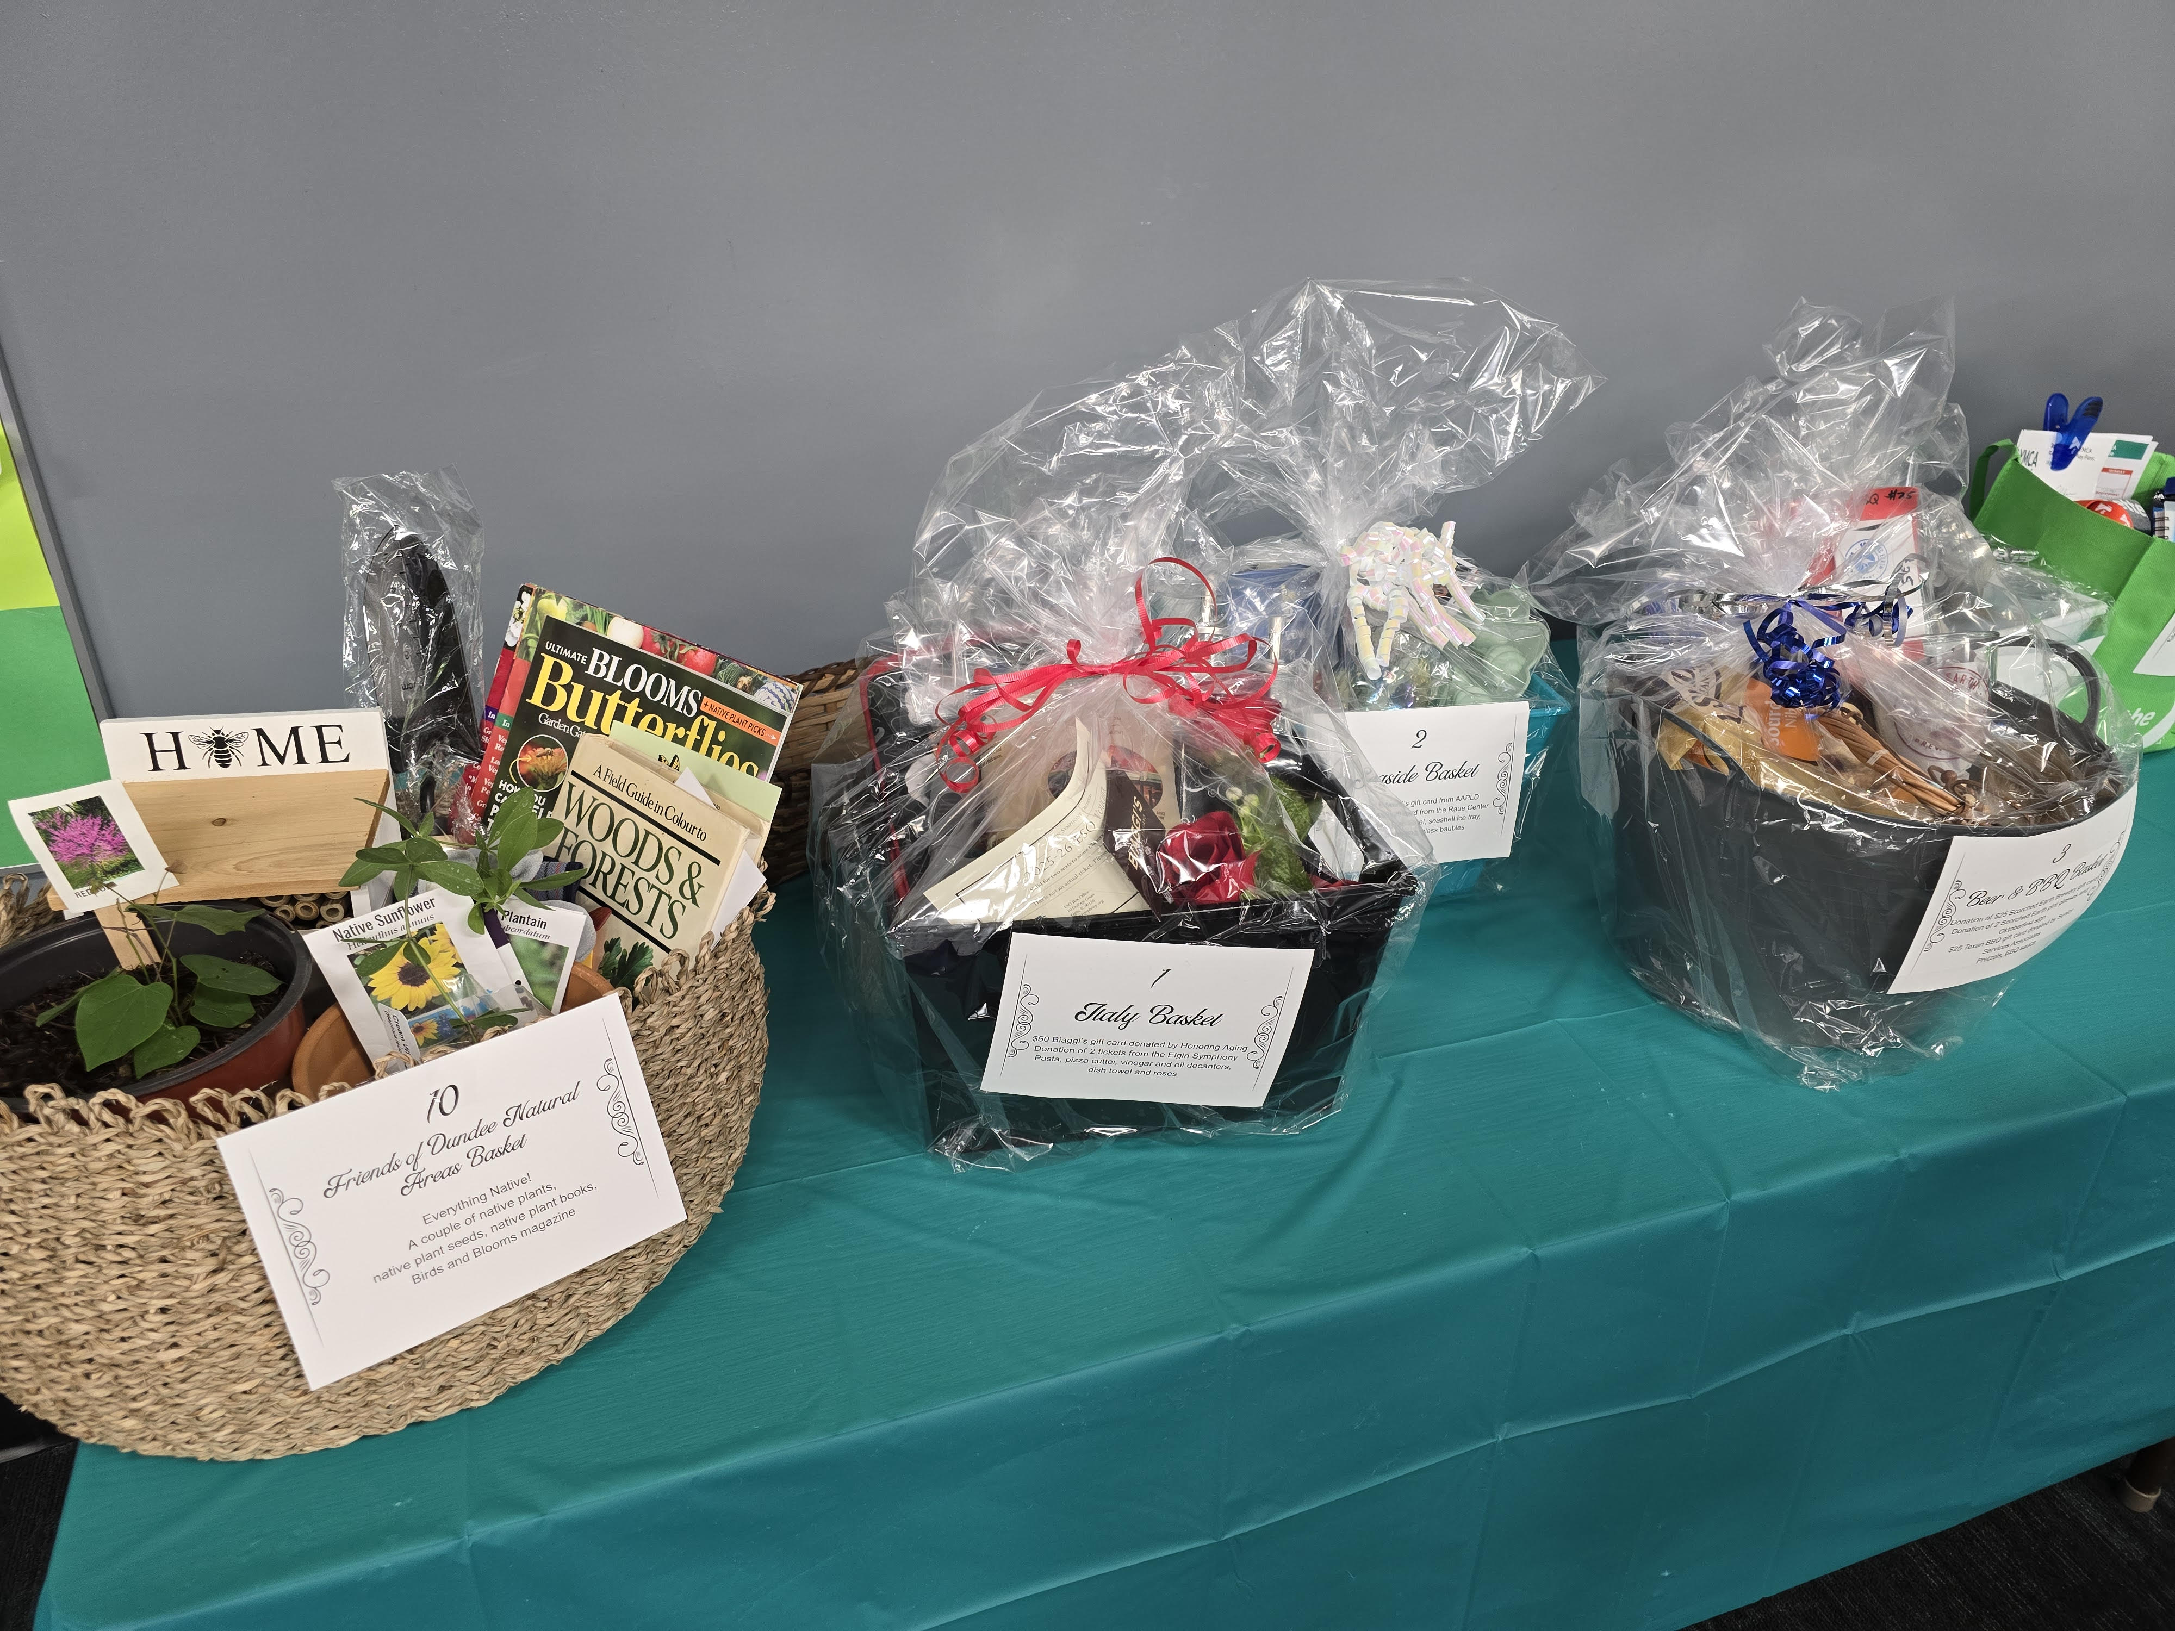

Slide 17
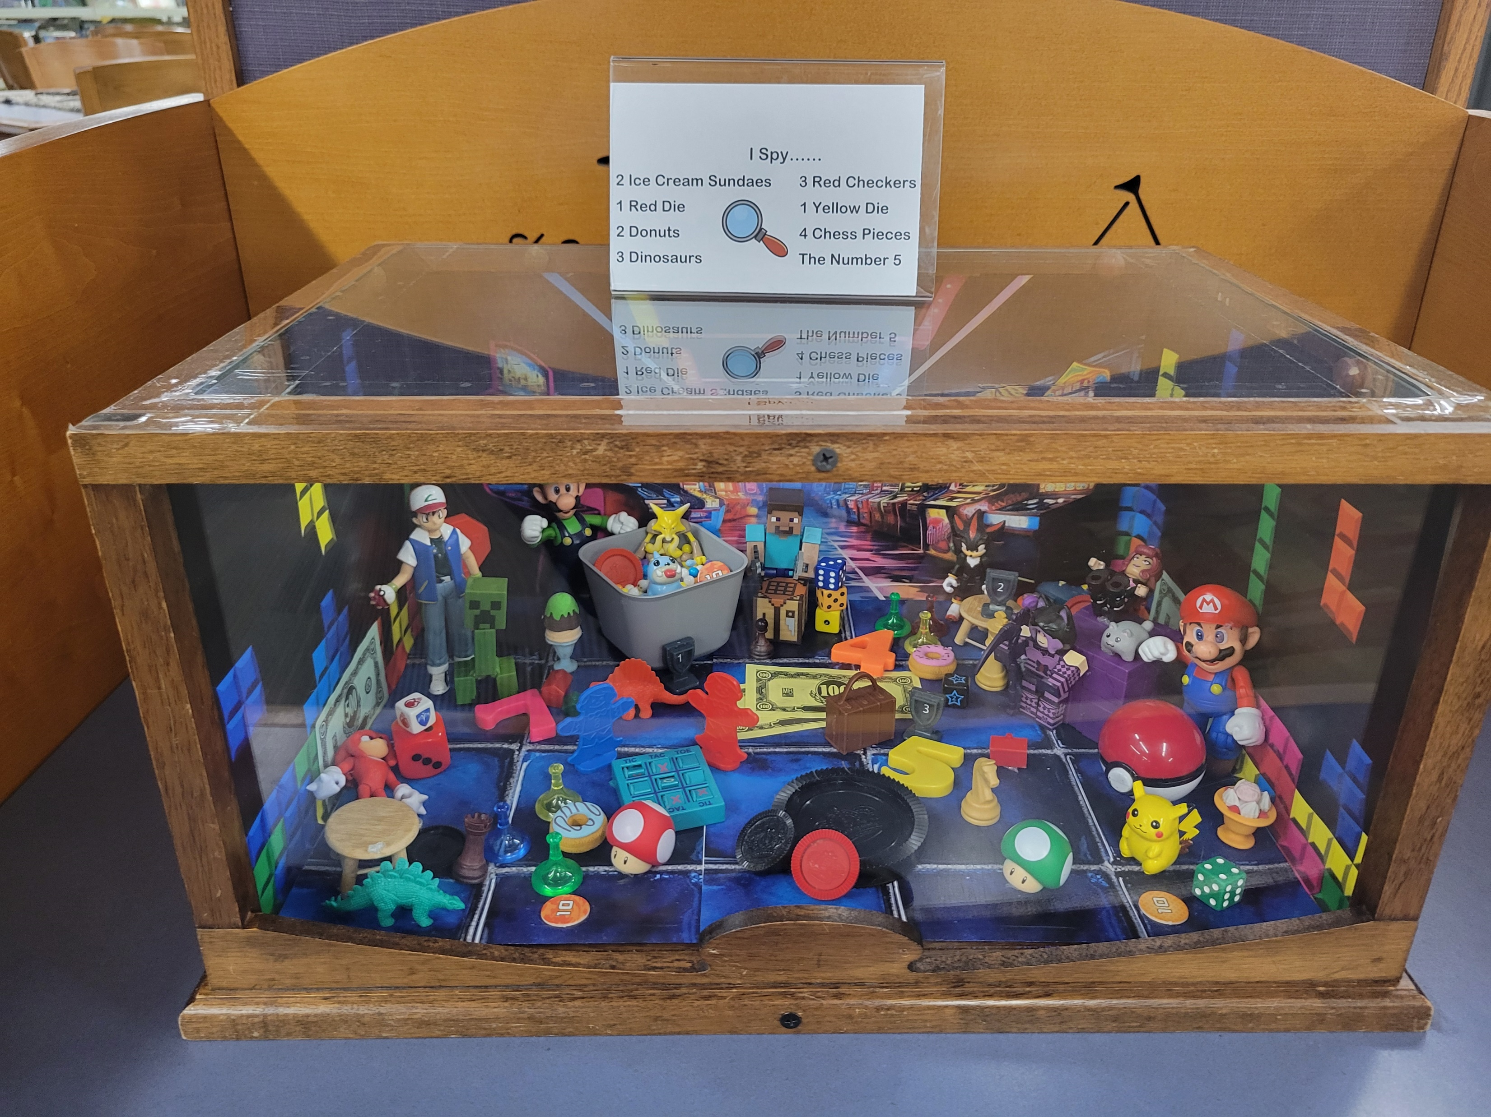
Crystal Lake Public Library – I Spy

Slide 18
Future Planning

Slide 19
Future Planning
What would you like to see for the PAS Technical Group?
3 mins: Think of ideas (both practical and no-limits!)
5 mins: Post ideas to sheets
7 mins: “Second” stickers

Slide 20
Future Planning
What do you like about meetings? What can be improved?
Physical or Virtual Space
Meeting Structure
What kinds of activities would you like to see?
Activities
Guest speakers
Discussions
Continuing Ed topics
Polaris Topics
General Library Topics
Any other ideas!

Slide 21
Future Planning
What do you like about meetings? What can be improved?
Physical or Virtual Space – Meetings sheet
Meeting Structure – Meetings sheet
What kinds of activities would you like to see?
Activities – Activities sheet
Guest speakers – Activities sheet
Discussions – Discussions sheet
Continuing Ed topics – Continuing Ed sheet
Polaris Topics
General Library Topics
Any other ideas! – Other sheet

