Slide 1
Circulation Technical Group
July 10, 2025

Slide 2
CCS Updates

Slide 3
CCS Updates
Discovery Layer
  Decision at September Governing Board meeting
  https://www.ccslib.org/training/library-online-catalog-evaluation-project
Use L2 Directory for delivery info, barcode prefixes
  https://librarylearning.org/directory
Polaris 8.0 development
  Improved Display Functionality
  Dated patron notes

Slide 4
Options for Check Out Screen Adjustments

Slide 5
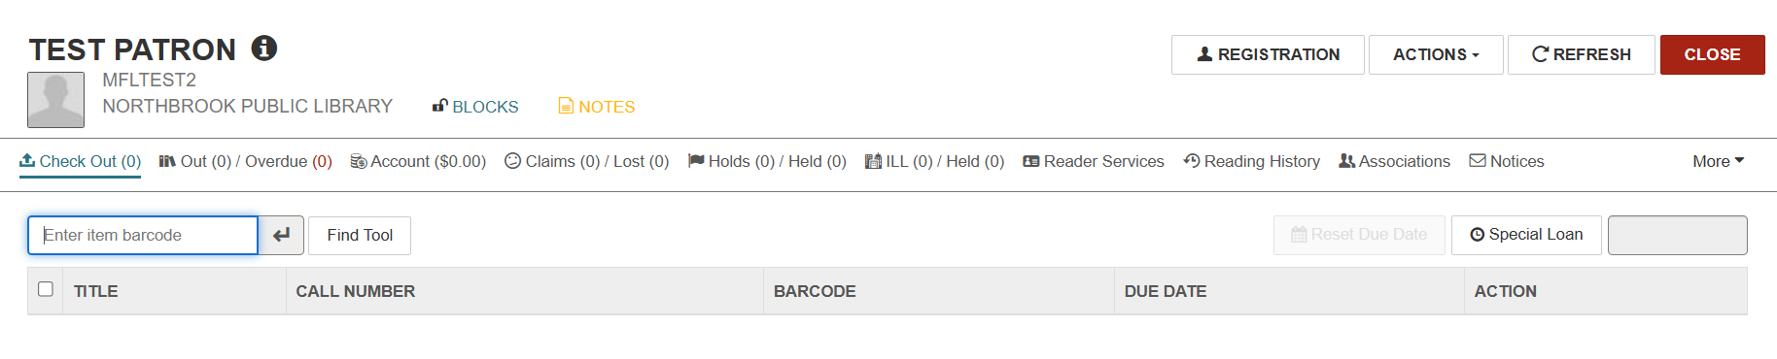
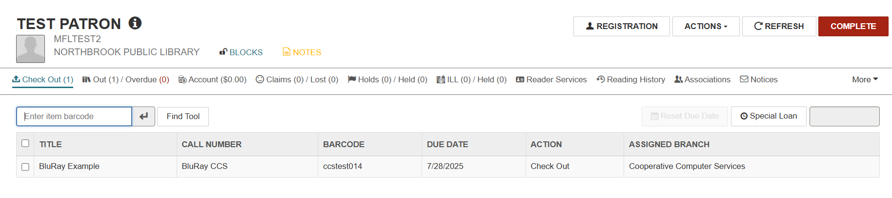
Options for Check Out Screen Adjustments

Slide 6
Options for Check Out Screen Adjustments
Option to add:
Item Assigned Branch
Item Material Type
Item Shelf Location
Email help@ccslib.org to request adjustment

Slide 7
Vernon Migration

Slide 8
Vernon Migration: Go Live Timeline
Offline and Go Live schedule finalized
  Thurs, Aug 28: Vernon offline
  Fri, Aug 29 – Tues, Sept 2: All CCS libraries offline
  Wed, Sept 3: All libraries resume Polaris operations; Vernon live with CCS!
Libraries should use Polaris Remote Offline (via production Staff Client) during offline period. CCS will upload remote offline transaction files on behalf of libraries.

Slide 9
Vernon Migration: Testing Remote Offline Circ
CCS Libraries required to test remote offline circulation
  Verify can connect, login, check out, and print receipts
  CCS will verify transaction file created
  Also test self-check if using
CCS will open a help desk ticket on behalf of each library and share testing checklist (IT and Circ contacts)
Testing deadline: August 15, 2025

Slide 10
Vernon Migration: SIP/PAC Redirect
During offline period, Innovative will redirect SIP and PAC to our training database
  Redirect will not apply for libraries using Bibliocommons
Staff will also have view-only access to training Leap
Data in training database will be from end-of-day August 27

Slide 11
Vernon Migration: Available Services
Available Services
Unavailable Services
Checking out materials
Checking out items on the hold shelf
Patron registration (optional)
Hourly non-holdable material check-in (optional)
Training PowerPAC search functions
Training Leap/Client search functions
Database/SIP Authentication against training (except for Vernon)
Materials check-in (including delivery)
Running the picklist
Processing Holds (expired holds, placing new holds)
Modifying patron records
Paying fees
Creating ILL or on-the-fly records
Technical Services functions (Add/edit items, bibs, etc.)
API Services (including Bibliocommons)

Slide 12
Vernon Migration: Available Services
Available Services
Unavailable Services
Checking out materials
Checking out items on the hold shelf
Patron registration (optional)
Hourly non-holdable material check-in (optional)
Training PowerPAC search functions
Training Leap/Client search functions
Database/SIP Authentication against training (except for Vernon)
Materials check-in (including delivery)
Running the picklist
Processing Holds (expired holds, placing new holds)
Modifying patron records
Paying fees
Creating ILL or on-the-fly records
Technical Services functions (Add/edit items, bibs, etc.)
API Services (including Bibliocommons)

Slide 13
Vernon Migration: Resources and To-Do
Vernon Area Migration Info Page:
https://www.ccslib.org/vernon-area-public-library-migration
To Do:
Register for Go Live Review and Offline Demo webinar (Aug 6)
Test Remote Offline Circulation (Aug 15)
(Optional) Send patron registration workstation to help desk (Aug 15)
(Optional) Contact RAILS to pause delivery during offline

Slide 14
Patron Record Gender Field

Slide 15
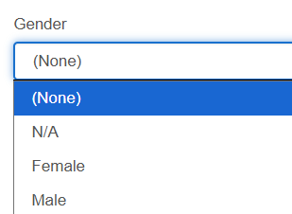
Patron Record Gender Field
Background:
The Polaris patron registration workform includes a field for Gender
Default values are N/A, Female, Male, or (None)
Libraries have the option of suppressing this field from view
Suppressing the field does not erase existing data

Slide 16
Patron Record Gender Field
Background:
CCS informally surveyed libraries on Gender field use in November 2024
  2 libraires collect gender data
  30 libraries do not collect gender data
    However, around 7.8% of patrons registered at these libraires end up with gender data
Circ/ILL Advisory discussed at December and June meetings
  Do not want to take away the ability to collect data
  Protect records at libraries that do not collect gender

Slide 17
Patron Record Gender Field
Moving Forward:
If a library does not collect gender data, that field will be suppressed and existing data removed from patron records
Next steps:
CCS re-survey libraries; send survey to both Circ and LibAdmin listserv in July
If your library responds that it does not collect gender data, will suppress that field and remove existing data

Slide 18
Billing for Library of Things

Slide 19
Billing for Library of Things
CCS Governing Board Policy states, "All CCS libraries will use the automatic billing process for overdue materials at 45 days overdue." (pg. 38)
Previously, interpreted to apply to all overdue materials
Library collections are very different since the policy was created!
Staff can issue a manual bill for special collections, like Library of Things, ahead of the 45-day threshold

Slide 20
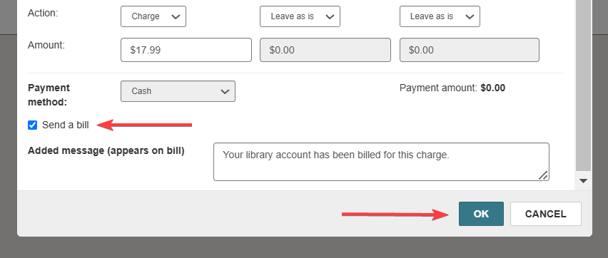
Billing for Library of Things
Sending a manual bill
"Lost Items" - https://www.ccslib.org/training/lost-items

Slide 21
Patron Record Title Field

Slide 22
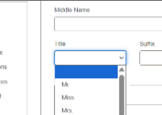
Patron Record Title Field
Optional-use field where staff select a name prefix from a pre-defined list
Title options set at system-level and shared between all libraries
Cannot suppress field from view, but can add/remove/edit list options
Patron Registration Workform Title Field

Slide 23
Patron Record Title Field
0.89% of patron records use Title field (5,210 patron records)
99.1% of patron records do not use Title field (574,207)
Less than 30 patrons registered since 2020 have Title information in their record

Slide 24
Title | No. Patrons Assigned
No title used | 574,207
Ms. / Ms | 2,536
Mr. / Mr | 1,506
Miss | 444
Mrs. / Mrs | 666
Dr. / Dr | 24
Jr. / Jr | 19
Sr. / Sr | 10
III | 3
IV | 1
(S) / s | 1
Capt | 0
Title | No. Patrons Assigned
Fr. | 0
Hunk | 0
MD | 0
NTR | 0
o | 0
Rev. / Rev | 0
Sstr | 0
St | 0
; | 0
= | 0
Test | 0
WLK | 0

Slide 25
Patron Record Title Field
Circulation/ILL Advisory Group Recommendation
Recommends CCS libraries cease use of the Title field.
If the recommendation passes, CCS will remove all options from the drop-down list and clear existing data or (if appropriate) move to the Suffix field.

