Slide 1
ILL Technical Group
August 21, 2025

Slide 2
CCS Updates

Slide 3
Vernon Migration Update
Vernon offline starting Thursday, August 28. All other CCS libraries offline starting Friday, August 29.
Libraries back online on Wednesday, September 3, at start of day.
Vernon currently uses dummy cards with local prefix for out-of-system ILLs, so will not run into duplicate barcodes from items lent to Vernon via WorldShare
For CCS libraries who borrowed Vernon items via WorldShare, may run into duplicate item barcodes/records when ILL returned. Email help@ccslib.org and CCS will fix duplicate record.

Slide 4
CCS Updates
RAILS Delivery Count Week – August25 – August 29 (https://railslibraries.org/delivery/count)
ILL Tech Group liaison updates!

Slide 5
Patron-Initiated Renewals on ILLs

Slide 6
Patron-Initiated Renewals on ILLs
The Polaris auto-renew job currently does not differentiate between patron codes when running.
Historically, CCS libraries have had to employ workarounds if they wanted to prevent items lent through ILL from renewing.
CCS has identified a setting configuration to prevent items checked out to ILL patron accounts from auto-renewing

Slide 7
Patron-Initiated Renewals on ILLs
If implemented, this setting would prevent:
  Auto-renewals
  Renewal attempts in the PAC
  Renewal attempts via telephony
The setting configuration would not block staff renewals in Leap or the Client.
  Any staff with general permissions would continue to be able to manually renew materials for ILL Library patron accounts

Slide 8
Patron-Initiated Renewals on ILLs
If implemented, the setting configuration would apply to all records using patron code 'ILL Library.'
CCS reviewed records with patron code ILL Library and have identified records for cleanup ahead of change
The Circulation/ILL Advisory Group recommends implementing this setting change to block patron-initiated renewals for ILL Library patron code.

Slide 9
New Business

Slide 10
Library Showcase

Slide 11
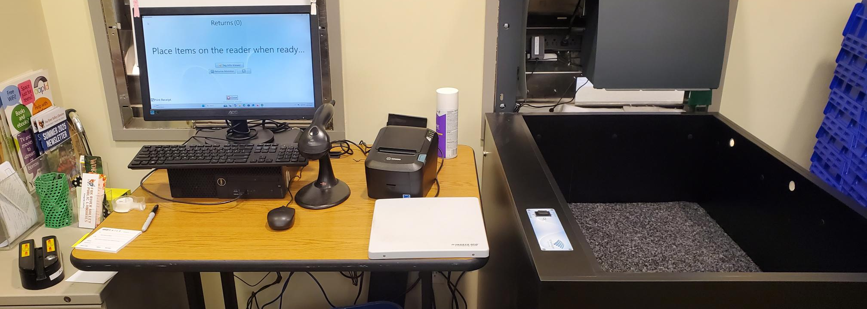

Slide 12
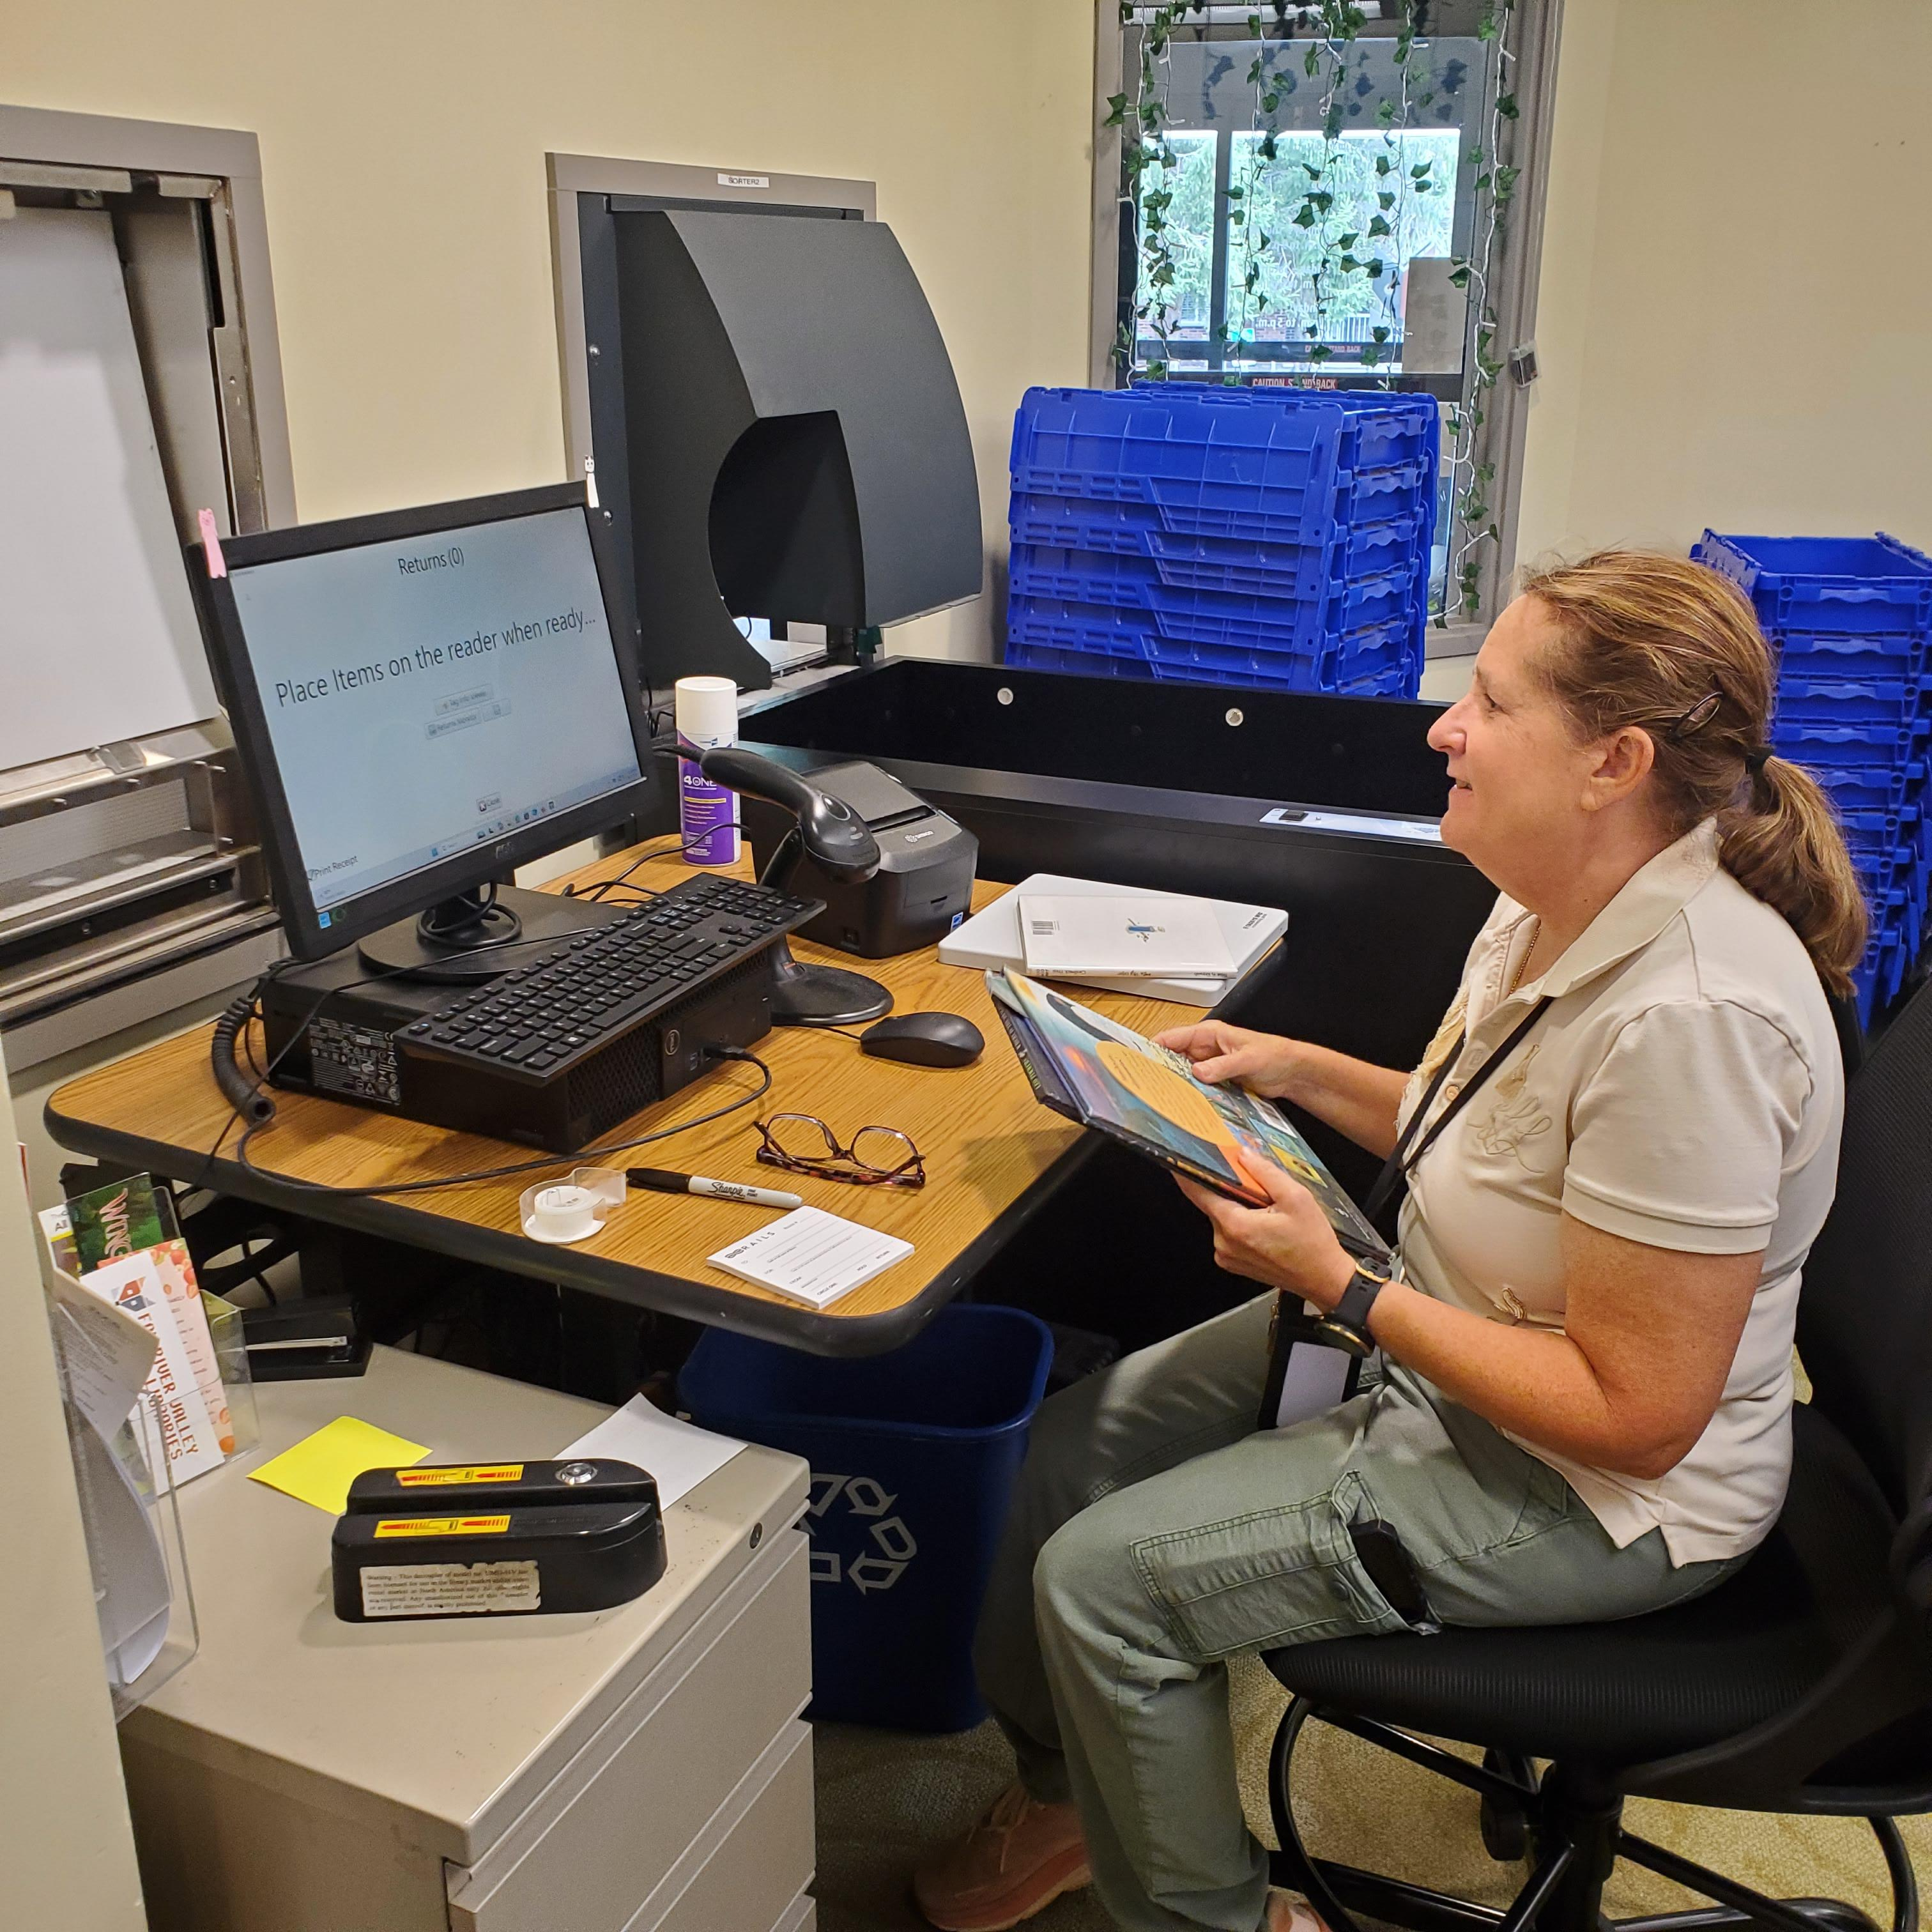

Slide 13
