Slide 1
CAMM Technical Group
August 19, 2026
Notes:
Liaison update

Slide 2
In Person Attendance
Make sure to sign in on the attendance form!

Slide 3
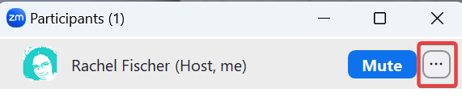
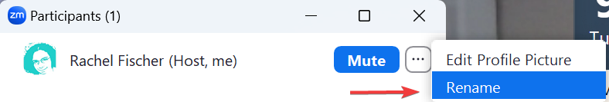
For virtual attendance: Please change your Zoom name to display your name and library.
Open the list of participants.
Find your name.
Click on the three dots.
Click on rename.

Slide 4
BiblioCore

Slide 5
BiblioCore Launch
Performance issues should now be resolved:
  Increase in 500 errors and We're Very Sorry errors
  Indexing Delays
Issues affected all BiblioCore customers
Root cause has not been shared yet

Slide 6
BiblioCore Launch
BiblioCore should sync regularly moving forward:
  Hourly: Hourly syncs manage record additions, updates to existing records, changes in item status, and hold counts
  Nightly: AKA nightly "corrections" process. Handles bibliographic record deletions/updates/additions, admin setting changes, and other settings that are not caught during hourly syncs

Slide 7
Upcoming Changes for EContent Record Display

Slide 8
Upcoming Changes for eContent
Due to issues with how eContent is scoped in BiblioCore, Governing Board voted to temporarily suppress non-integrated eContent in the catalog.
CCS staff will conduct additional research and make a recommendation for a permanent solution later in FY 2027.

Slide 9
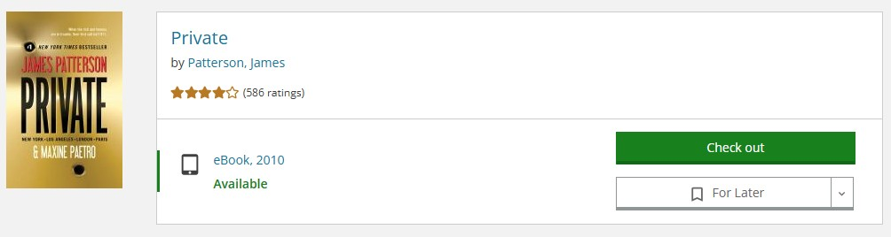
Integrated EContent
Records are automatically imported into the system through the Polaris API
Users can search, check out, and place holds in the catalog.
Checkouts and holds are synched to the user's account
Vendors: Overdrive, Cloud Library
Notes:
Current intefgrated econtent vendors: Cloud library and OVerdrive.

Slide 10
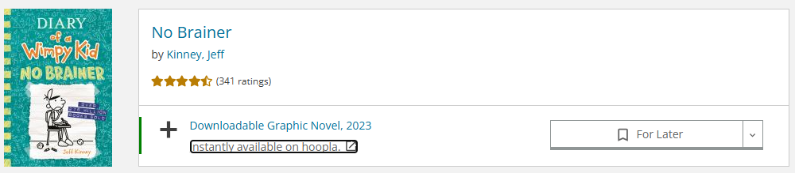
Nonintegrated EContent
Records are manually loaded into Polaris and maintained by CCS or members
Records appear in catalog search results
Records include a link that push the patron out to the vendor’s platform to access the material.
  Checkouts happen on the vendor's website, not within the catalog
Some vendors are set up with individual marc records for each title within the tool (Hoopla, LinkedIn Learning, etc), others are set up as a single record linking to the vendor/database

Slide 11
Scoping in PowerPAC
Logged in users only see eContent they can access
Non-logged in users see eContent accessible to patrons of the library site they are using.
These behaviors are true whether the user searches All Member Libraries or a specific library.
Records are scoped using Polaris Resource Group functionality
Scoping setup is done by CCS with support from members

Slide 12
Scoping in BiblioCore
EContent is scoped based on the library site being used, regardless of user’s registered library.
Requires library-specific URLS in the 856 to determine which library owns.
  In most cases, eContent without library-specific URLs in the bibliographic record cannot be scoped correctly.
Searching “All Partner Libraries” displays eContent owned by all of CCS. Searching a specific library displays eContent owned by that library (that is scoped correctly)
Scoping is configured by Bibliocommons support
Notes:
Examples of records that aren't scoped properly:
LearningExpressLibrary in Grayslake
. https://grayslake.bibliocommons.com/v2/search?query=LearningExpressLibrary&searchType=smart
Niche Academy (Crystal Lake) : http://crystallake.bibliocommons.com/v2/search?query=Niche%20Academy&searchType=smart
Niles-Maine Pressreader: https://nmdl.bibliocommons.com/v2/search?query=pressreader&searchType=smart

Slide 13
Group Recommendations
Database Management recommendation:
  CCS remove non-integrated eContent that cannot be properly scoped from the catalog
Challenge:
  Requires extensive review of records
  Requires manual updates to individual bibliographic records to either delete or correct individual URLs
Governing Board Decision:
  Temporarily suppress all non-integrated eContent records until further research is completed
Benefits:
  Suppression keeps records available for future use if needed
  More flexible than permanent deletion

Slide 14
EContent that will continue to display
Scoping Complete
Overdrive
Cloud Library
Hoopla
Flipster
Scoping In Progress
LinkedIn Learning
Comics Plus
Kanopy
Creativebug
Notes:
Can a library do cleanup to scope? No
PressReader – no unique URLs & libraries have different holdings.

Slide 15
Next Steps
End of August: CCS will suppress remaining non-integrated eContent records
H2 FY2027: CCS staff will conduct additional research and make a recommendation for a permanent solution
CCS will continue to maintain eContent holdings for resources on previous slide

Slide 16
Polaris Updates

Slide 17
Polaris Updates – Item Record Slowness
Some libraries have reported slowness working with item records in the staff client
This issue is impacting other Polaris customers and Polaris support has been able to replicate
Currently being investigated by the Cloud team
  Conducting stress tests on internal servers to determine root cause
No firm timeline for resolution, but it has been escalated and is being actively worked on

Slide 18
Rolling Meadows/
Wauconda Migration

Slide 19
Rolling Meadows/Wauconda Migration
EVENT | DATE
RMK/WUK's last day on legacy ILS. Data extracted after libraries close | October 15, 2026
RMK/WUK begin using Polaris offline. Innovative preps data for load. | October 16, 2026
All CCS libraries offline. | October 17, 2026
All CCS libraries offline. | October 18, 2026
All CCS libraries offline. | October 19, 2026
RMK/WUK live on Polaris! All CCS libraries resume Polaris activity. | October 20, 2026

Slide 20
Subject heading update

Slide 21
Subject heading update
Transsexual headings have been updated to Trans headings.
Many Indians headings have been updated to Indigenous peoples headings.
Not all Indians headings have been changed by Library of Congress yet.
Changes will happen over a long period of time.
Notes:
Major changes have been made to the LCSH terms for Trans people and Indigenous people. Transsexual headings have been updated to Trans headings. Many Indians headings have been updated to Indigenous peoples headings. I’ve already updated the bibliographic records. There are tables in the packet depicting the changes that were made. The efforts to change the LCSH terms for Indigenous people of the Americas will take place over a long period of time. In the mean time, you will see both Indians and Indigenous peoples headings in the catalog.

Slide 22
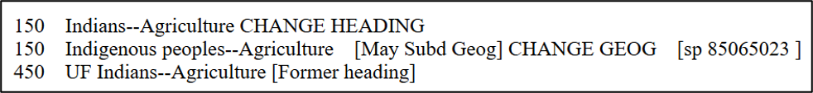
Subfield X is Subdivided Geographically
Example:
650 0 ‡a Indigenous peoples ‡x Agriculture ‡z America.
Notes:
The Indigenous people terms require geographic subdivisions to distinguish between the Americas and the rest of the world. Depending on the subdivision in $x, the geographic subdivision ($z) may come before or after the subdivision in $x. There's a link to the approved list in the packet. Please review this list if you have any questions on geographic subdivisions. On this slide, agriculture is in the $x. The image is from the approved list. This has an abbreviation in the red box for may subdivide geographically. So, the geographic subdivision goes after agriculture.

Slide 23
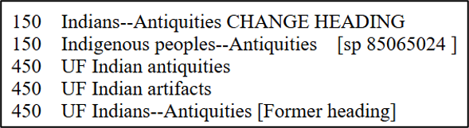
Subfield a is Subdivided Geographically
Example:
650 0 ‡a Indigenous peoples ‡z America ‡x Antiquities.
Notes:
On this slide, there is no notation for the geographic subdivision in the approved list. In this case, the geographic subdivision comes after Indigenous people and before antiquities.

Slide 24
BSLW Batch Processing Schedule

Slide 25
BSLW Schedule
Service | Date
Batch processing | Postponed until Sept. 17th
Authority Notification Services | Sept. 17
Batch processing | Oct. 15
Authority Notification Services | Dec. 17
Batch processing | Dec. 17
Batch processing | Feb. 18
Authority Notification Service | Mar. 18
Batch processing | Apr. 15
Authority Notification Service | June 17
Batch processing | June 17
Notes:
Here's the BSLW schedule of services for the year. The bibliographic batch processing for August has been postponed until Sept. 17th. This has the schedule for the authority notification service and batch processing. The batch processing dates are the only ones that require restrictions to cataloging tasks.

Slide 26
Import Jobs Queue

Slide 27
Import Jobs Queue Retention Policy
Large amounts of reports retained in the import jobs queue can slow down the loading time.
CCS plans to reduce the number of import reports that are being retained in the import jobs queue to 1 month.
Notes:
Large amounts of reports retained in the import jobs queue can slowdown the loading time. CCS plans to reduce the number of import reports that are being retained in the import jobs queue to 1 month. We hope that decreasing the amount of reports that need to load will improve the speed that the import jobs queue takes to load.

Slide 28
Local Practices for the 856 Tag

Slide 29
856 tag and Cover Images
The local practice for 856 tags includes deleting URLs for cover images.
Most cover images come from Syndetics.
Cover images are matched to bib records by ISBN, UPC, or EAN.
If a cover image is missing, BiblioCore can display an image from a link in the 856 tag.
Notes:
The local practice for 856 tags includes deleting URLs for cover images. If a record has an ISBN, UPC or EAN, cover images come from Syndetics. CCS staff can upload cover images to Syndetics to make corrections or add one that is missing. Syndetics can’t supply a cover image for a local item that is missing an ISBN, UPC, or EAN. However, BiblioCore has the ability to use a url in the 856 tag for local items when Syndetics can’t supply a cover image.

Slide 30
CCS Recommends Changing the Policy
    The 856 tag for cover images should only be allowed in records for unique local material and material that does not have a single UPC or EAN.
    The library must host the image in a drive that can produce a link that will allow public access to the image.
    All other cover images should be removed from bibliographic records.
Notes:
CCS staff reviewed a request to change the policy to allow cover images in the 856 tag for local items. In order to accommadate local images in Bibliocore, CCS recommends that
The 856 tag for cover images should only be allowed in records for unique local material and material that does not have a single UPC or EAN.
The library must host the image in a drive that can produce a link that will allow public access to the image.
All other cover images should be removed from bibliographic records.

Slide 31
SCRAP Advisory Group Recommendation
SCRAP voted to approve the motion to:
  Recommend that CAMM allows the 856 tags for cover images for unique local material and material that does not have a single UPC or EAN in the CCS database.

Slide 32
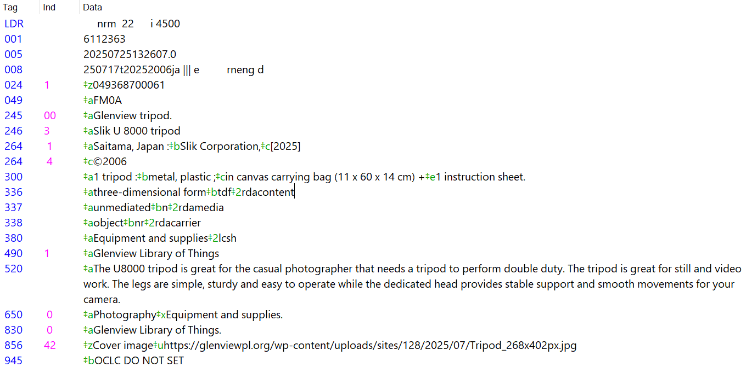
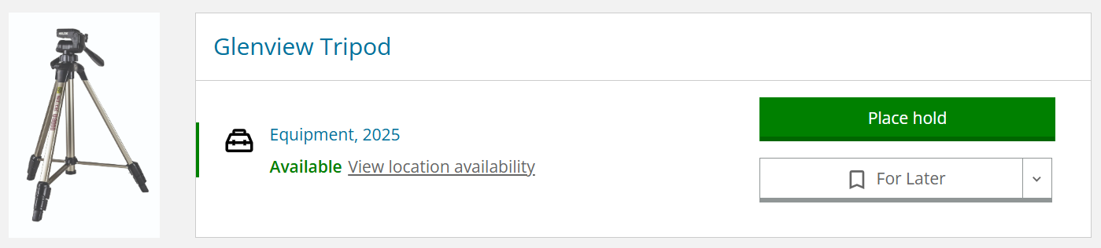
Example
Notes:
Here's an example of a record from Glenview. 024 has $z, not a $a. This would prevent the image to appear from Syndetics.

Slide 33
Example Motion
Allow the 856 tags for cover images for unique local material and material that does not have a single UPC or EAN in the CCS database.

Slide 34
Cover Images in BiblioCore

Slide 35
Adding Images to the 856 for BiblioCore
Use indicator 42.
Add subfield z or 3 with the following text: 'Cover Image'
Add the URL to the image following the u subfield indicator.
Example:
856 42 $zCover Image$uhttp://anytownlibrary.org/images/9780545029360.JPG
Notes:
Most cover images come from Syndetics, as they did in PowerPAC. Use for LOT, local material? Not for use to replace Syndetics image—open a ticket for CCS

Slide 36
Image Specifications
Formats | Image files must be in one of two formats: JPEG GIF PNG
Image Size | BiblioCore will display the same image on search results and on the bib page. Image size should be 268 px wide by 402 px high.
File Names | Use any file-naming convention that is convenient for you. Ensure that each image has a unique file name.
Hosting | Images can be stored anywhere as long as they are publicly accessible (can be linked to)

Slide 37
TCP/IP Importing

Slide 38
Limitations of TCP/IP MARC Import
Only final bibliographic records can be imported using the TCP/IP connection.
Options for importing on-order bibliographic records or authority records:
  Use the export settings in Connexion to export to a file and import it as usual.
  Import the records from the remote database (Z39.50) with the Find Tool in Polaris.
Everyone must use the same import profile.
  Import profile name: TCP-IP connection
  This is the import profile for importing final records from OCLC.
Record set name:
  TCP-IP OCLC Full Bibs Final (with date and time after)
  TCP-IP OCLC Full Bibs Provisional (with date and time after)
Import jobs queue does not show the name of a library or username.
Notes:
Before setting up the TCP/IP MARC Import, there are several limitations that you need to understand. Only final bibliographic records can be imported using the TCP/IP connection to OCLC. If you import on-order bibliographic records or authority records from OCLC, you will need to continue to use the previously existing methods. These include exporting a file from Connexion that is imported via MARC import to Polaris, or importing records from the remote database using the Find Tool. Regarding the TCP/IP MARC Import process, all staff will need to use the same import profile. This has already been set up for you. The import profile is called TCP-IP connection. It is the same import profile as the one for importing final records from OCLC. The record set names are listed on the slide. Finally, the import jobs queue does not show the name of a library or username. So, you may need to check more than one import report before finding the one for your import job.

