Slide 1
The CMC is Here to Help!
Dr. Pamela Thomas, Bibliographic Grant Manager
CAMM, August 19, 2026, 10:00 a.m.
Notes:
Welcome! My name is Dr. Pamela (Pam) Thomas, and I am going to share a little bit about how the CMC (Cataloging Maintenance Center) can help you.

Slide 2
CMC Mission/Funding
The Cataloging Maintenance Center (CMC) provides statewide cataloging support for Illinois libraries, including free original and copy cataloging of eligible special collections, consultation on metadata projects, database cleanup for LLSAPs, cataloging training, and more. It is funded by a grant that was awarded by the Illinois State Library, with additional support from the Illinois Heartland Library System (IHLS).

Slide 3
CMC’s Free Services
Free cataloging of Illinois authors, history, and genealogy, government documents, microfilm, and special collections
  Special collections are defined by your library and might include world language materials, kits, binge boxes, realia, theses, dissertations, library of things, etc.
Free cataloging-related courses in Moodle via the SHARE training portal
Monthly (Aug.-May) Online with the CMC webinars on cataloging-related topics with a Q&A
Online cataloging request form, when you don’t want to send your physical items in for cataloging
Database cleanup—usually for consortia
Creation of authority records (names, titles, and subjects)
Merging duplicate records in OCLC Connexion
Notes:
These are all the free services the CMC staff provide to Illinois libraries in good standing.

Slide 4
Upcoming Online with the CMC Webinars
Press Start: Cataloging Games with RDA, Sept. 10, 2026. Register in L2.
Join CMC Cataloging Trainer Eric McKinney and Bibliographic Grant Manager Pamela Thomas as they guide you step by step through the process of cataloging video, outdoor, card, and board games using Resource Description and Access (RDA) guidelines. This session will provide practical insight into applying cataloging standards to games, highlighting key elements, common challenges, and best practices for creating accurate and consistent metadata. Ideal for catalogers, librarians, and information professionals, this webinar will help you build confidence in working with non-traditional materials, such as games.
Do You Catch My Drift?: Cataloging "Drift" in Your ILS, Oct. 15, 2026. Register in L2.
What is cataloging drift? Join Barb Scoby as she discusses what it is and how you can keep your ILS up to date.

Slide 5
More Online with the CMC Webinars
MARC-ing My Territory: Adventures in Cataloging, Nov. 12, 2026. Register in L2.
Curious about what catalogers really do and how MARC records work behind the scenes? Join Bibliographic Grant Manager Dr. Pamela Thomas as she shares her cataloging journey and breaks down the anatomy of a MARC record. This session will offer both personal perspective and practical guidance, helping attendees better understand how bibliographic data is structured and why it matters.
What’s It All About?: The Use of Genres and LCSH Subdivisions, Dec. 10, 2026. Register in L2.
Join CMC Cataloger Mary Cornell as they look at when to use LCGFT genre headings vs the $v, what order to string together LCSH subdivisions in subject headings, and some basics about subdivision application.

Slide 6
More Online with the CMC Webinars
AI and the Library World, Part IV, Jan. 14, 2027. Register in L2.
Join CMC Cataloging Trainer Eric McKinney for our annual foray into the world of Artificial Intelligence (AI). This time, looking at the most popular uses of AI in the library world outside of chatbots. Want to see how libraries (at all levels? of all stripes?) are using AI in their work? Join us to find out.
Metadata Basics: MODS, Feb. 11, 2027. Register in L2.
Join Metadata Cataloger Kat Anderberg in this introduction to the Metadata Objects Description Schema (MODS). Topics covered include the history of MODS, elements, and example records.
March-May 2027, TBD

Slide 7
CMC Cataloging Training
Focus on Deriving a Record, Eric McKinney, September 21 – October 4, 2026. Register in L2.
Have you found records in OCLC that are almost a match, but you need to create a new bibliographic record, or do you? If you find a close match, you can derive a new record. Eric McKinney will teach you how to do that.
Cataloging Basics, Eric McKinney, November 2, 2026 – December 13, 2026. Register in L2.
This six-week crash course in basic cataloging dives into cataloging using RDA, the Resource Description and Access standards, and using MARC, the MAchine-Readable Cataloging standards. Eric McKinney will cover MARC fields 0XX-8XX and fixed-field elements, the most commonly used fields when cataloging library items.
Focus on World Language Cataloging, Mary Cornell, November 2-15, 2026. Register in L2.
Has your library been purchasing materials in world languages, and you need help figuring out where to start cataloging these items? Mary Cornell will help walk you through the steps of cataloging world language materials.
Focus on Serials Cataloging, Mary Cornell, January 11-24, 2027. Register in L2.
Are you new to cataloging serials (continuing resources), or do you need a refresher? Then this is the class for you! Mary Cornell will spend two weeks discussing how to fill in the fixed and variable fields of a serials bibliographic MARC record.

Slide 8
More CMC Cataloging Training
Cataloging Basics, Eric McKinney, March 1 – April 11, 2027. Register in L2.
  This six-week crash course in basic cataloging dives into cataloging using RDA, the Resource Description and Access standards, and using MARC, the MAchine-Readable Cataloging standards. Eric McKinney will cover MARC fields 0XX-8XX and fixed-field elements, the most commonly used fields when cataloging library items.
Focus on DDC, Mary Cornell, March 8-21, 2027. Register in L2.
  Are you new to the Dewey Decimal Classification (DDC) system, or would you like to learn more about the beginner technical aspects? Mary Cornell will spend two weeks discussing the basics of DDC, including classes, tables, and more!
Focus on LCC, Eric McKinney, March 22-April 4, 2027. Register in L2.
  Join Eric McKinney for this two-week course on the Library of Congress Classification (LCC). Whether you are new to LCC or just looking for a refresher, this course will cover the historical context, the structure of the classification system, how to build a call number, and more!
Focus on NLM, Ryan Rafferty, April 5-18, 2027. Register in L2.
  Are you interested in learning about the National Library of Medicine (NLM) classification scheme? Ryan Rafferty will guide you through two weeks of learning and discussing the basics of NLM, which covers some history, understanding, and creating call numbers, an introduction to Medical Subject Headings (MeSH), and more!
Notes:
The three two-week focus on classification classes that we are offering next spring are new!

Slide 9
Cataloging Statistics
Notes:
During FY2026, CMC staff originally cataloged 2,144 items and enhanced 3,035 records for 124 libraries. Not shown on the chart: CMC staff created or enhanced 227 name, series, subject, and title authority records and merged 376 bibliographic records for books, e-books, and visual materials in OCLC.

Slide 10
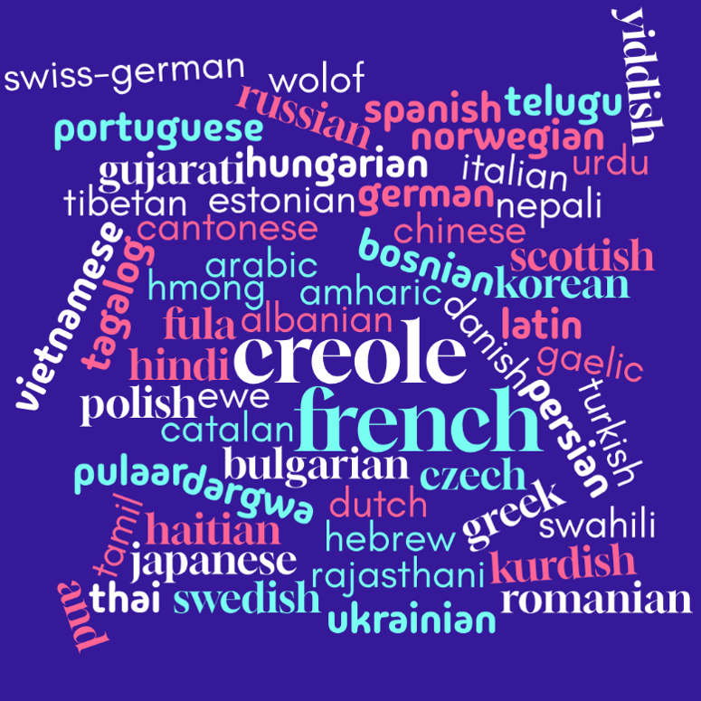
World Language Cataloging
Notes:
During FY2026, CMC staff originally cataloged or enhanced records in 55 different world languages.

Slide 11
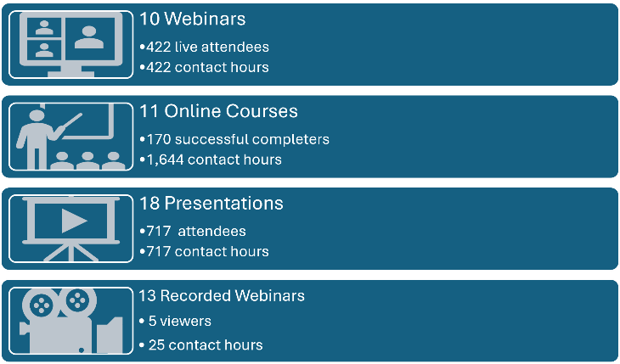
Training
Notes:
During FY2026, CMC staff presented 10 webinars with 422 live attendees, offered 11 courses with 170 successful completers, and presented at 18 conferences or consortial meetings with 717 attendees for 717 contact hours. Overall, there were 1,309 total attendees/completers of courses and presentations, and 2,783 contact hours from the webinars, courses, and presentations. Five people viewed a total of 25 recorded Online with the CMC webinars for 25 total contact hours.

Slide 12
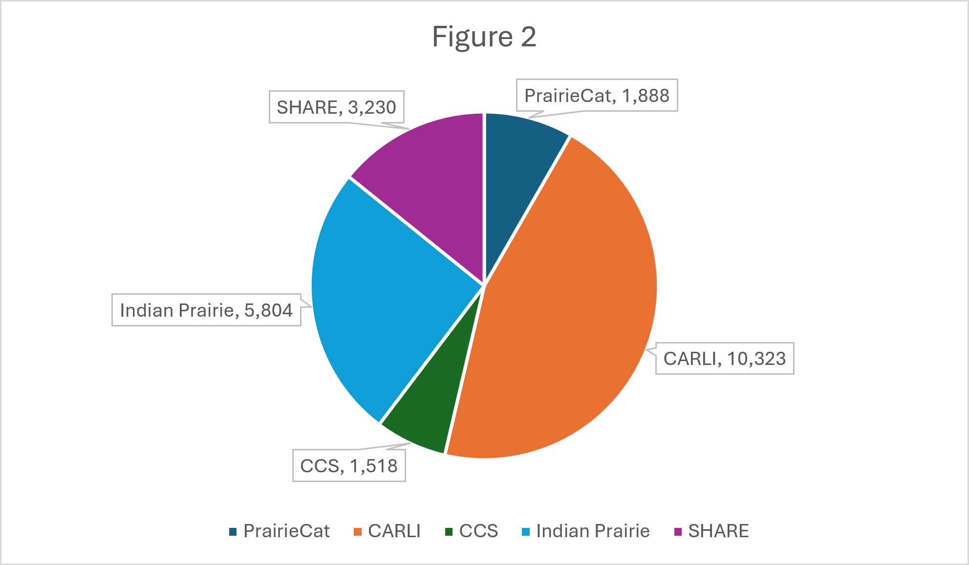
Database Cleanup
Total database cleanup: records touched in FY2026
Notes:
CMC staff provided database cleanup, and during FY2026, 1,888 records were enhanced and identified as merges for PrairieCat; 1,518 records were enhanced and merged for CCS; 10,323 records were edited, deleted, or merged for CARLI; 5,804 brief records were enhanced to full bibliographic records or merged in Follett Destiny for Indian Prairie Community Unit School District #204; and 3,230 links were checked for the SHARE 856 Field Removal Project. A total of 22,763 bibliographic records were enhanced, originally cataloged, merged, deleted, or links retained or removed. On the next slide are the projects with a description of what each entails.

Slide 13
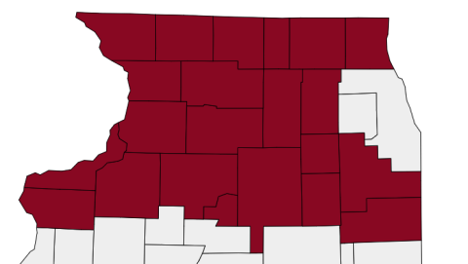
PrairieCat
Bibliographic records enhanced,
originally cataloged,
or identified as a merge/match
PrairieCat: 1,888
Notes:
PrairieCat is a consortium of 138 libraries in 22 northern counties. In 2019, PrairieCat approached the CMC about helping update the records in their database to meet current RDA standards. They also wanted to identify any records in their catalog that needed to be merged. After discussing the project and determining the best way to proceed, PrairieCat supplies us with 50 records in a notepad file, and we get to work! We search Vega for the title to look for any duplicate records. We find the item in OCLC and enhance the record if it isn’t already. Sometimes it may be necessary to create a new record, and we are always happy to do so. The friendly staff request items from member libraries on our behalf and send them to one of our hubs, should we need information that only having the item in hand can provide. When finished, we email a spreadsheet that lists which updated OCLC records match their local control numbers. We also note any records they will need to merge into their catalog. We provide a .dat file of the updated records so their staff can overwrite the old records with the enhanced bibliographic records. We have made a lot of progress! In May, the CMC began working on a cleanup project for MARC field 263, Projected Publication Date. From 2019 to 2026, CMC staff enhanced, originally cataloged, or identified as a merge/match 27,787 records.

Slide 14

CARLI
Bibliographic records
edited, deleted, or merged
CARLI: 10,323
Notes:
The Consortium of Academic and Research Libraries (CARLI) asked us to merge, edit, and delete records from Alma in 2021. The CMC has three special projects catalogers who work almost exclusively on these records. As you can see, they have been quite busy editing, deleting, and merging bibliographic records in the CARLI database. During FY2026, they edited, deleted, or merged 10,323 bibliographic records. Between September 2021 and June 2026, CMC staff have edited, deleted, or merged 3.178 million bibliographic records.

Slide 15
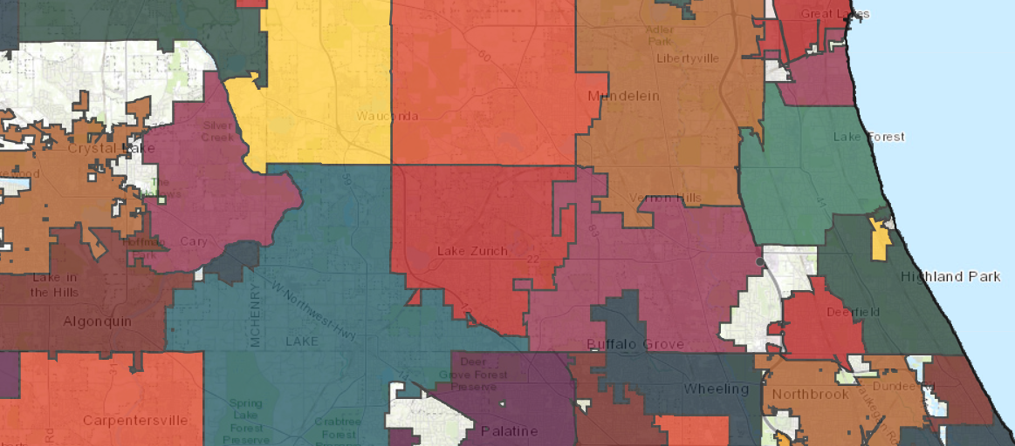
CCS
Scope of the project: 16,309 CCS bibliographic records match the Vernon records
Merging duplicate records
CCS: 1,996
Notes:
CMC staff merged duplicate records from the Vernon Area Public Library into existing bibliographic records in the CCS database using the Leap interface. Each staff member was assigned specific record sets. CMC staff began working on this project on Sept. 15, 2025, to determine whether 16,309 duplicate records are matches. CMC staff completed 1,996 by February 2026, when the project was completed.

Slide 16
Indian Prairie Community Unit School District #204
Enhancing brief records, 9,875
Merging duplicate records, 15,281
Indian Prairie: 5,804
Notes:
Indian Prairie Community Unit School District #204 (IPSD) serves roughly 26,000 students from the Illinois communities of Aurora, Bolingbrook, Plainfield, and Naperville, in DuPage and Will counties. Currently, one preschool, twenty-one elementary schools, seven middle schools, three high schools, one alternative high school, and one transition program are in the district (see the pie chart on the slide for the breakdown). There are thirty-three District 204 schools in Naperville and Aurora, and one in Bolingbrook. The CMC began enhancing brief records in May 2025. Once we have finished working on the brief records (9,875), we will start on the duplicate record list (15,281). We log into IPSD’s Destiny database to work on this project. In FY2026, CMC staff enhanced or merged 5,804 records.

Slide 17

SHARE (Sharing Heartland’s Available Resources Equally
856 links were checked and retained or deleted from bibliographic records.
SHARE Records checked: 3,230
Notes:
CMC staff began working on the SHARE 856 Field Removal cleanup project in May 2026, where 3,230 links were checked and retained or removed. Certain 856 fields have been found to cause confusion and unnecessary links for end users in Aspen. The following record sets contain bib records with 856 fields that need to be examined for accuracy and, in most cases, removed. There are specific 856 fields that will be retained depending on the nature of the item being described by the bibliographic record. There are 108,576 records to be checked.

Slide 18
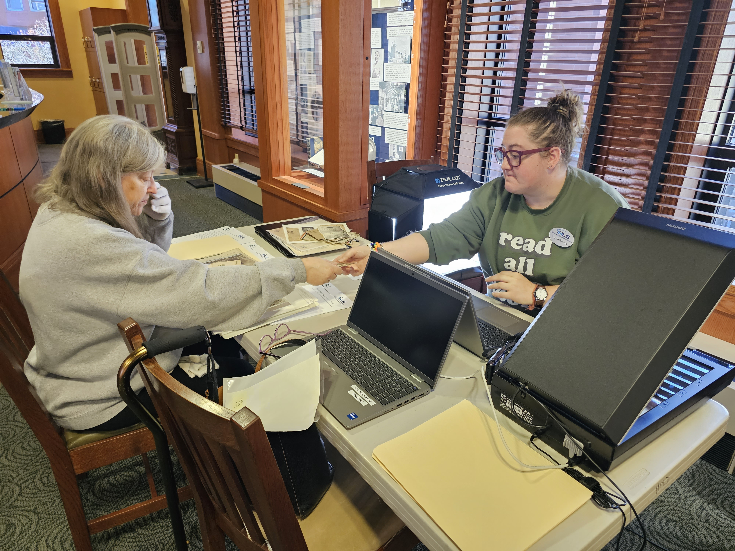
Metadata Cataloging and Consultations
Digitization projects:
Chatham Public Library
Marshall Public Library
New Lenox PL
Chicago Psychoanalytic Institute
ALPLM project
Mobile Memory Lab
kanderberg@illinoisheartland.org
Notes:
In addition to cataloging and database maintenance, the CMC also does metadata cataloging and consultations. Our Metadata Cataloger, Kat Anderberg, has a variety of ways she can help meet the metadata needs of Illinois libraries. Some of the projects she has worked on, or is currently working on, include:
Chatham Public Library—yearbooks, school documents, school newspapers, city newspapers.
Marshall Public Library—oral histories and historical photo collection.
New Lenox Public Library—Civil War letters, obituaries, schools, churches, businesses.
Chicago Psychoanalytic Institute—digitized photos, letters, realia, etc.
Abraham Lincoln Presidential Library & Museum (ALPLM)—pictures project: 6 spreadsheets that need subject headings.
Stinson Memorial Public Library—Digitized newspaper project
Groff Memorial Library and Museum—Photographs (2 collections)
Mobile Memory Lab—a cool, grant-funded program where libraries can sign up to have IHLS staff visit and digitize photographs, family documents (letters, official documents, etc.), and have digital photographs taken of items like family heirlooms (scrapbooks, shadow boxes, jewelry, etc.). Kat then catalogs the digitized items. That is Kat on the right helping a patron reformat important family information for future generations. Contact her at the email address on the slide if you would like to discuss how she can help with your metadata needs.

Slide 19
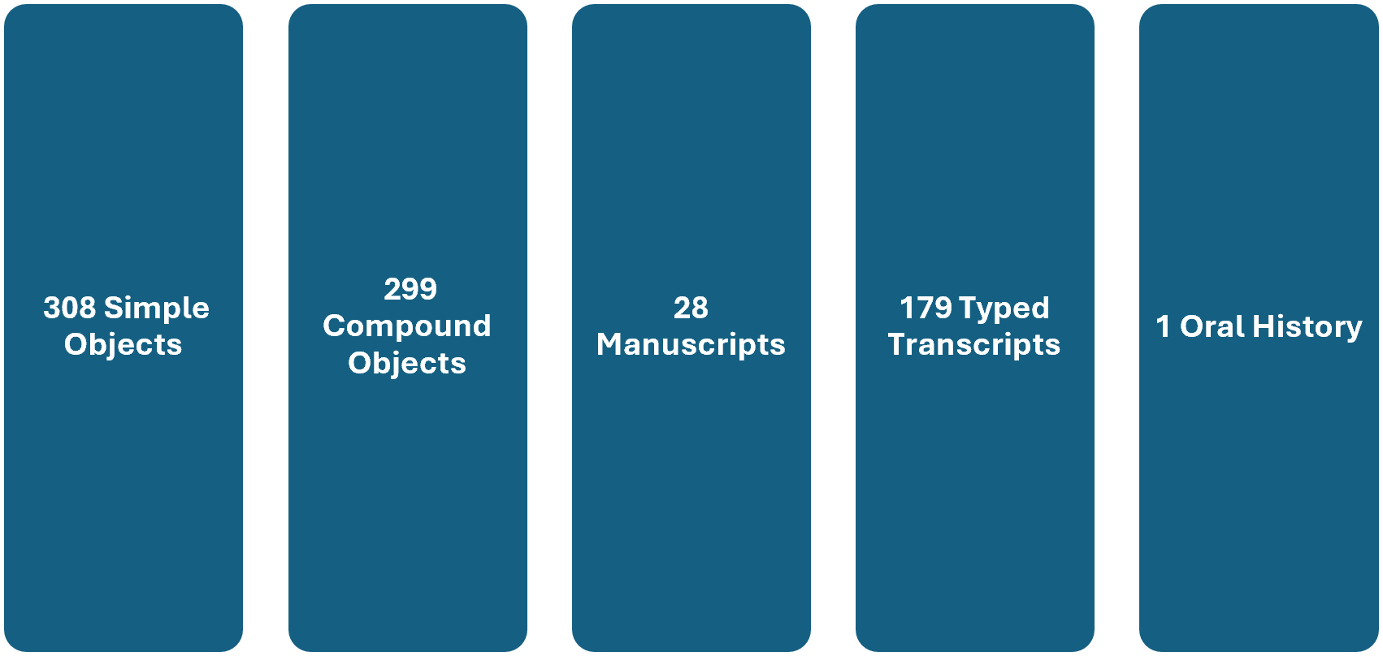
Metadata Statistics
Notes:
The Metadata Cataloger cataloged and digitized 815 items for the Mobile Memory Lab and other libraries, resulting in the creation and upload of 308 simple objects and 299 compound objects. There were 179 typed transcripts, 28 manuscripts, and one oral history transcript completed for a total of 815 digitized items.

Slide 20
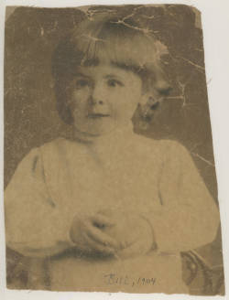
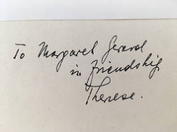
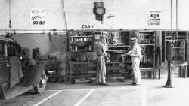
Transcriptions
Notes:
Kat transcribes audio files for the Marshall Public Library's Oral History project. The Friends of Marshall Library have been interviewing citizens and archiving the tapes since 1994. That is a lot of transcribing!! The transcriptions are made available through their website. She also transcribes audio files for the Chatham Public Library. In addition to audio materials, Kat can transcribe handwritten and typed documents previously available only as unsearchable image files and provide typed transcriptions. Most of the materials are uploaded to the Illinois Digital Archives website. Handwritten transcriptions can be challenging. The image on the left is from the Chicago Psychoanalytic Institute collection and says, “To Margaret Gerard in friendship Therese.”
From a signed copy of “Insight and Personality Adjustment” given by Benedek to fellow clinical staff member Margaret Gerard, M.D., now in the library’s collection. This can be found on the Illinois Digital Archives website, https://www.idaillinois.org/digital/collection/p16614coll96/id/7/rec/18. The image in the middle is a photograph of Bill from 1904, part of the Strand family photos, and was taken at a Mobile Memory Lab site visit. The image can be found on the IDA website, https://www.idaillinois.org/digital/collection/p16614coll107/id/7/rec/33. The image on the right is the Ford Repair Shop, part of the Marshall Public Library Digital Archive Collection, which gathers and preserves historical pictures, events, and memories of the Marshall, Illinois area residents through photographs. Photographs were collected by Friend of the Library volunteer Eleanor Macke, community volunteers, and library staff. The image can be found on the IDA website, https://www.idaillinois.org/digital/collection/p16614coll75/id/61/rec/29.

Slide 21
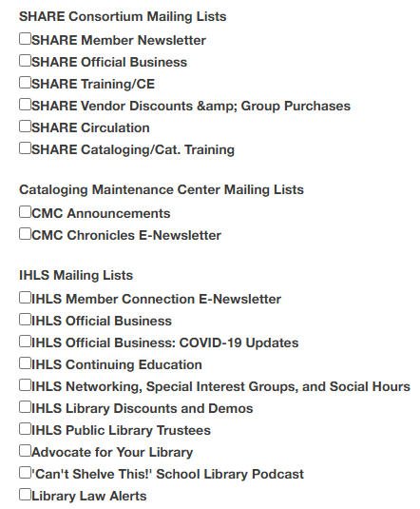
CMC Resources
CMC e-newsletter, CMC Chronicles, https://www.illinoisheartland.org/signup
CMC Chronicles archives, https://www.illinoisheartland.org/services/cmc/chronicles
CMC Online Cataloging Request Form, https://forms.office.com/Pages/ResponsePage.aspx?id=s3c4rTtrLEyHj3jjqNoQdZeZqrEdbHBJnpEDtI3cC3RUOUJZWlMzVE1CODZQNUVMSkxLRzNCU0xTRC4u
CMC web page, https://www.illinoisheartland.org/services/cmc
cmc@illinoisheartland.org
pthomas@illinoisheartland.org
Notes:
I have included a link to the CMC e-newsletter sign-up, and the choices of things to sign up for are on the right of the slide, with the arrow pointing towards CMC Chronicles E-Newsletter, but if anything else interests you, please sign up for that as well, the CMC Chronicles archives web page, the CMC Online Cataloging Request Form, the CMC web page, the group CMC email, and my work email.
In July 2025, the CMC published the first issue of the CMC Chronicles, a bi-monthly e-newsletter. Each newsletter features an article, a quick tip, announcements, and upcoming continuing education opportunities. During FY206, the CMC wrote about the local history center at Mattoon Public Library, text strings, problem subject headings, formatting the same date in MARC records, the bookmobile at Sherman School, recording dates in Dublin Core and the Illinois Digital Archives (IDA) website, the CMC internship program, adding series statements to MARC records, authority work, searching in the Library of Congress Authorities Database, microfilm, and the 580/785 MARC fields. The July issue featured the article, “Why Do I Need a Collection Development Policy?” and the quick tip, Weeding Quick Tips.

Slide 22
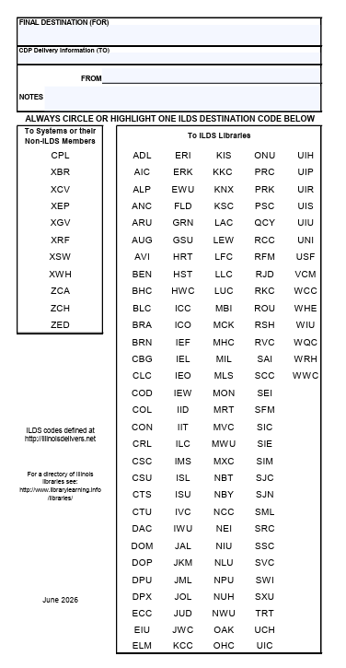
Sending Items for Cataloging
ILDS label
Notes:
Let’s talk about sending items to the CMC for cataloging. Please use an ILDS label when sending in physical items. In the Final Destination (For) line of the ILDS label, write CMC. In the From line, add your library, in the Notes line, add what it is: local author, local history, local genealogy, government document, microfilm, special collection, etc., and circle the system: ZCA (Carbondale), ZCH (Champaign), or ZED (Edwardsville)—whichever hub is geographically nearest to you.
If you are sending your items through delivery:
Rubber band the label to the items, covering the barcode of the item with the ILDS label, and tape the label to the rubber bands.
Send as many items as will fit in a box. The box should not weigh more than 40 pounds. You don’t need to fill a box to send items to us—you can send one item at a time or as many as you have that need to be cataloged, as long as they fit within our purview.
In some circumstances, CMC staff may be able to visit your library to complete the cataloging. Travel by CMC staff will be on a limited basis, depending on several factors (i.e., availability of staff, distance, size of the collection to be cataloged, condition of the collection, etc.). Wi-Fi capability is required.
Items will be cataloged in the order they are received, with turnaround time varying depending on the scope of the project and other factors. Most items will be returned within 30 days, typically within two weeks.

Slide 23
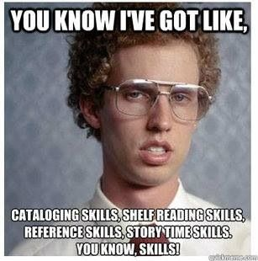
Notes:
Your laugh for the day!

Slide 24
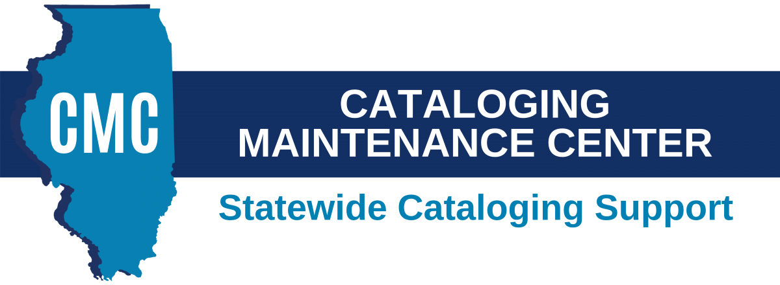
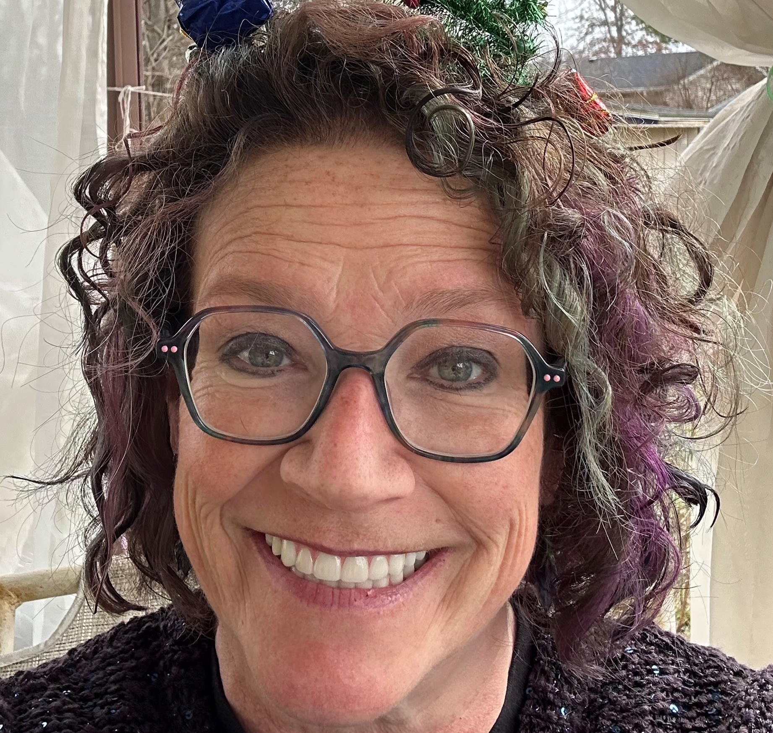
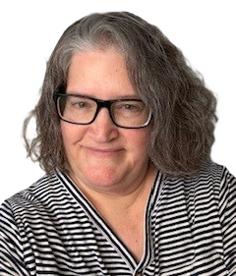
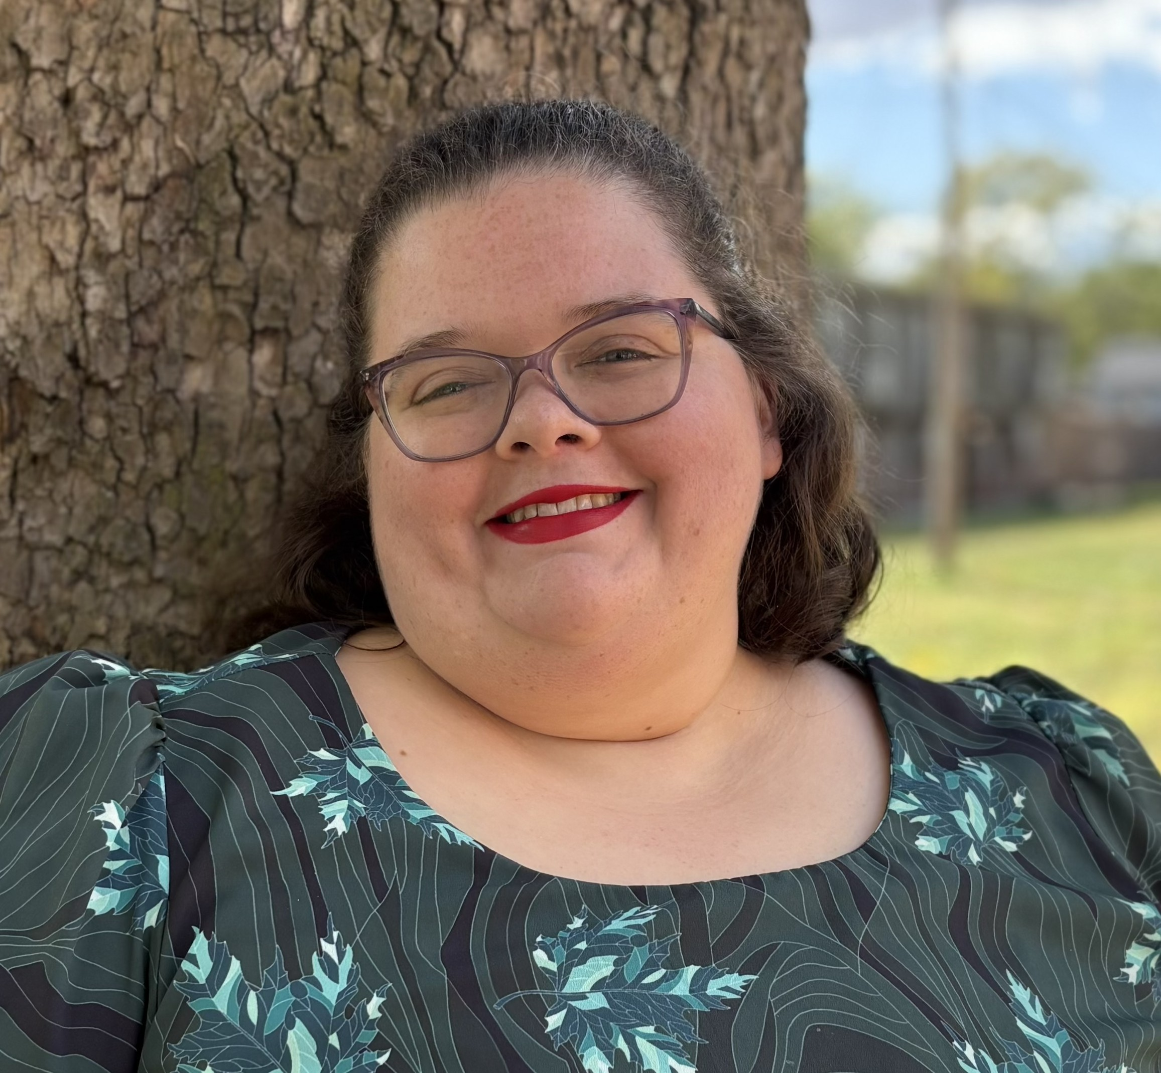
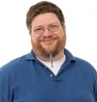
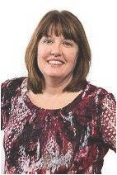
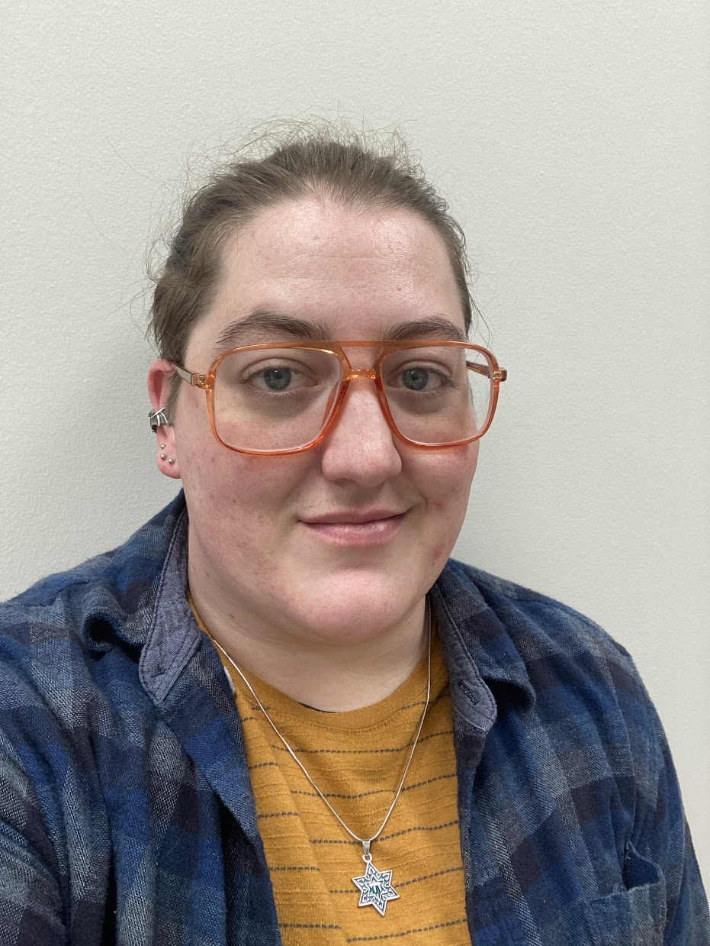
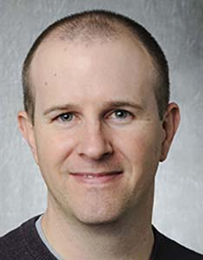
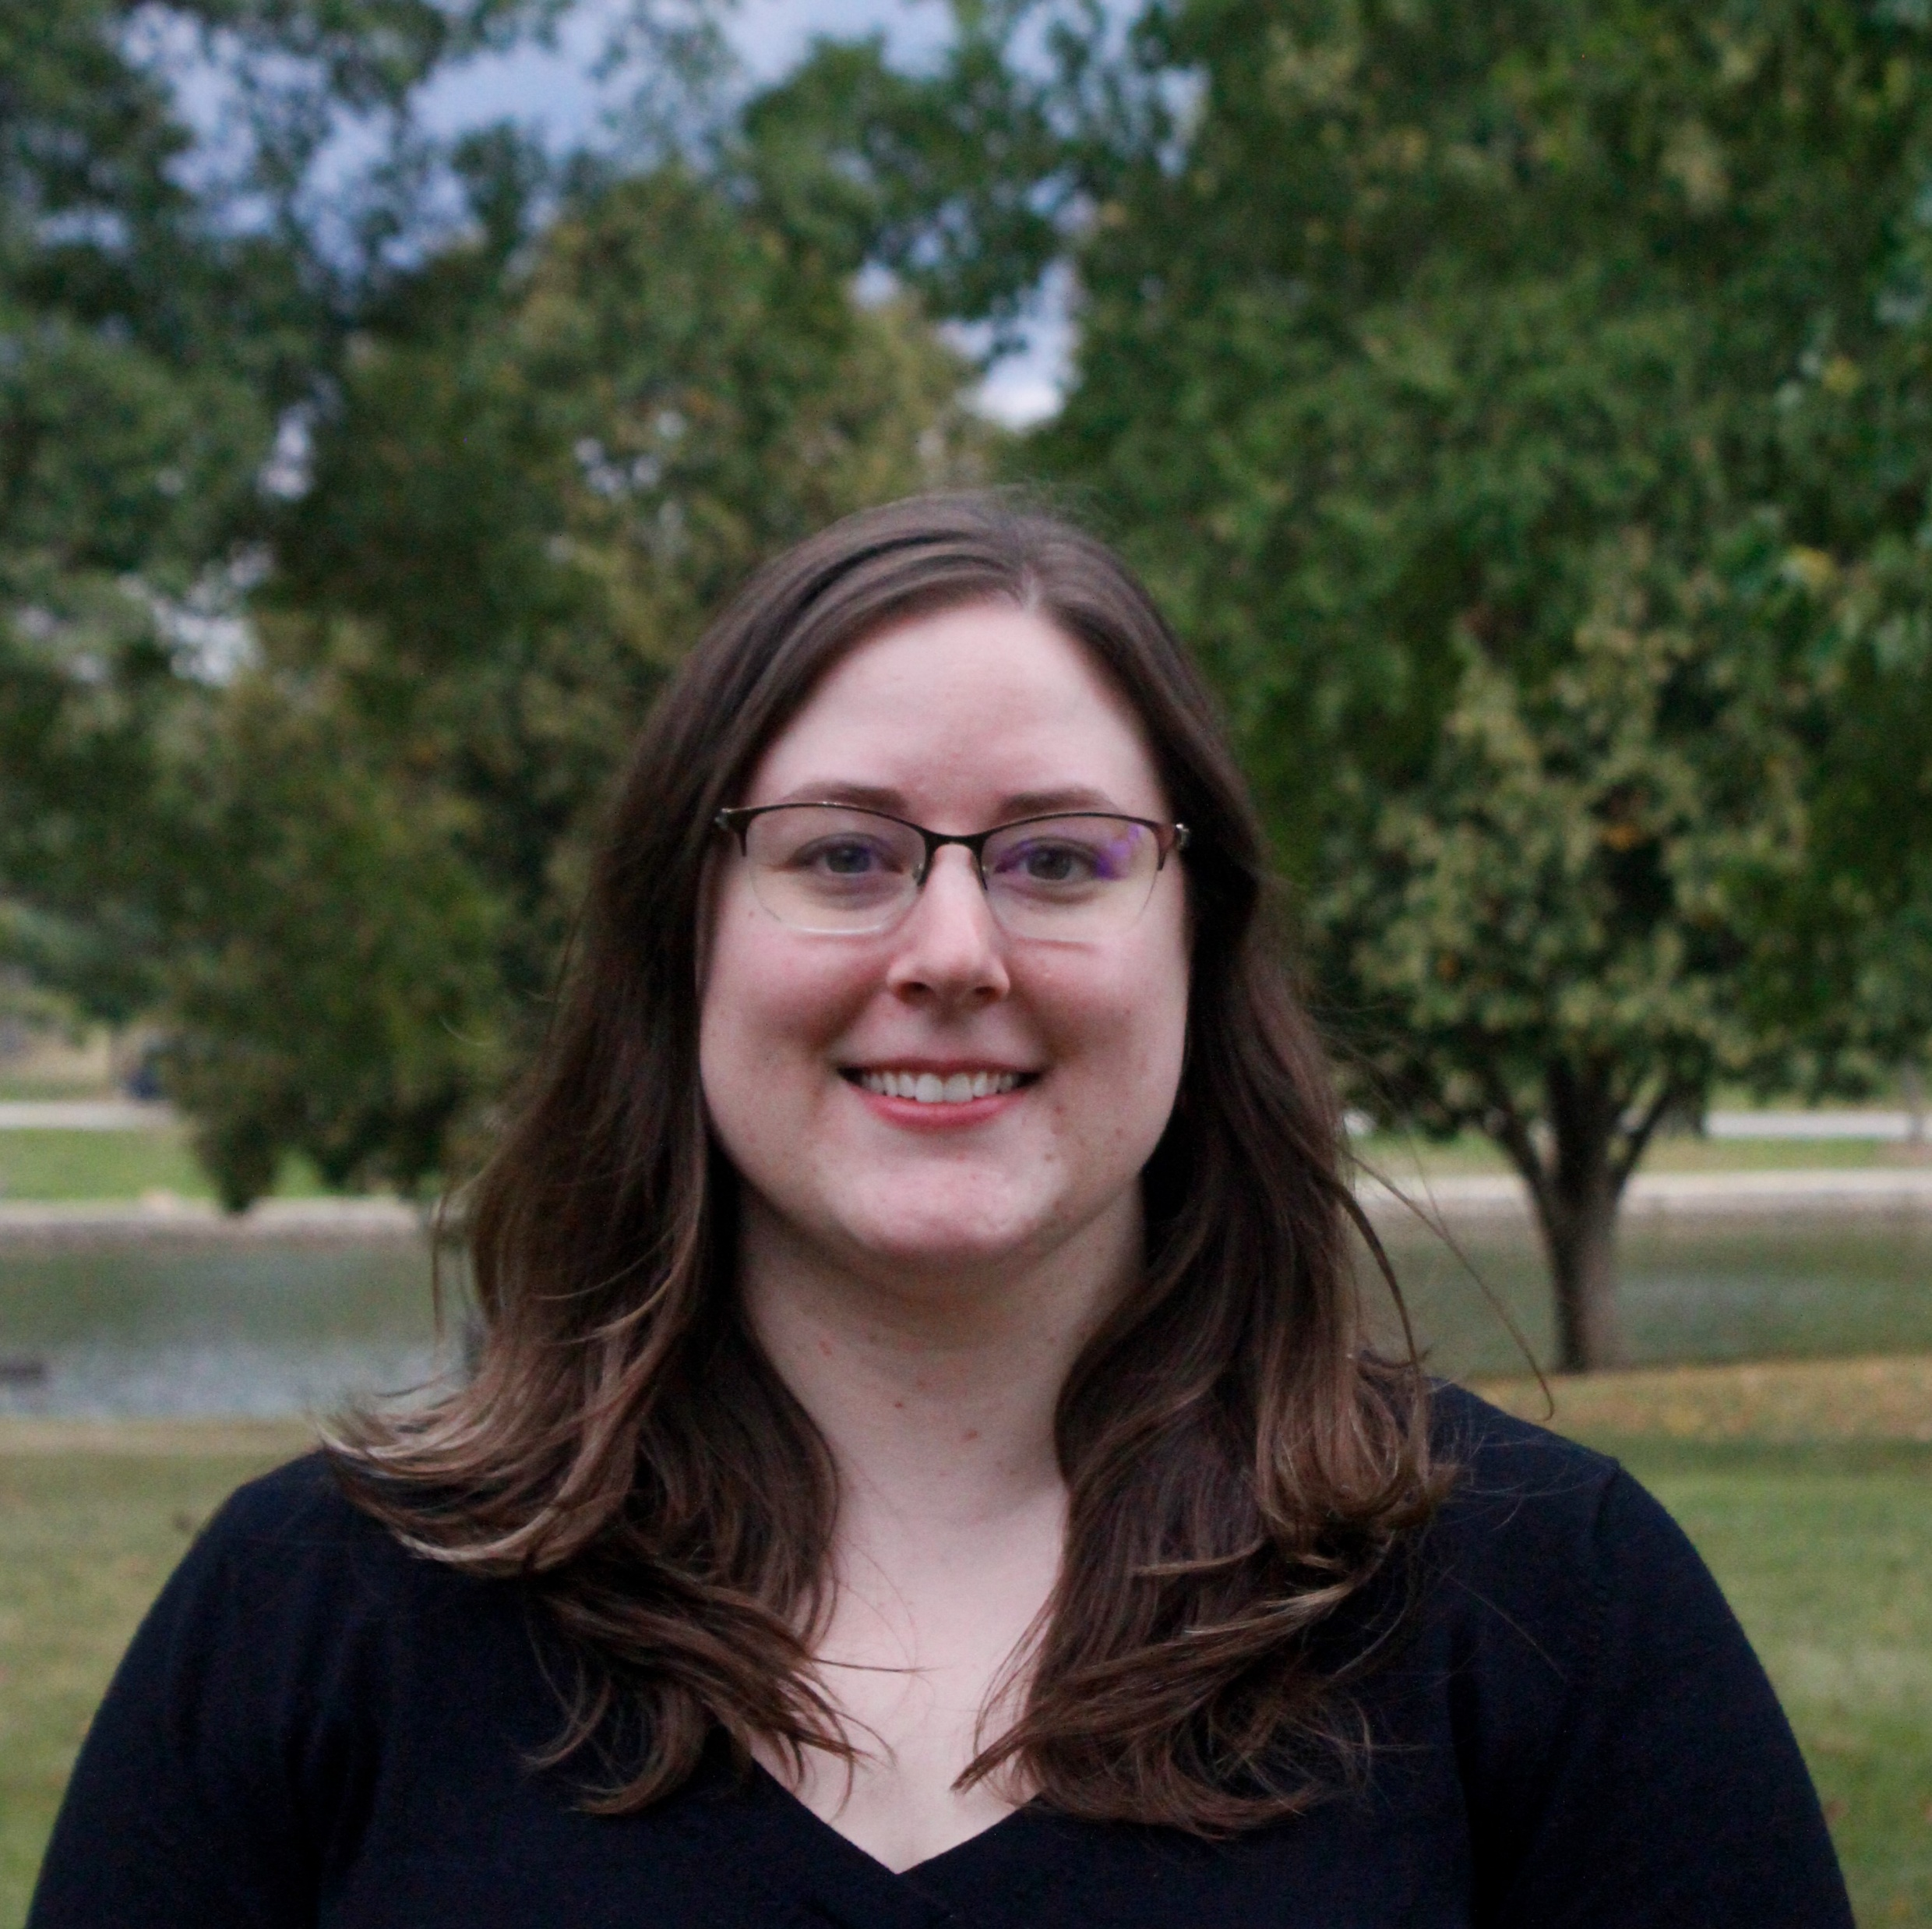
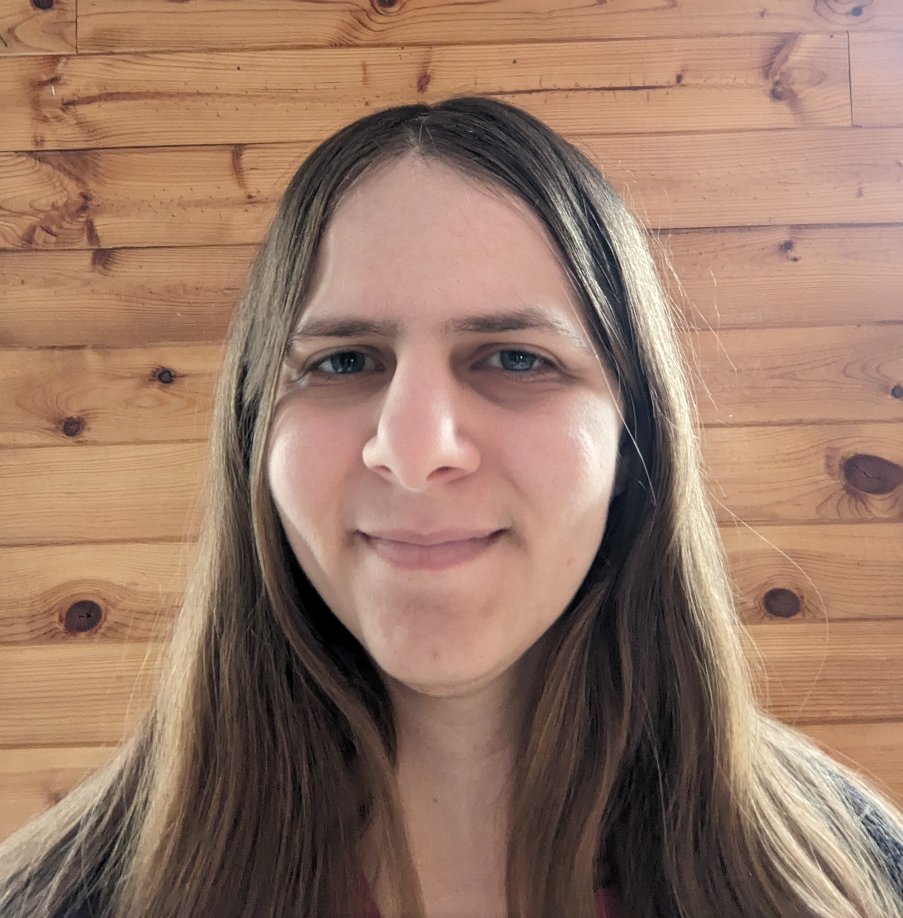
CMC Team
Barbera Scoby
CMC Cataloger
Dr. Pamela Thomas
Bibliographic Grant Manager
Mary Cornell
CMC Cataloger
Eric McKinney
CMC Cataloging Trainer
Shelley Stone
CMC Cataloger
Kat Anderberg
Metadata Cataloger
Ryan Rafferty
Special Project Cataloger
Katie Roberts
Special Project Cataloger
Andrea Giosta
Special Project Cataloger

Slide 25

Questions?
This Photo by Unknown Author is licensed under CC BY-SA-NC
Notes:
I know, this is a lot. Does anyone have any questions?

