Slide 1
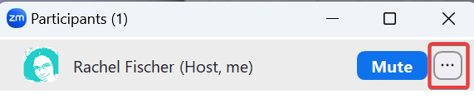
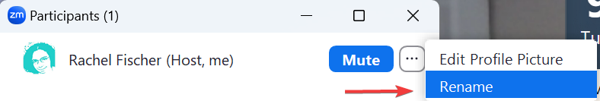
The webinar will start shortly. If needed, please update your profile display to your name and library/library code for attendance.
Open the list of participants.
Find your name.
Click on the three dots.
Click on rename.

Slide 2
CAMM Technical Group
May 20, 2026

Slide 3
Agenda
Call to order
Approval of minutes from last meeting
Additions to the agenda
Call for Officers
Staff Update – Mieko (15 min.)
  BiblioCore
Staff Reminders - Molly (10 min.)
Staff Reminders & Report – Rachel (10 min.)
SCRAP Report – Rachel (10 min.)
Demo – OrangeBoy – Molly (10 min.)

Slide 4
Call for Officers
  Technical Group Member Job Description

Slide 5
BiblioCore Discovery Layer - Mieko

Slide 6
BiblioCore Discovery Layer
PROJECT STAGES
Library Preparation (Oct 2025 – Dec 2025)
Installation and Configuration (Dec 2025 – Feb 2026)
Validation (Feb 2026 – mid-Mar 2026)
Staff Preview and Training (mid-Mar 2026 – mid-Apr 2026)
Public Preview (mid-Apr 2026 – mid-May 2026)
Public Launch (tentative – May 19, 2026)
*Extended Preview (May 2026 – Oct 2026)

Slide 7
BiblioCore Discovery Layer
PROJECT STAGES
Library Preparation
Installation and Configuration
Validation
Staff Preview and Training
Public Preview
Public Launch
*Extended Preview
Dates: April 2026 – May 2026
BiblioCore is soft-launched and patrons can preview the new discovery interface.
Patrons can try out BiblioCore and submit feedback
Libraries promote new catalog to patrons
Library staff continue to create content for their BiblioCore site

Slide 8
BiblioCore Discovery Layer
PROJECT STAGES
Library Preparation
Installation and Configuration
Validation
Staff Preview and Training
Public Preview
Public Launch
*Extended Preview
Date: May 19
BiblioCore becomes the library's primary discovery interface.
For libraries that will launch in May, BiblioCore becomes the primary discovery interface
Libraries will update catalog links from website, external services, etc. to BiblioCore

Slide 9
BiblioCore Discovery Layer
PROJECT STAGES
Library Preparation
Installation and Configuration
Validation
Staff Preview and Training
Public Preview
Public Launch
*Extended Preview
May 2026 – October 2026
For libraries where a May launch is not feasible, they can opt-in to an extended preview until ready for a full public launch.

Slide 10
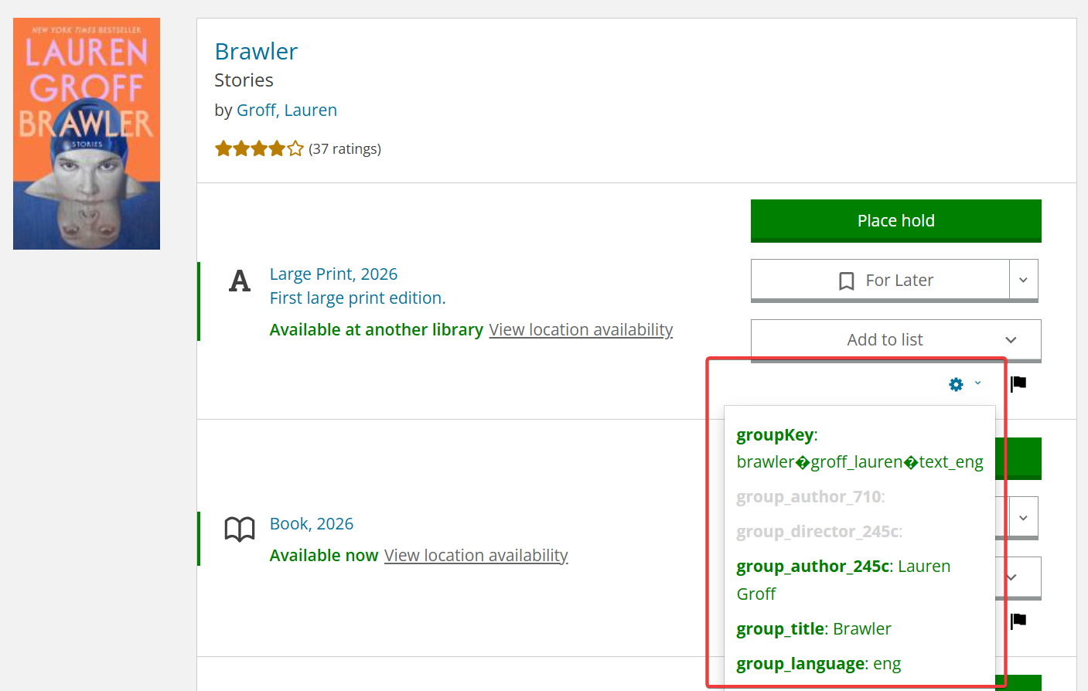
BiblioCore Discovery Layer
Feature: Search Debug Tools
Purpose: Identify metadata used for a grouping
Available to: accounts assigned to the BiblioCore Readers' Advisory permission group

Slide 11
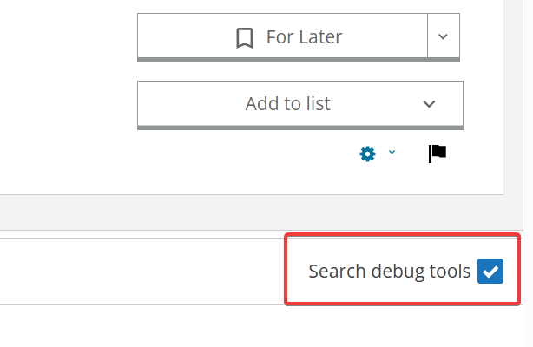
BiblioCore Discovery Layer
To Use:
Log into Core with your staff account
Do a search
Scroll to the bottom of the page and select ‘Search debug tools’
Click the gear icon next to the manifestation you want to check out

Slide 12
BiblioCore Discovery Layer
RESOURCES
BiblioCommons Partner Portal - https://partnerportal.bibliocommons.com/
BiblioCore Help Files - https://help.bibliocommons.com/
CCS How To Pages - https://www.ccslib.org/training/list/14
CCS BiblioCore Marketing Toolkit - https://www.ccslib.org/training/bibliocore-marketing-toolkit
Patron resources - https://catalog.ccslib.org/

Slide 13
Staff Reminders – Molly

Slide 14
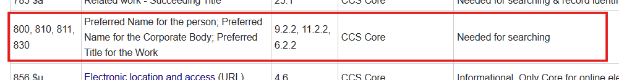
Proper Capitalization and Punctuation
Proper Capitalization and Punctuation: reminder to use the proper capitalization and punctuation in records
  Example of errors found:
    800 1 ‡arowling, j.k.‡tharry potter
https://www.ccslib.org/Catalogers/index.php?title=Bibliographic_input_standards

Slide 15
Mismatched volume numbers
Report items with mismatched volume numbers:
  Please report items with mismatched volume numbers via a HelpDesk ticket so CCS can assist in fixing the errors.

Slide 16
994 Tags
994 Tags:
  Do not delete the 994 tag; this tag informs CCS which library imported the record.

Slide 17
500, 504, Fixed Fields
National practices for 500, 504, and fixed fields:
  Follow national practice for noting the index and bibliography in the 500, 504, and fixed fields.
    500: https://www.loc.gov/marc/bibliographic/bd500.html
    504: https://www.loc.gov/marc/bibliographic/bd504.html
    Fixed fields: https://www.loc.gov/marc/bibliographic/bd008.html

Slide 18
Adding a summary
Adding a summary:
  Follow local practices to add a summary when required.
    Summary notes (MARC tag 520) are required for all children's materials. They are also recommended for all materials whose contents cannot be physically browsed, such as audiobooks and video recordings. A summary note is not required if an existing contents note is descriptive of the nature and the scope of the work.

Slide 19
Staff Reminders & Report - Rachel

Slide 20
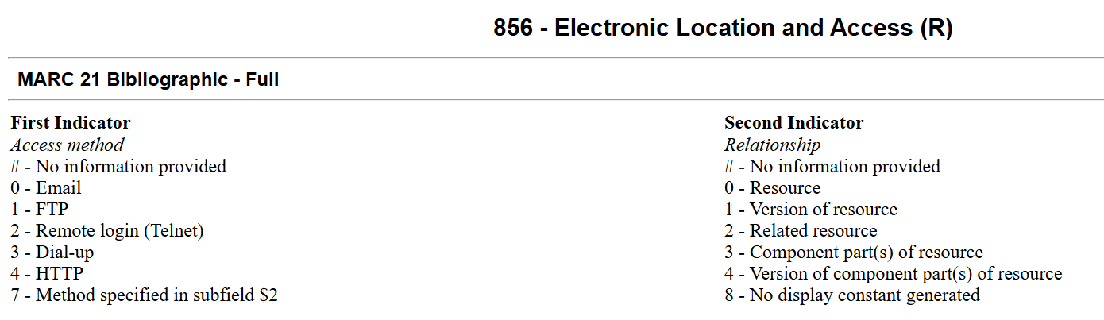
Use the Correct Indicators for 856
Notes:
856 Tag for physical periodicals – If you ever decide to include an 856 tag in a bibliographic record for a physical item, it’s important to use the correct indicators. Do not use a second indicator of 0. You can use 1 for version of resource or 2 for related resource. This affects how the availability is displayed in Bibliocore. We discovered the issue with periodicals, but it could affect other materials too. I made a brief demonstration that I can show you. [Search for Audiofile and AARP Bulletin.)

Slide 21
Authority Record Updates
Is anyone willing to volunteer to review reports on changes to the author’s names that may affect spine labels?
Many changes are coming for transgender, transexual, and Indigenous people headings. More updates are coming in June or later.
We are working on manual updates for “hearing impaired headings.” These are being changed to “hard of hearing people.”
Notes:
Authority Record Updates –
I’ve worked with Backstage to get a report of when the 1XX tag was changed to identify when a spine label may need to be updated. The reports go all the way back to the time we began services. If anyone is interested in volunteering to help review these reports, please let me know.
Library of Congress is working on making changes to transgender and transexual headings. I provided a link to the bulletin. Some updates were made with the last batch processing load, but there are many more updates pending. After the June Backstage files, I’ll have a better idea of what manual updates need to be done to update the bib records.
Someone pointed out to me that there were still many bib records that hearing impaired headings. I’m in the process of manually updating what wasn’t changed with the global updates. It will take a while, but eventually the hearing impaired headings will all be hard of hearing headings.
As of, May 15, 2026 there has been an approval in LCSH of Subject Terms related to the Indigenous Headings Project. We should begin to see updates for these headings in June. However, there may be a lot of manual changes that may be needed to add geographic subdivisions to these headings. So, I will assess what changes will be needed at that time.

Slide 22
Cataloger’s Wiki Updates
Local practices summary – A typo was corrected in the line on other standard numbers.
Summary note – A link was corrected for the LC CIP guidelines for summaries.
Local subject headings – The second bullet point mentioned record set. This was changed to list in Bibliocore.
MARC variable field 910 – This page will be deleted after 910 is removed from records. 914 tag has the same information in the tag. This will be deleted. More than 25,000 records have a 910. It will take a while to bulk delete the tags.
MARC variable field 913 – The tag was bulk deleted. The page was deleted.
Storage Cards and Storage Card Players – The 5XX note section was updated. Warning notes no longer need to be put in the 520 field. The 500 field is visible in Bibliocore.
Playaway WhaZoodles – This is a new page that is pending the approval of CAMM.
Notes:
I included a list of Cataloger’s Wiki updates in the packet. Many of them were minor changes this month. So, I won’t review them. If you have any questions about the changes after reviewing them, please let me know.

Slide 23
SCRAP Report
SCRAP Advisory Group Meeting Minutes for January 21
SCRAP Advisory Group Meeting Recording from January 21
SCRAP needs new members. Please nominate yourself by the end of day on Friday, May 22.
Notes:
The links to the minutes and video are in the packet. I will summarize the report that’s in the packet and take any questions. With Bibliocore available, the SCRAP members revisited questions from PAS about multivolume set records. They identified enhancement requests for Bibliocore, but would not recommend changing the cataloging practices at this time. They discussed the issue regarding Library of Congress’ decision to stop using form subdivisions and passed a motion recommending that we continue to use them. I will provide a more in depth review of that after the SCRAP report. They reviewed a draft page on Playaway WhaZoodles and passed a motion to recommend that CCS adopt the page as a local practice. The link to this page is in the packet. You will get to vote on that today. I already mentioned the pages that they reviewed, because I updated those. SCRAP members reviewed a report on searches related to terms about disabilities and accessibility. They are interested in researching the term little people for next year. I will begin this research. SCRAP is looking for new members for next year. If you are interested in discussing and researching cataloging policies please submit your nomination by the end of the week.

Slide 24
Subfield V (Form Subdivision)
Effective February 2, 2026, the Library of Congress (LC) stopped adding form subdivisions ($v) to the end of LC subject heading strings and chose to expand its use of LCGFT (Library of Congress Genre Form/Terms) headings.
Library of Congress is only requiring their records to follow this practice when cataloging in BIBFRAME.
Libraries are not required to follow this practice.
Notes:
For more information on the $v issue, I’m going to provide an overview the document on the issue that was sent out. Effective February 2, 2026, the Library of Congress (LC) discontinued adding form subdivisions ($v) to the end of LC subject heading strings and chose to expand its use of LCGFT (Library of Congress Genre Form/Terms) headings. At this time, only records cataloged using the BIBFRAME editor, Marva, are required to be cataloged without the form subdivision. Staff using MARC will continue to use the form subdivision until they have switched completely to BIBFRAME. The number of records that will be cataloged using MARC and how long it will take for their catalogers to transition to BIBFRAME is uncertain. There is no requirement for any institution to follow Library of Congress’s practice of not using $v.

Slide 25
Example
Example: Bad Kitty gets a phone by Nick Bruel
Headings in current record | Headings in record without form subdivisions
Cats‡vComic books, strips, etc. | Cats.
Cats‡vJuvenile fiction. | Cell phones.
Cell phones‡vComic books, strips, etc. | Internet‡xSafety measures.
Cell phones‡vJuvenile fiction. | Animal fiction.‡2lcgft
Internet‡xSafety measures‡vJuvenile fiction. | Humorous fiction.‡2lcgft
Animal fiction.‡2lcgft | Funny animal comics.‡2lcgft
Humorous fiction.‡2lcgft (and other genre headings) | Graphic novels.‡2lcgft
Notes:
In the document there’s an example of a current record in the catalog for Bad Kitty gets a phone. The headings on the left are the ones that are currently in the record. You can see that there are form subdivisions for both comic books and Juvenile fiction. On the right is an example of how the headings would appear if they didn’t have form subdivisions and only relied on lcgft for the form.

Slide 26
Concerns from the Library Community
Decision was made in a hasty manner without research.
Old records that have the $v and new records that do not have the $v will cause browse searches to split the results list and make it difficult to find resources in the catalog.
Notes:
Because this decision was made in a hasty manner and without research, the library community is largely unhappy with the decision. The American Library Association (ALA) Subject Access Committee (SAC) formed a Working Group on $v Retention to investigate whether or not form subdivision omission had broad community support, and what the body of user research suggested about the value of $v. The main concern from the greater library community is that browse searches will split the results list and make it difficult to find resources in the catalog because old records will have the $v and new records won’t.

Slide 27
SCRAP Opinion
Concerns from SCRAP about this change included:
  The impact to patron/staff searches.
  Record quality and database inconsistencies.
  Difficulty of removing all form subdivisions.
  Impacts to staff workflow and training.
  Finding the easiest solution.
Voted on a motion to recommend continuing to use the $v form subdivision.
Notes:
SCRAP discussed the issue at the previous two meetings. Concerns from SCRAP about this change included the impact to patron/staff searches, record quality, difficulty of removing all form subdivisions, impacts to staff workflow and training, risk of inconsistency in the database, and identifying the easiest solutioin. As I mentioned, they voted on a motion to recommend continuing to use the $v form subdivision.

Slide 28
Next Steps
Gather usage data on subject headings and facets within CCS BiblioCore instances from June – October 2026. Analyze patron data from November – December 2026 to determine what impact a change could have on patron search and discovery.
Develop a method to monitor incoming records for the presence or lack of $v to understand how the change is impacting records in OCLC.
Monitor the library landscape by reviewing decisions and statements from national and international working groups, professional organizations, and committees, as well as Illinois consortia and libraries. Conduct research as needed into how library organizations are adapting workflows because of the change.
Work with libraries to understand and evaluate impact on staff workflows and database maintenance.
Work with Backstage to identify what process modifications are needed for ongoing Backstage updates long-term, if continuing to use $v as a local practice.

Slide 29
OrangeBoy Updates
Uploading data
Wifi Data
Database Access
Past IPLAR Data
Patron Map
Redirect to the Knowledgebase ?

