Slide 1

Stephanie Girardi
Technical Services Manager

Slide 2

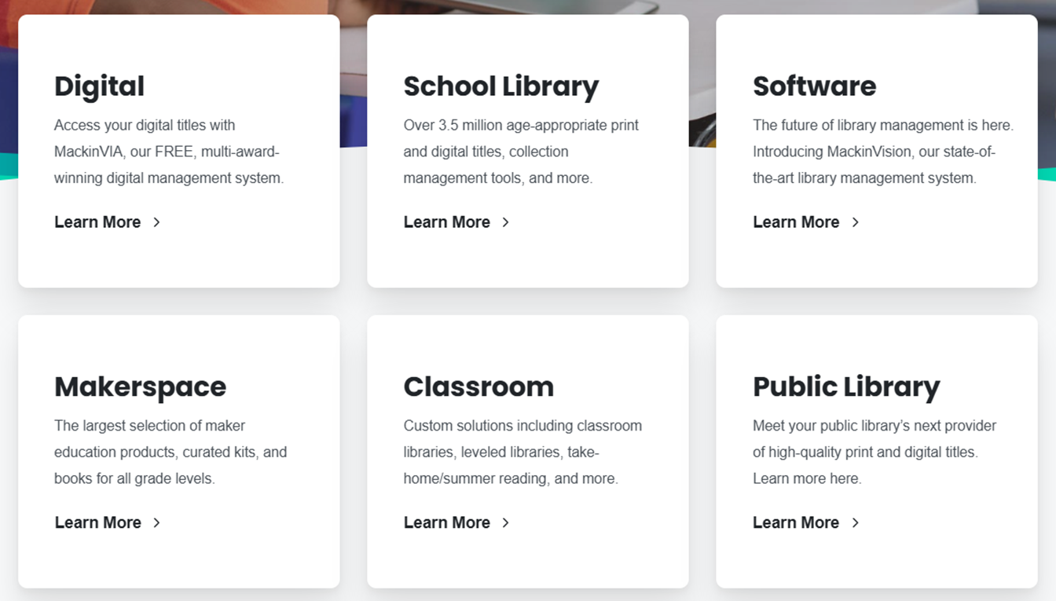
Notes:
Mackin was founded in 1983 as a family-owned business now supplying 60,000 customers worldwide. They offer children’s and adult print and digital titles in all bindings, eBooks, audiobooks, Read-Alongs, educational videos, makerspace products, kits and online databases.

Slide 3
Some reasons to use Mackin:
Their site is easy for selectors to use.
Their youth book selection is great.
Their processing, mylar and laminate, is excellent.
The books come fully processed in about 3 weeks.
Mackin is more reliable than Libraria is now.
Selectors create their own log in that is linked by library.

Slide 4

Their prices are comparable to Libraria’s, after some negotiation.

Slide 5
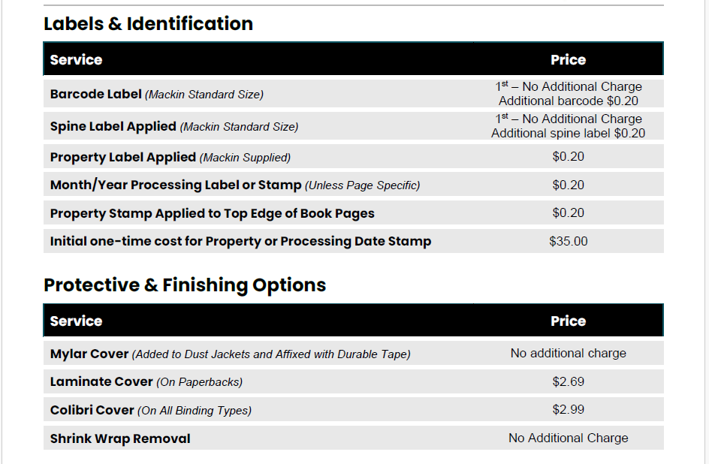
Their processing is cheaper and better than Libraria’s.

Slide 6


Slide 7
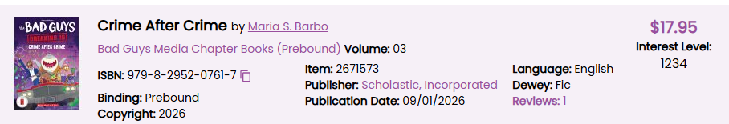
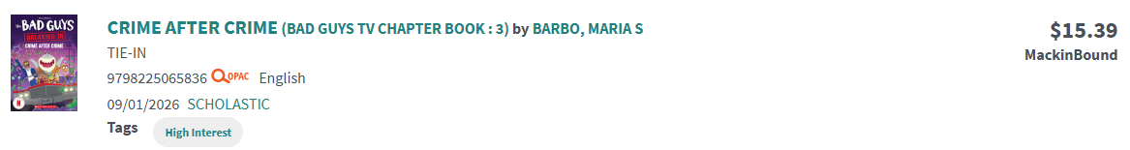
MackinBound prebound books are cheaper than Libraria’s and arrive in a month.

Slide 8
Mackin does provide EDI ordering but…
They don’t use prefilled grids. You select “additional MARC fields”.
You can’t download MARC records directly from their site.
You need to add MARC Import via FTP to your vendor record in Leap.
The “quantity” is number of items, not records.
They still can’t correctly generate EDI invoices if there are processing charges on the PO.

Slide 9
The Mackin Ordering Process

Slide 10
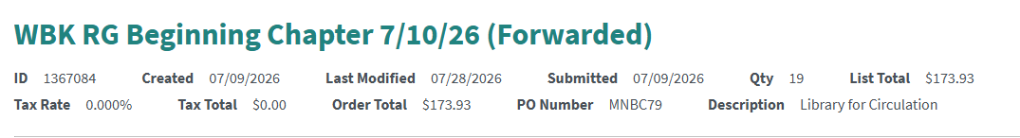
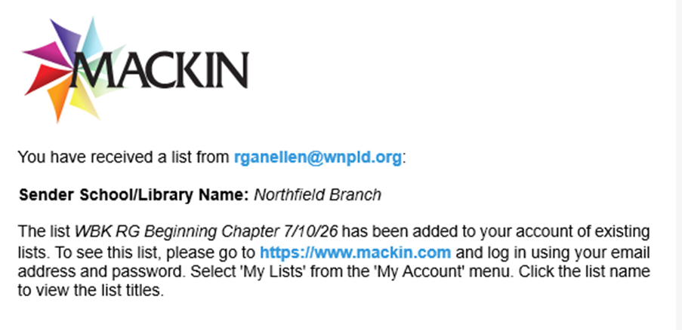
A selector makes a list and forwards it to acquisitions.
You get an email letting you know there is a list to order.

Slide 11
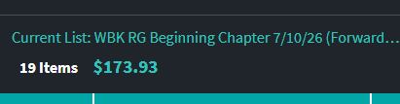
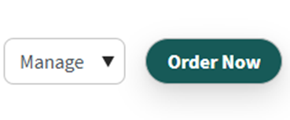
You find the list on Mackin, inspect it for errors, and then click “Order Now”

Slide 12
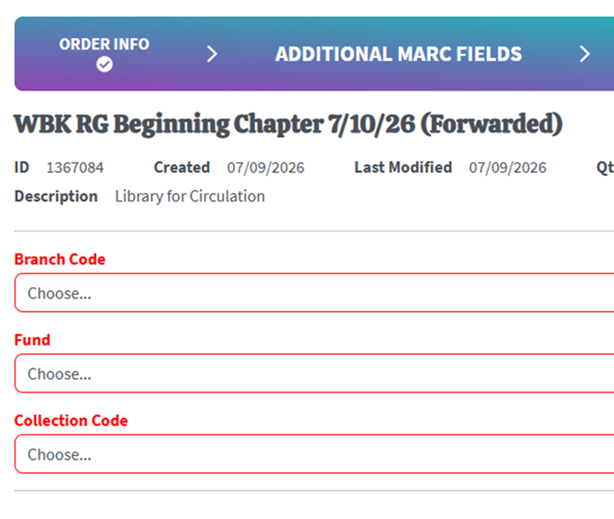
You create your grid from the elements you provided to Mackin.

Slide 13
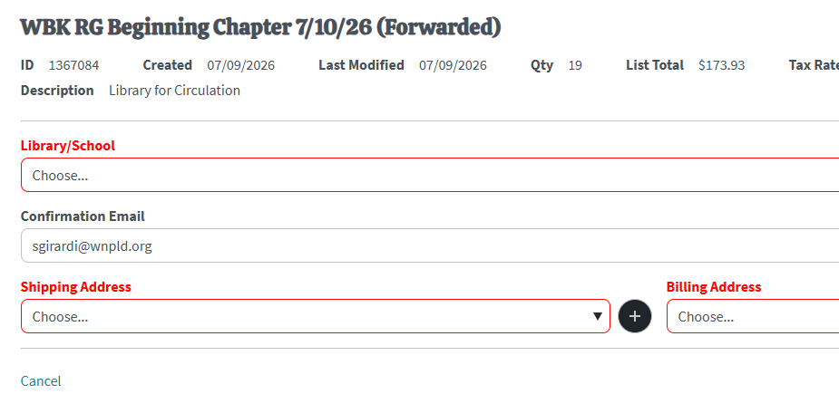
You confirm shipping and billing addresses

Slide 14
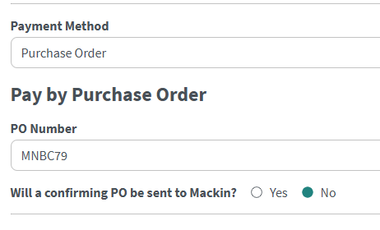
You provide your PO number and select “no” that a confirming PO will be sent to Mackin because you are ordering it using EDI.

Slide 15
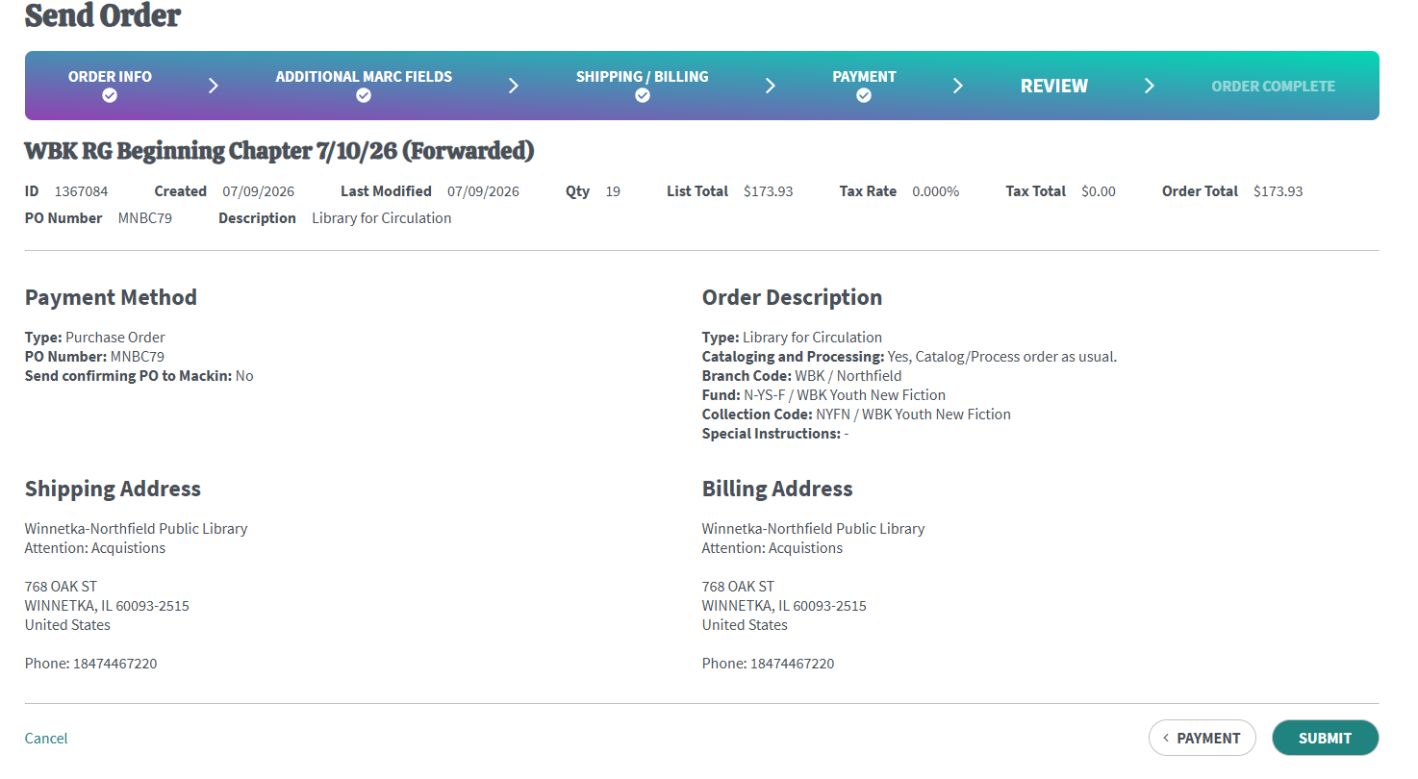
It’s finally time to submit the order.

Slide 16
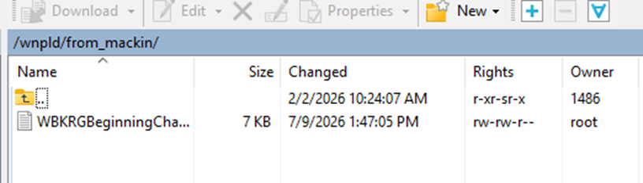
It’s EDI time!
You get your MARC records two different ways:
Use an FTP client to retrieve the file from the "from_mackin" folder on the FTP server.
OR

Slide 17
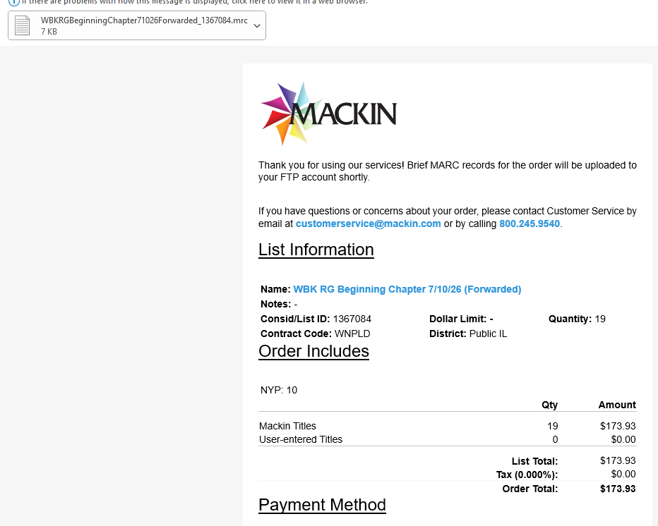
Use the MARC records attached to the confirmation email.

Slide 18
Something to be aware of:
Mackin adds 028 fields to the bib records.
These can be deleted after ordering, if you wish.

Slide 19
Mackin is working on:
Reducing the number of screens to get through to place an order
Having real grids
Being able to download MARC records from their website
Generating invoices correctly

Slide 20
Contact me directly with any questions. sgirardi@wnpld.org
WNKtech@ccslib.org

