Slide 1
PAS Technical Group
September 17, 2026
Notes:
Liaison update

Slide 2
In Person Attendance
Make sure to sign in on the attendance form!

Slide 3
Rolling Meadows/
Wauconda Migration

Slide 4
Rolling Meadows/Wauconda Migration
EVENT | DATE
RMK/WUK's last day on legacy ILS. Data extracted after libraries close | October 15, 2026
RMK/WUK begin using Polaris offline. Innovative preps data for load. | October 16, 2026
All CCS libraries offline. | October 17, 2026
All CCS libraries offline. | October 18, 2026
All CCS libraries offline. | October 19, 2026
RMK/WUK live on Polaris! All CCS libraries resume Polaris activity. | October 20, 2026

Slide 5
Offline Period: SIP/PAC Redirect
During offline period, Innovative will redirect SIP and PAC to our training database
    Note: BiblioCore does not have a redirect option. See Available/Unavailable slides for more info
Staff will also have view-only access to training Leap
Data in training database will be update prior to going offline. Date/time TBD. (Will likely be Oct 15 or 16)

Slide 6
Preparing for Offline
CCS will host a Migration Go Live Review and Offline Demo webinar on October 1 (1:00pm-2:00pm).
  The webinar will review the offline and go live schedule, and give a brief demo of offline circulation.
https://www.ccslib.org/rolling-meadows-wauconda-migration

Slide 7
Available Services during Offline
Checking out materials
Ready-for-pickup holds checkout
Patron registration (optional)
BiblioCore search functions
  Search results out of date as items are checked out in offline
  A banner will be added to all libraries' BibioCore sites ahead of offline to alert patrons to the down time.
Training Leap search functions
Database/SIP Authentication against training
  SIP redirect to training

Slide 8
Unavailable Services
Materials check-in
Placing new holds
Processing holds
Paying fines
Modifying patron records
BiblioCore login/account access and availability status
Creating ILL or on-the-fly records
Technical Services functions (adding/editing items, bibs, etc.)
Simply Reports access
Find More Illinois
API authentication - API-connected services will be down during the offline period. Libraries have the option of telling patrons services will be unavailable during offline or reach out to vendors of other API-connected resources to discuss access options for the offline period

Slide 9
API Services
BiblioCommons
Boopsie
CapriaMobile
CenTec
CincoBooks
CloudLibrary
Communico (see below for more information)
Comprise
Creativebug
CuriosityStream
Ebsco Stacks (open ticket via EBSCOConnect)
Ebsco (open ticket via EBSCOConnect)
Evanced
Explore More IL - TBD
Hoopla
Kanopy
Library Market
Libro
LinkedIn
Lynda
NoveList
PatronPoint
ReadSquared
Solus
SpringShare
Syndetics Unbound
Zoobean
Please note – some vendors offer both SIP and API authentication options. For these vendors, CCS is unable to determine which libraries use which protocols.

Slide 10
Communico Services
CCS will work directly with Communico on behalf of libraries to disable app services and add a message about services being unavailable. We are requesting Communico disable the following features in library mobile apps:
  Searching on the catalog
  My Account
  Recommended Reads (as this also allows the ability to place holds)
If you would like to opt-out of these updates or work directly with Communico yourself, email help@ccslib.org.

Slide 11
ERead Illinois
Palace Project authenticates via SIP. We should not see disruption to service
CCS has reached out to Palace Project to confirm

Slide 12
Find More Illinois
While we are down, ShareIt will be unable to communicate with Polaris.
CCS will put all libraries into holiday mode
Patrons will be unable to log into SHAREit. Staff will be able to log in, but should not take any action or process any requests.

Slide 13
Explore More Illinois
CCS is discussing options with RAILS
  If Explore More is currently authenticating via SIP, access should not be disrupted
  If Explore More authenticates via API, patrons will not be able to log in to retrieve passes while offline. RAILS can send us a list of reservations prior to offline so that libraries can contact patrons to make sure they retrieve before we go offline.

Slide 14
LX Starter Rollout

Slide 15
LX Starter
Interface for creating and sending custom Polaris email notices
Libraries have been assigned to Waves for LX Starter rollout based on library preferences

Slide 16
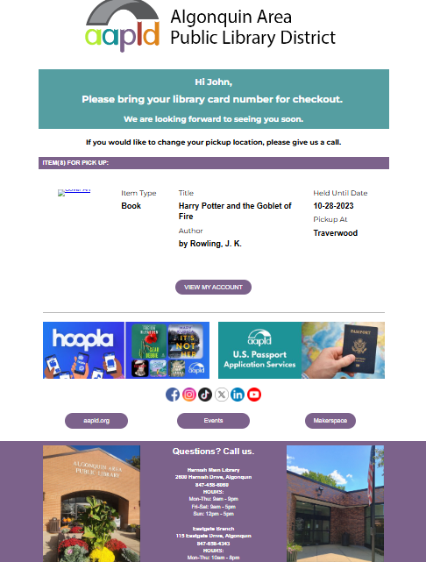
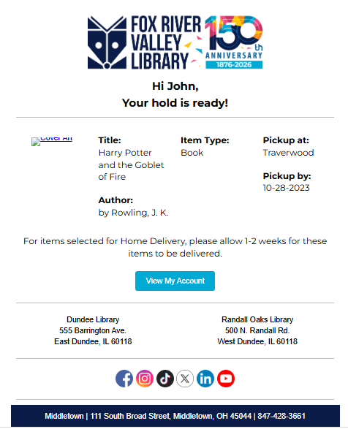
CCS Updates

Slide 17
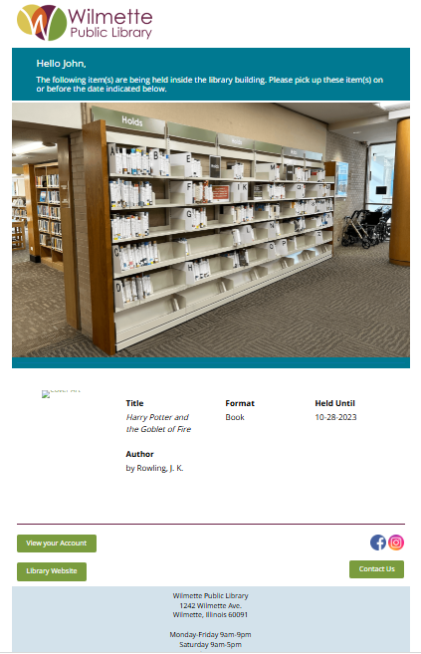
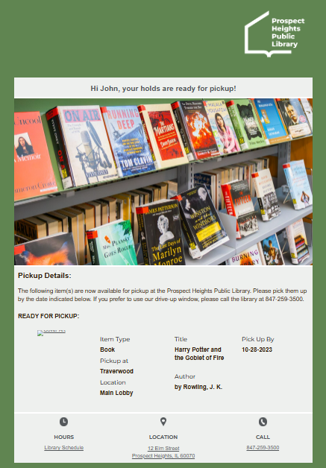
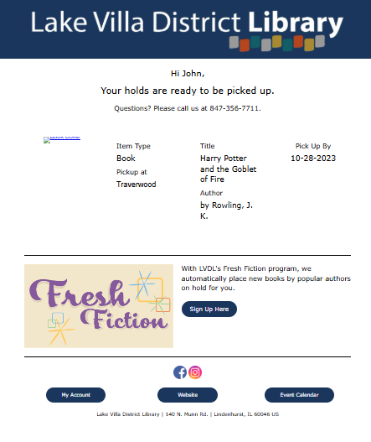

Slide 18
LX Starter Waves
Wave 1 (September 2026 - December 2026)
Des Plaines Public Library
Zion-Benton Public Library District
Wave 2 (January 2027 - March 2027)
Crystal Lake Public Library
Glencoe Public Library
Glenview Public Library
Morton Grove Public Library
Mount Prospect Public Library
Park Ridge Public Library
Rolling Meadows Library
Wave 3 (March 2027 - May 2027)
Ela Area Public Library District
Grayslake Area Public Library District
Huntley Area Public Library District
Indian Trails Public Library District
Lake Forest Library
Waukegan Public Library
Wave 4 (May 2027 - August 2027)
McHenry Public Library District
Niles-Maine District Library
Round Lake Area Public Library District
Vernon Area Public Library District

Slide 19
LX Starter Waves
Wave 5 (August 2027 - October 2027)
Cary Area Public Library
Evanston Public Library
Highland Park Public Library
Lincolnwood Public Library District
Northbrook Public Library
Palatine Public Library District
Winnetka-Northfield Public Library District

Slide 20
Polaris Performance Updates

Slide 21
Polaris Performance Updates
Continued to experience intermittent PowerPAC issues in August
Tied to flood of bot traffic
Clarivate to implement CloudFlare in Q4

Slide 22
CCS Training

Slide 23
Set up a CCS visit!
The CCS team is available to come out to lead a training, presentation, workflow consultation, etc!
  New Manager or CCS Orientation
  Simply Reports
  Searching in Leap
  Record Sets
  BiblioCore
  Any other custom session!
Email help@ccslib.org

Slide 24
BiblioCore Launch

Slide 25
By the Numbers
26 libraries live on Core
Most remaining libraries to launch by end of October

Slide 26
BiblioCore Performance
Performance issues should now be resolved:
  Increase in 500 errors and We're Very Sorry errors
  Indexing Delays
Issues affected all BiblioCore customers
Tied to software updates on July 23

Slide 27
BiblioCore Performance
BiblioCore should sync regularly moving forward:
  Hourly: Hourly syncs manage record additions, updates to existing records, changes in item status, and hold counts
  Nightly: AKA nightly "corrections" process. Handles bibliographic record deletions/updates/additions, admin setting changes, and other settings that are not caught during hourly syncs

Slide 28
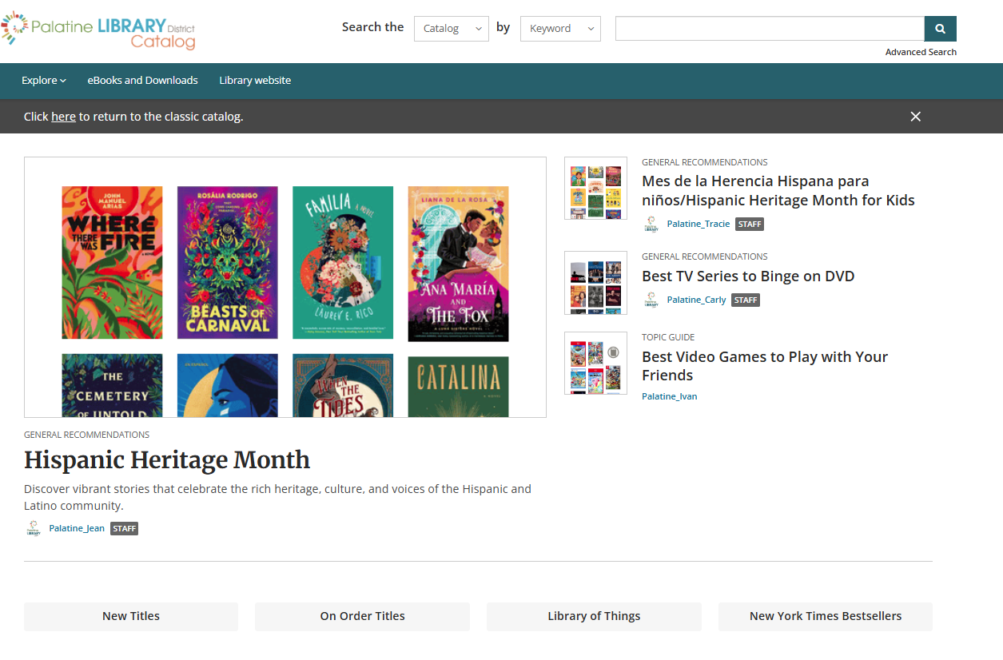
Browse & Discover Released
Staff with permissions can now set up new Browse & Discover homepage
The "Explore" page will continue to be your library's Core site homepage until you're ready to publish the Browse & Discover page.
Open a help desk ticket when ready to publish.

Slide 29
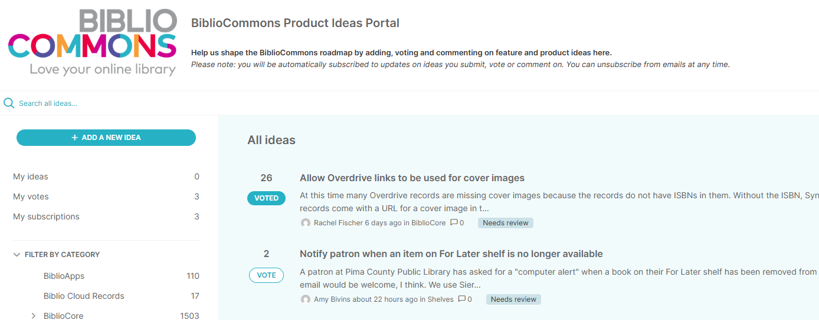
BiblioCore Product Idea Portal
Any CCS member can register: https://bibliocommonspartners.ideas.aha.io/
Add, vote and comment on feature and product ideas

Slide 30
Changes to eContent Display
Due to issues with how eContent is scoped in BiblioCore, Governing Board voted to temporarily suppress non-integrated eContent in the catalog.
CCS staff will conduct additional research and make a recommendation for a permanent solution later in FY 2027.

Slide 31
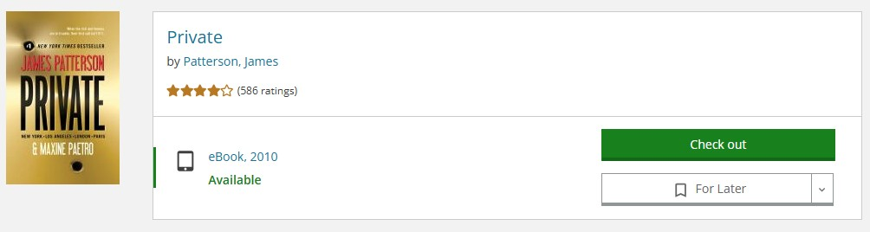
Integrated EContent
Records are automatically imported into the system through the Polaris API
Users can search, check out, and place holds in the catalog.
Checkouts and holds are synched to the user's account
Vendors: Overdrive, Cloud Library
Notes:
Current intefgrated econtent vendors: Cloud library and OVerdrive.

Slide 32
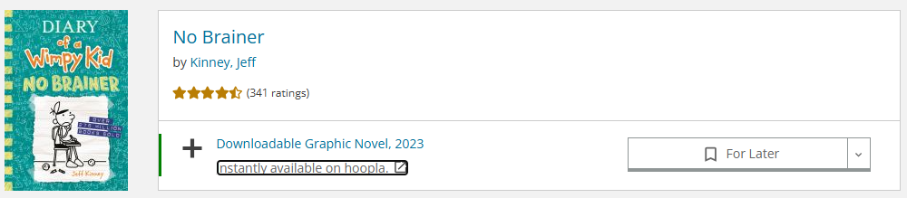
Nonintegrated EContent
Records are manually loaded into Polaris and maintained by CCS or members
Records appear in catalog search results
Records include a link that push the patron out to the vendor’s platform to access the material.
  Checkouts happen on the vendor's website, not within the catalog
Some vendors are set up with individual marc records for each title within the tool (Hoopla, LinkedIn Learning, etc), others are set up as a single record linking to the vendor/database

Slide 33
Scoping in PowerPAC
Logged in users only see eContent they can access
Non-logged in users see eContent accessible to patrons of the library site they are using.
These behaviors are true whether the user searches All Member Libraries or a specific library.
Records are scoped using Polaris Resource Group functionality
Scoping setup is done by CCS with support from members

Slide 34
Scoping in BiblioCore
EContent is scoped based on the library site being used, regardless of user’s registered library.
Requires library-specific URLS in the 856 to determine which library owns.
  In most cases, eContent without library-specific URLs in the bibliographic record cannot be scoped correctly.
Searching “All Partner Libraries” displays eContent owned by all of CCS. Searching a specific library displays scoped eContent owned by that library
Scoping is configured by Bibliocommons support

Slide 35
Group Recommendations
Database Management recommendation:
  CCS remove non-integrated eContent that cannot be properly scoped from the catalog
Challenge:
  Requires extensive review of records
  Requires manual updates to individual bibliographic records to either delete or correct individual URLs
Governing Board Decision:
  Temporarily suppress all non-integrated eContent records until further research is completed
Benefits:
  Suppression keeps records available for future use if needed
  More flexible than permanent deletion

Slide 36
EContent that will continue to display
Scoping Complete
Overdrive
Cloud Library
Hoopla
Flipster
Scoping In Progress
LinkedIn Learning
Comics Plus
Kanopy
Creativebug

Slide 37
Next Steps
End of August: CCS suppressed remaining non-integrated eContent records
H2 FY2027: CCS staff will conduct additional research and make a recommendation for a permanent solution
CCS will continue to maintain eContent holdings for resources on previous slide

Slide 38
Customizing Leap

Slide 39
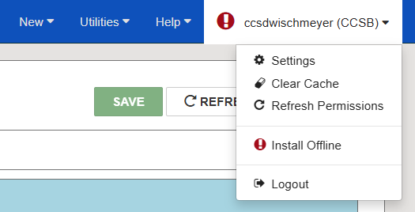
Leap Customization
Username settings:
  Available under Polaris sername > Settings
  Can customize your Workform defaults for various record types, workform tracker, etc
Find Tool customization:
  Set default search database
  Default search configuration for each record type. Can include filters
  Options > Column Settings

